Slide 1
STAT 206:
Chapter 3
Numerical Descriptive Measures
Central Tendency, Variation, Shape

Slide 2
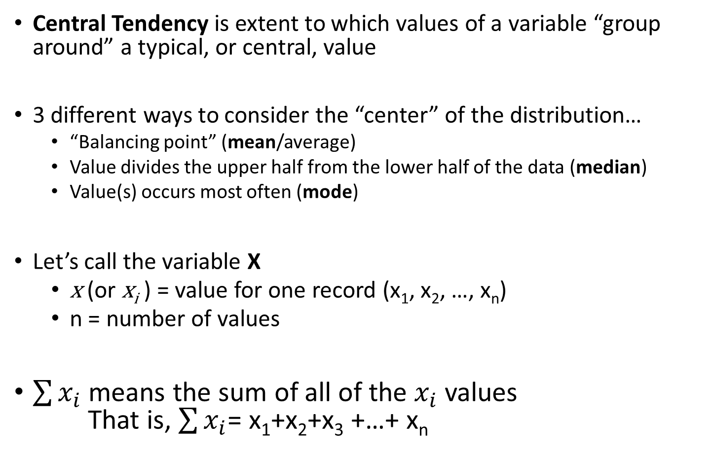
3.1 Central Tendency
Central Tendency is extent to which values of a variable “group around” a typical, or central, value
3 different ways to consider the “center” of the distribution…
  “Balancing point” (mean/average)
  Value divides the upper half from the lower half of the data (median)
  Value(s) occurs most often (mode)
Let’s call the variable X
  x (or x_{i} ) = value for one record (x₁, x₂, …, x_{n})
  n = number of values
$\sum{x_{i}}$ means the sum of all of the $x_{i}$ values
That is, $\sum{x_{i}}$= x₁+x₂+x₃ +…+ x_{n}

Slide 3
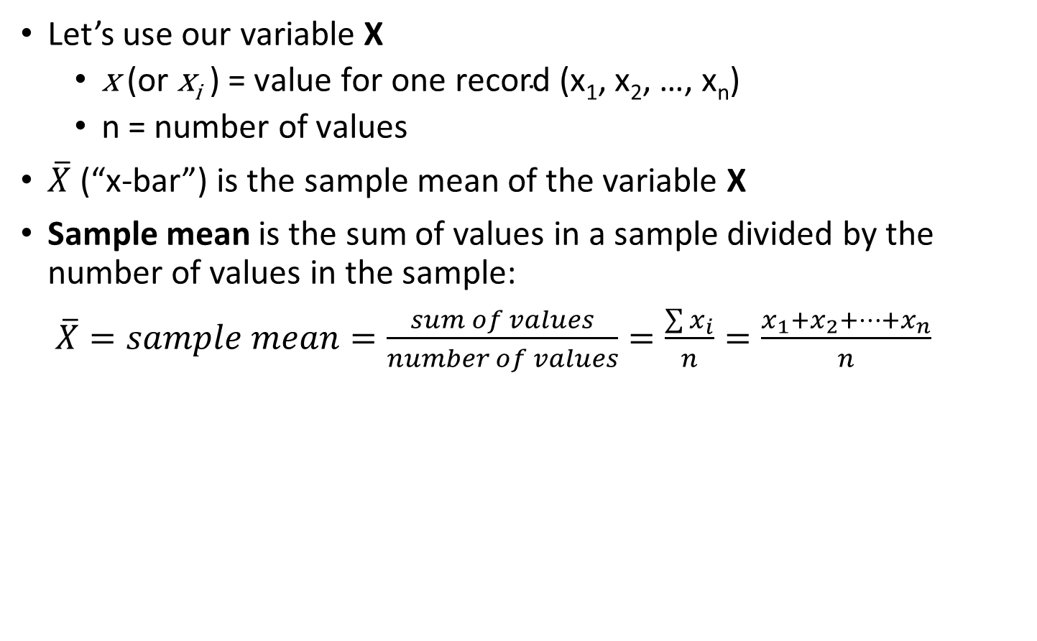
MEAN – arithmetic average
Let’s use our variable X
  $\text{x}\text{ (}\text{or} \text{x}\text{i}\text{ ) = }\text{value} \text{for} \text{one} \text{record}\text{ (}\text{x}\text{1}\text{, }\text{x}\text{2}\text{, …, }\text{xn}\text{)}$
  $\text{n}\text{ = }\text{number} \text{of} \text{values}$
$\overline{X}$ (“x-bar”) is the sample mean of the variable X
Sample mean is the sum of values in a sample divided by the number of values in the sample:
$\overline{X}=sample mean=\frac{sum of values}{number of values}=\frac{\sum{x_{i}}}{n}=\frac{x_{1}+x_{2}+…+x_{n}}{n}$

Slide 4
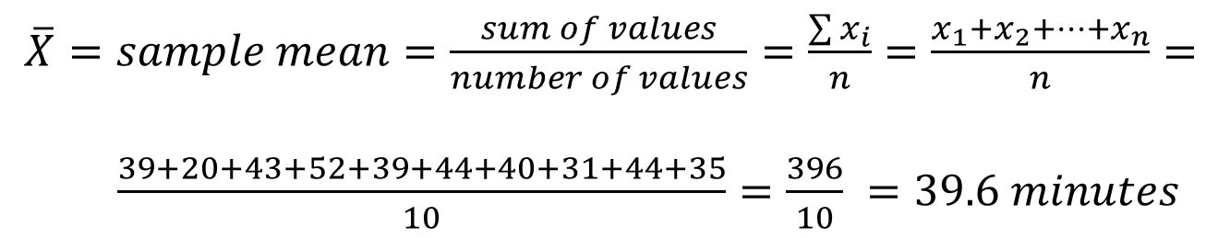
MEAN – example
Example: what is the (typical) MEAN time it takes you to get ready in the morning? Measure time between when you get up until you leave your home (rounded to the nearest minute) for 10 days.
Day | 1 | 2 | 3 | 4 | 5 | 6 | 7 | 8 | 9 | 10
Time | 39 | 29 | 43 | 52 | 39 | 44 | 40 | 31 | 44 | 35
$\overline{X}=sample mean=\frac{sum of values}{number of values}=\frac{\sum{x_{i}}}{n}=\frac{x_{1}+x_{2}+…+x_{n}}{n}=$
$\frac{39+20+43+52+39+44+40+31+44+35}{10}=\frac{396}{10} =39.6 minutes$
Notice:
  No individual day had a value of 39.6. It is an average
  No very small or very large values in the data
  But what if there were?

Slide 5
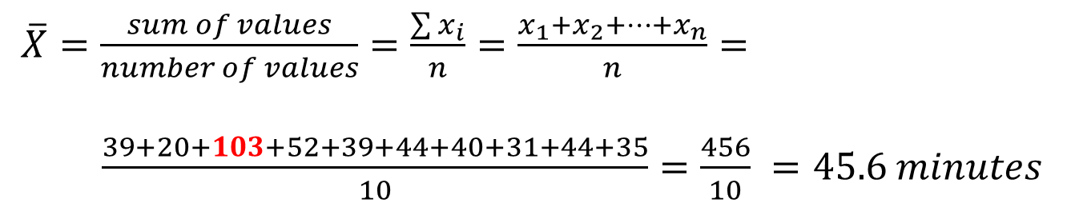
MEAN – example
Consider if on day 3, it took 103 minutes.
Example: what is the (typical) MEAN time it takes you to get ready in the morning? Measure time between when you get up until you leave your home (rounded to the nearest minute) for 10 days.
Day | 1 | 2 | 3 | 4 | 5 | 6 | 7 | 8 | 9 | 10
Time | 39 | 29 | 103 | 52 | 39 | 44 | 40 | 31 | 44 | 35
$\overline{X}=\frac{sum of values}{number of values}=\frac{\sum{x_{i}}}{n}=\frac{x_{1}+x_{2}+…+x_{n}}{n}=$
$\frac{39+20+103+52+39+44+40+31+44+35}{10}=\frac{456}{10} =45.6 minutes$
ONE extreme value changed the mean by 6 minutes…
MEAN is STRONGLY AFFECTED by extreme values
Is it still “central”?

Slide 6
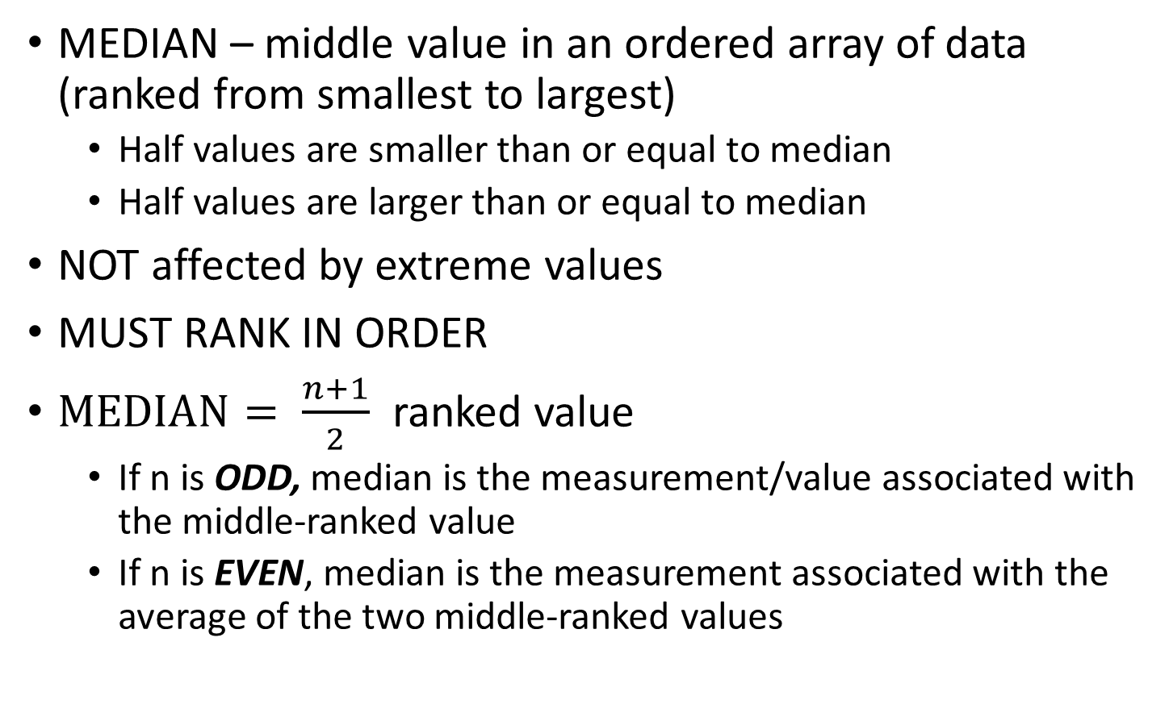
Median – middle value
MEDIAN – middle value in an ordered array of data (ranked from smallest to largest)
  Half values are smaller than or equal to median
  Half values are larger than or equal to median
NOT affected by extreme values
MUST RANK IN ORDER
$MEDIAN= \frac{n+1}{2}$ ranked value
  If n is ODD, median is the measurement/value associated with the middle-ranked value
  If n is EVEN, median is the measurement associated with the average of the two middle-ranked values

Slide 7
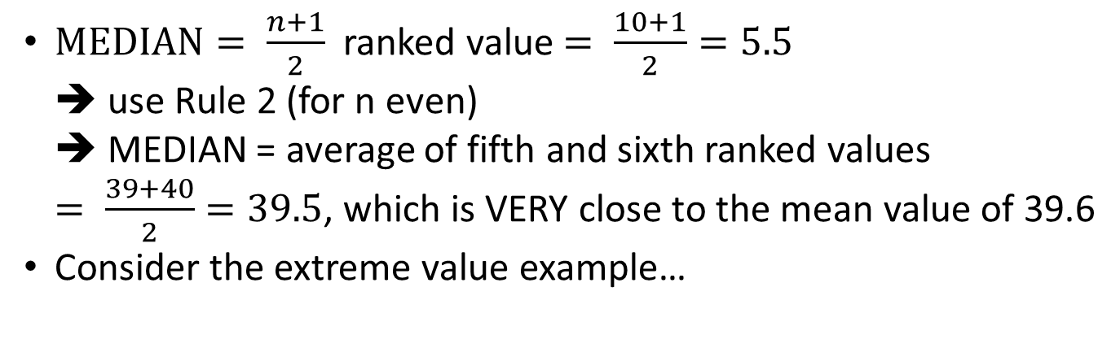
MEDIAN – example
Example: what is the (typical) MEAN time it takes you to get ready in the morning? Measure time between when you get up until you leave your home (rounded to the nearest minute) for 10 days.
Day | 1 | 2 | 3 | 4 | 5 | 6 | 7 | 8 | 9 | 10
Time | 39 | 29 | 43 | 52 | 39 | 44 | 40 | 31 | 44 | 35
Order Values smallest to largest
Values | 29 | 31 | 35 | 39 | 39 | 40 | 43 | 44 | 44 | 52
Ranks | 1 | 2 | 3 | 4 | 5 | 6 | 7 | 8 | 9 | 10
$MEDIAN= \frac{n+1}{2}$ ranked value $= \frac{10+1}{2}=5.5$
➔ use Rule 2 (for n even)
➔ MEDIAN = average of fifth and sixth ranked values
$= \frac{39+40}{2}=39.5$, which is VERY close to the mean value of 39.6
Consider the extreme value example…
39.5 ➔ NO change
in the Median
due to extreme
Ranks | 1 | 2 | 3 | 4 | 5 | 6 | 7 | 8 | 9 | 10
Values | 29 | 31 | 35 | 39 | 39 | 40 | 44 | 44 | 52 | 103

Slide 8
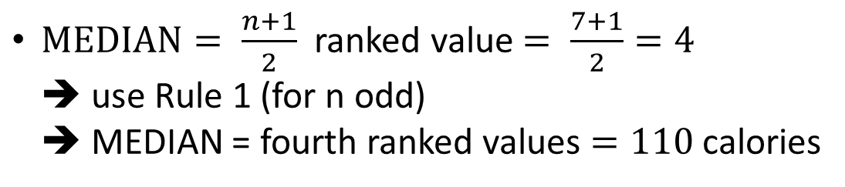
Median – example 2
Calories for 7 breakfast cereals. Compute the median.
$MEDIAN= \frac{n+1}{2}$ ranked value $= \frac{7+1}{2}=4$
➔ use Rule 1 (for n odd)
➔ MEDIAN = fourth ranked values $=110$ calories
Notice:
  Data must be ordered
  Maintain duplicates of data values

Slide 9
MODE – most frequently occurring value
Extreme values do NOT affect the MODE
There may be one mode, two modes (bi-modal),
three modes (tri-modal), etc.
OR there may be NO mode if all values are unique
EXAMPLE: times to get ready in the morning (again)
Values | 29 | 31 | 35 | 39 | 39 | 40 | 43 | 44 | 44 | 52
Values | 29 | 31 | 35 | 39 | 39 | 40 | 43 | 44 | 44 | 52
Two modes ➔ BI-modal

Slide 10

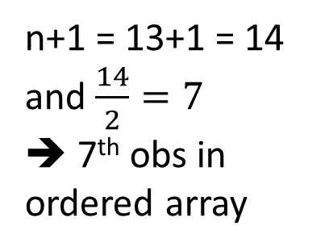
Examples:
Find MEDIAN, mean and mode number of homeruns for
Mark McGwire’s reported seasons: n=13 and $Σx_{i}=519$
49 32 33 39 22 42 9 9 39 52 58 70 65
Step 1: Order the observations from smallest to largest
9 9 22 32 33 39 39 42 49 52 58 65 70
Step 2: Is the number of observations even or odd?
9 9 22 32 33 39 39 42 49 52 58 65 70
ODD
n+1 = 13+1 = 14
and $\frac{14}{2}=7$
➔ 7th obs in
ordered array
Step 3: So… What is the median?
  39.92
  39
  9 and 39

Slide 11
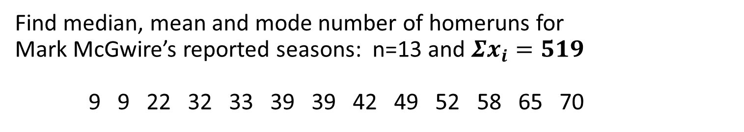
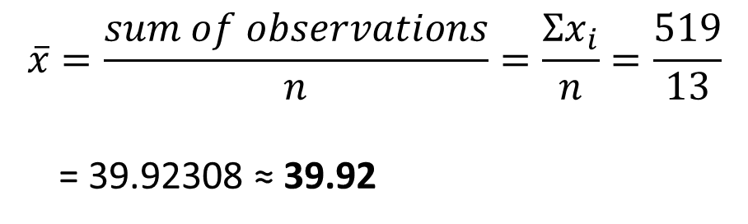
Examples:
Find median, mean and mode number of homeruns for
Mark McGwire’s reported seasons: n=13 and $Σx_{i}=519$
9 9 22 32 33 39 39 42 49 52 58 65 70
$$\overline{x}=\frac{sum of observations}{n}=\frac{Σx_{i}}{n}=\frac{519}{13}$$
= 39.92308 ≈ 39.92
What is the MEAN?
What is the MODE?
  9 and 39
TWO modes ➔ BI-modal

Slide 12
EXCEL functions for Central Tendency
MEAN:
  =AVERAGE(<data string>)
MEDIAN:
  =MEDIAN(<data string>)
MODE:
  =MODE(<data string>)

Slide 13
3.2 Variation and Shape
VARIATION measures the amount of dispersion, or scattering from a central value. That is, how spread out are the data values
RANGE = largest value – smallest value
= maximum – minimum
= x_{largest} – x_{smallest}
  EXAMPLE: times to get ready in the morning (and again)
Values | 29 | 31 | 35 | 39 | 39 | 40 | 43 | 44 | 44 | 52
RANGE = largest value – smallest value
= 52 – 29 = 23 minutes

Slide 14
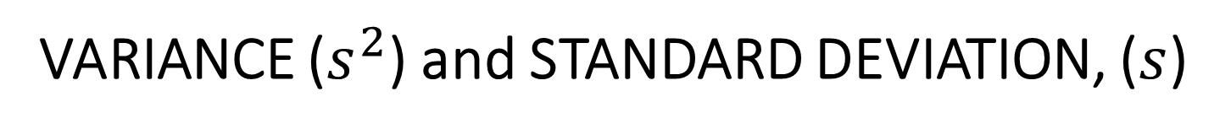

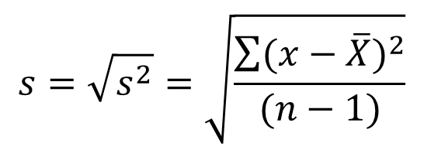
VARIANCE ($s^{2}$) and STANDARD DEVIATION, ($s$)
VARIANCE: average of the squared deviations of each observation from the mean
$$s^{2}=\frac{\sum{{(x−\overline{X})}^{2}}}{(n−1)}$$
Variance is difficult to interpret.
STANDARD DEVIATION: square root of the variance
$$s=\sqrt{s^{2}}=\sqrt{\frac{\sum{{(x−\overline{X})}^{2}}}{(n−1)}}$$
Can be thought of as a “typical”/ “average” distance of an observation from the mean
REMEMBER! Neither the variance nor the standard deviation can ever be NEGATIVE

Slide 15
EXCEL functions for Variation
VARIANCE:
  =VAR.S(<data string>)
  =VAR.P(<data string>)
STANDARD DEVIATION:
  =STDEV.S(<data string>)
  =STDEV.P(<data string>)
sample
population
sample
population

Slide 16
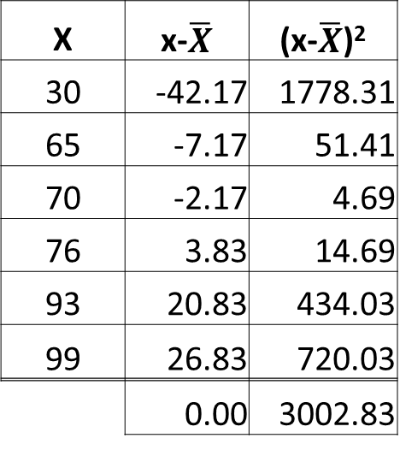
Example: Scores for CLASS A: 30, 65, 70, 76, 93, 99
Scores for CLASS B: 68, 72, 73, 73, 74, 77
 | n | Mean | Median
Class A | 6 | 72.17 | 73
Class B | 6 | 72.83 | 73
What is the difference? Find the standard deviation for each class.
Class A
x | x-xbar | (x-xbar)²
30
65
70
76
93
99
n = 6
X | x-$\overline{X}$ | (x-$\overline{X}$)²
30 | -42.17 | 1778.31
65 | -7.17 | 51.41
70 | -2.17 | 4.69
76 | 3.83 | 14.69
93 | 20.83 | 434.03
99 | 26.83 | 720.03
 | 0.00 | 3002.83
x | x-xbar | (x-xbar)²
30 | -42.17
65 | -7.17
70 | -2.17
76 | 3.83
93 | 20.83
99 | 26.83
X | x-xbar | (x-xbar)²
30 | -42.17 | 1778.03
65 | -7.17 | 51.36
70 | -2.17 | 4.69
76 | 3.83 | 14.69
93 | 20.83 | 434.03
99 | 26.83 | 720.03
Variance =
Standard deviation
Always “0” – except for rounding…
For Class B, s=2.93. Verify on your own as practice.

Slide 17



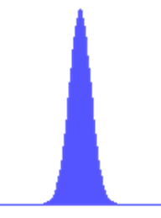
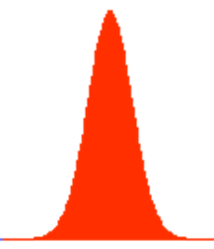
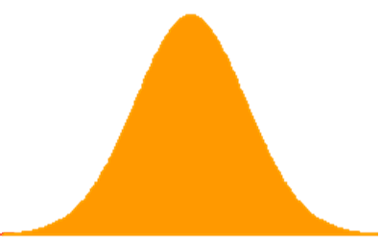
Standard deviation, σ or s, controls the spread. That is, the larger the value of s, the more spread out or “variable” the data are.

Slide 18
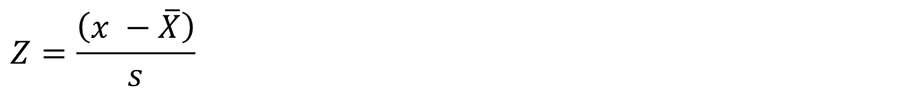
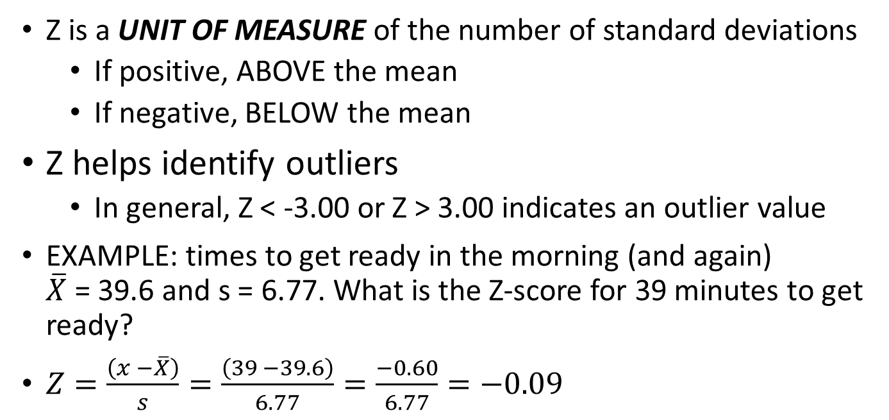
Z scores
Z-score is equal to the difference between a value and the mean, divided by the standard deviation
$$Z=\frac{\left(x −\overline{X}\right)}{s}$$
Z is a UNIT OF MEASURE of the number of standard deviations
  If positive, ABOVE the mean
  If negative, BELOW the mean
Z helps identify outliers
  In general, Z < -3.00 or Z > 3.00 indicates an outlier value
EXAMPLE: times to get ready in the morning (and again)
$\overline{X}$ = 39.6 and s = 6.77. What is the Z-score for 39 minutes to get ready?
$Z=\frac{\left(x −\overline{X}\right)}{s}=\frac{\left(39 −39.6\right)}{6.77}=\frac{−0.60}{6.77}=−0.09$

Slide 19
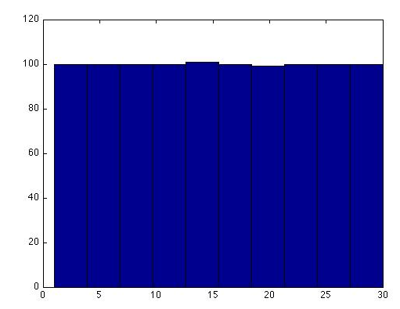
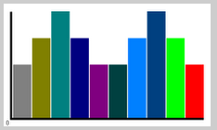
Shape of a variable – pattern of distribution of values from the lowest value to the highest value
SKEWNESS: extent to which data values are not symmetrical around the mean
e.g., human height
human weight,
bone length, etc.
IQ scores
Symmetric if the right and left sides of the histogram are approximately mirror images of each other
Skewed to the right if the right “tail” extends much farther out than the left tail
Skewed to the left if the left “tail” extends much farther out than the right tail
Uniform if all bars are the same height
Bimodal if two (2) bars are higher than others
e.g., income data
survival data
e.g., test grades,
possibly birth weight (in certain populations)
e.g., roll of a fair die (or dice),
coin toss
e.g., restaurant peak times (noon, 7:00pm)

Slide 20
Examples: mean vs. median
The mean is strongly influenced by a few extreme observations
The median is not strongly influenced by a few extreme observations
If the distribution is
  symmetric → mean median
  skewed right → mean median
  skewed left → mean median
pattern of distribution of values from the lowest value to the highest value
Mean ≈ Median
Mean > Median
Mean < Median

Slide 21
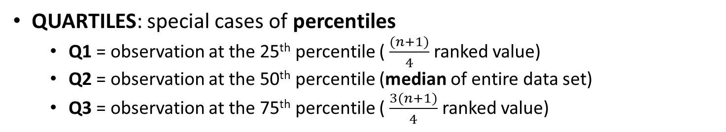
3.3 Exploring Numerical Data
Let’s consider Measures of Position:
PERCENTILES, QUARTILES, and 5-NUMBER SUMMARY
PERCENTILE: the p^{th} percentile is a value such that p percent of the observations fall below (or at) that value
QUARTILES: special cases of percentiles
  Q1 = observation at the 25th percentile ( $\frac{(n+1)}{4}$ ranked value)
  Q2 = observation at the 50th percentile (median of entire data set)
  Q3 = observation at the 75th percentile ( $\frac{3(n+1)}{4}$ ranked value)
5-NUMBER SUMMARY includes:
minimum, Q1, Q2 (median), Q3, maximum

Slide 22
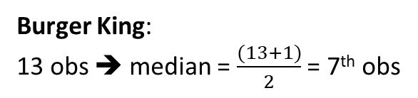
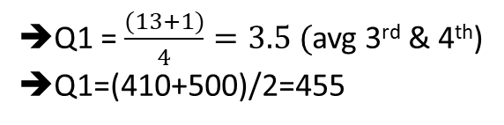
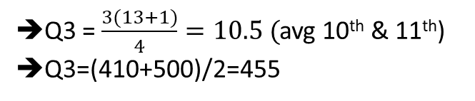
Example: Use the table
(at the right) to find the
5-number summaries for calories in hamburgers for each of the three restaurants.
(source: www.acoloriecounter.com/fast-food.php ).
 | Restaurant | Type | Calories
1 | Burger King | Whopper Jr. | 370
2 | Burger King | Whopper Jr. (cheese) | 410
3 | Burger King | Double Hamburger | 410
4 | Burger King | Double Cheeseburger | 500
5 | Burger King | Double Stacker | 610
6 | Burger King | Whopper | 670
7 | Burger King | Whopper (cheese) | 760
8 | Burger King | Triple Stacker | 800
9 | Burger King | Double Whopper | 900
10 | Burger King | Double Whopper (cheese) | 990
11 | Burger King | Quad Stacker | 1000
12 | Burger King | Triple Whopper | 1130
13 | Burger King | Triple Whopper (cheese) | 1230
1 | Hardee's | Low Carb Thickburger | 420
2 | Hardee's | Double Hamburger | 420
3 | Hardee's | Double Cheeseburger | 510
4 | Hardee's | Cheeseburger | 680
5 | Hardee's | Mushroom N' Swiss Thickburger | 720
6 | Hardee's | Thickburger | 910
7 | Hardee's | Bacon Cheese Thickburger | 910
8 | Hardee's | Grilled Sourdough Thickburger | 1030
9 | Hardee's | Six Dollar Burger | 1060
10 | Hardee's | Double Thickburger | 1250
11 | Hardee's | Double Bacon Cheese Thickburger | 1300
12 | Hardee's | Monster Thickburger | 1420
1 | McDonald's | Double Cheeseburger | 440
2 | McDonald's | Big N' Tasty | 460
3 | McDonald's | Quarter Pounder (cheese) | 510
4 | McDonald's | Big N' Tasty (cheese) | 510
5 | McDonald's | Big Mac | 540
6 | McDonald's | Double Quarter Pounder (cheese) | 740
- min=370
Q1=455
- Median=760
Burger King:
13 obs ➔ median = $\frac{(13+1)}{2}$ = 7th obs
Q3=995
- max=1230
Q1 = $\frac{(13+1)}{4}=3.5 ($avg 3rd & 4th)
Q1=(410+500)/2=455
Q3 = $\frac{3(13+1)}{4}=10.5 ($avg 10th & 11th)
Q3=(410+500)/2=455
BK 5-number summary
370, 455, 760, 995, 1230
McDonald’s 5-number summary
440, 460, 510, 540, 740
- min=440
- Q1=460
Hardee’s 5-number summary
Complete on your own…
Median=510
- Q3=540
- max=740

Slide 23
EXCEL functions for 5-Number Summary
Minimum:
  =MIN(<data string>)
Quartile 1 (Q1):
  =QUARTILE.EXC(<data string>,1)
Quartile 2 (Q2) or Median
  =MEDIAN(<data string>)
Quartile 3 (Q3):
  =QUARTILE.EXC(<data string>,3)
Maximum:
  =MAX(<data string>)

Slide 24
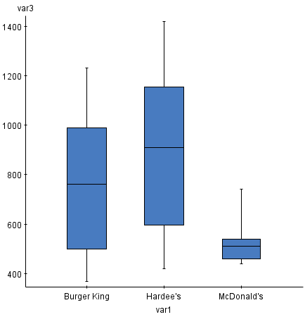
Use 5-Number summaries to construct boxplots. To compare different groups (e.g., restaurants), side-by-side boxplots can be constructed. (We will use Burger King’s to identify the boxplot features with the
5-number summary.)
Calories
Max=1230
Q3=995
Median=760
Q1=455
Min=370
BK 5-number summary
370, 455, 760, 995, 1230
Fast Food Restaurant

Slide 25
Which restaurant has higher calories overall?
Which restaurant has the least variability in calories?
Calories
Hardee’s
McDonald’s
Fast Food Restaurant

Slide 26
Distribution Shape and
The Boxplot
Left-Skewed
Symmetric
Right-Skewed
Q₁
Q₂
Q₃
Q₁
Q₂
Q₃
Q₁
Q₂
Q₃
Pearson slide (Chapter 3, #50)

Slide 27
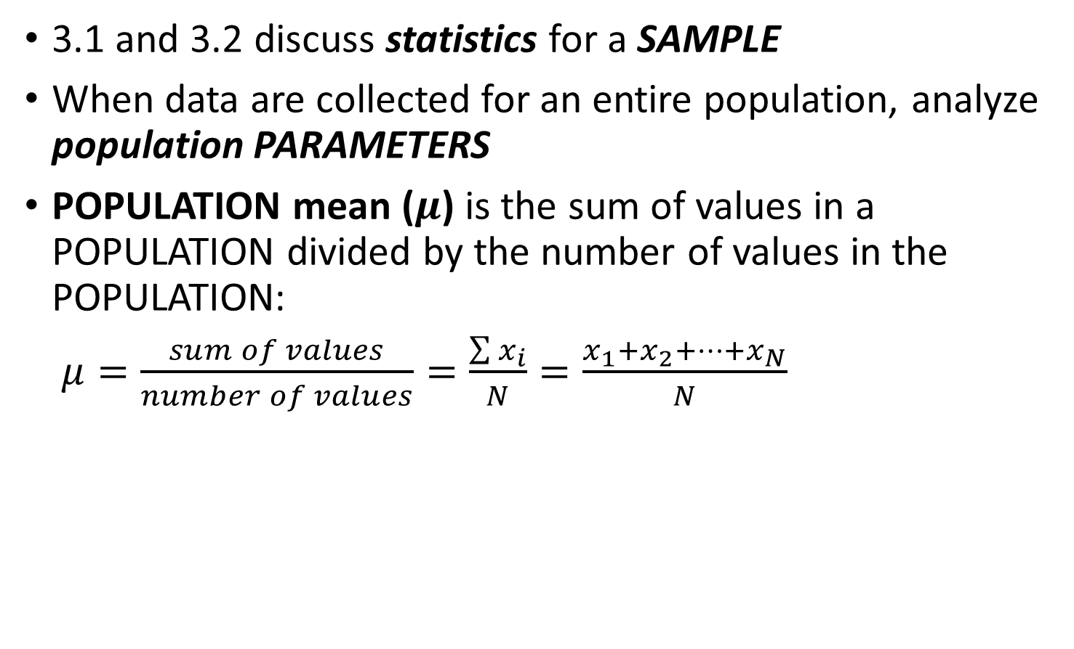
3.4 Numerical Descriptive Measures for a Population
3.1 and 3.2 discuss statistics for a SAMPLE
When data are collected for an entire population, analyze population PARAMETERS
POPULATION mean ($μ$) is the sum of values in a POPULATION divided by the number of values in the POPULATION:
$μ=\frac{sum of values}{number of values}=\frac{\sum{x_{i}}}{N}=\frac{x_{1}+x_{2}+…+x_{N}}{N}$

Slide 28
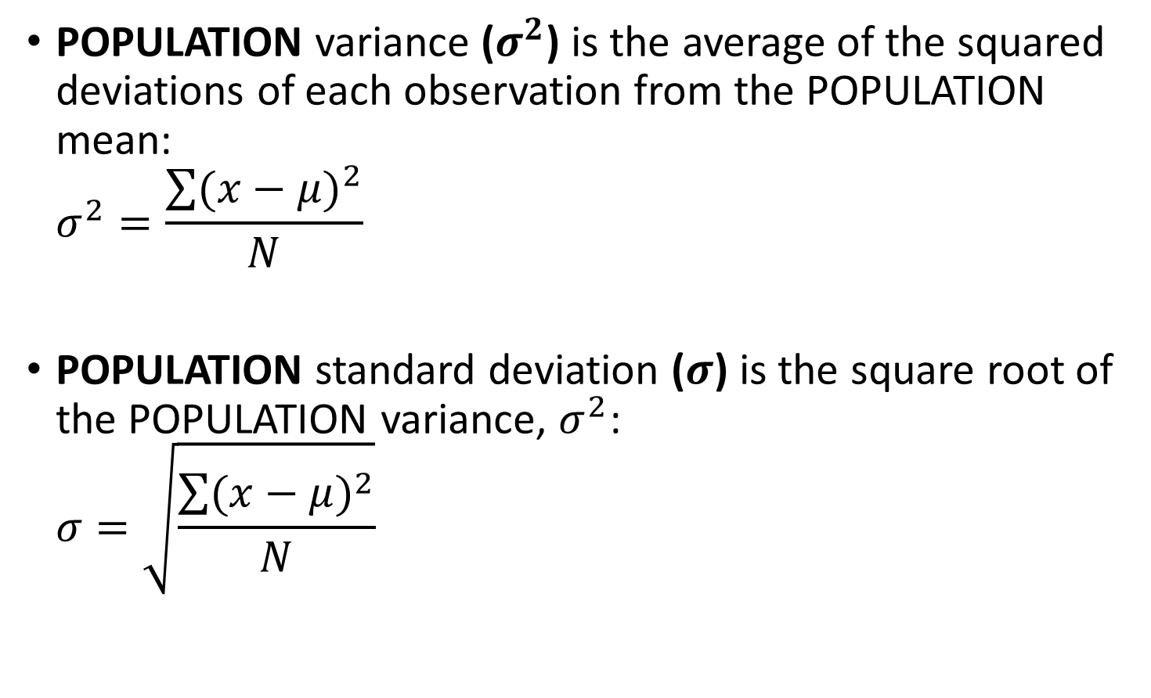
Population Variance and Standard Deviation
POPULATION variance ($σ^{2}$) is the average of the squared deviations of each observation from the POPULATION mean:
$σ^{2}=\frac{\sum{{(x−μ)}^{2}}}{N}$
POPULATION standard deviation ($σ$) is the square root of the POPULATION variance, $σ^{2}$:
$σ=\sqrt{\frac{\sum{{(x−μ)}^{2}}}{N}}$

Slide 29
Sample statistics versus population parameters
Measure | Population Parameter | Sample Statistic
Mean
Variance
Standard Deviation
Pearson slide (Chapter 3, #56)

Slide 30
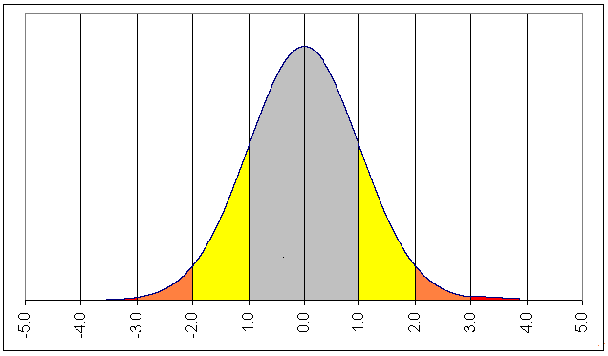
Empirical Rule for normal distributions
Remembering that in many data sets, a large portion of the values tend to cluster somewhere near the mean
For normal (bell-shaped, symmetric) distributions, we are able to use the Empirical Rule
  Within 1 std dev of the mean (gray area) ~ 68%
  Within 2 std dev of the mean (gray + yellow) ~ 95%
  Within 3 std dev of the mean (gray + yellow + orange) ~ 99.7%

Slide 31
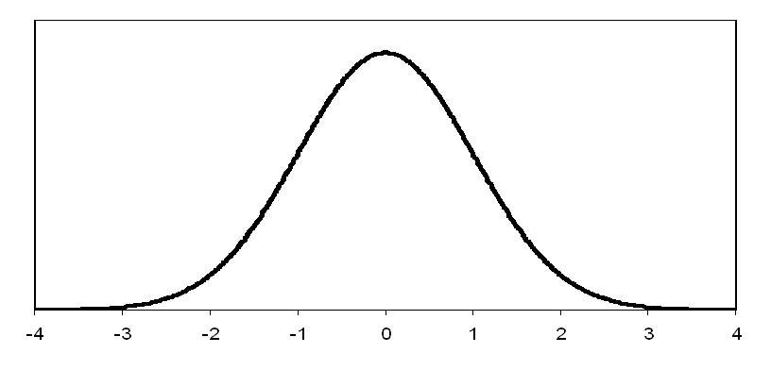
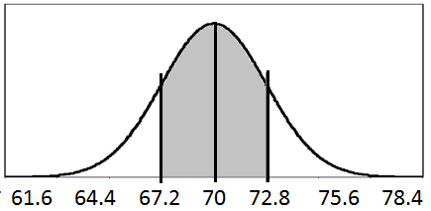
Example: The Health and Nutrition Examination Study of 1976-1980 (HANES) studied the heights of adults (aged 18-24) and found that the heights follow a normal distribution with the following:
Women Mean (μ): 65.0 inches standard deviation (σ): 2.5 inches
Men Mean (μ): 70.0 inches standard deviation (σ): 2.8 inches
Find the proportion of men with heights between 67.2 inches and 72.8 inches.
Proportion of men with heights
are between 67.2 (µ - σ) inches
and 72.8 (µ + σ) inches is 0.68 (68%) per the Empirical Rule.
0.68
61.6 64.4 67.2 70 72.8 75.6 78.4

Slide 32
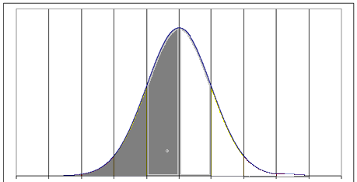
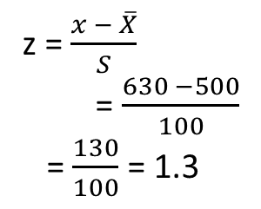
Questions:
If your data distribution follows a normal distribution, what proportion of the data do we expect to find below the mean?
  0.997 (99.7%)
  0.95 (95%)
  0.68 (68%)
  0.50 (50%)
Math SAT scores follow a normal distribution with a mean of 500 and standard deviation of 100. Calculate the standard score for a score of 630.
  1.3
  1.1
  -1.3
  -1.1
z = $\frac{x − \overline{X}}{S}$
= $\frac{630 −500}{100}$
= $\frac{130}{100}$ = 1.3

Slide 33
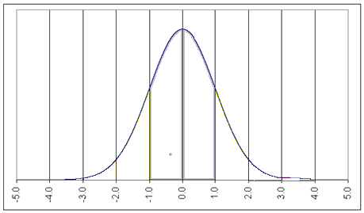
Questions:
Two students get a 65 on different tests.
Student A has a standard score of -1 while
Student B has a standard score of -2.
Which student had the better performance on the test?
  Student A
  Student B
  Both students gave equal performances.
B
A

Slide 34
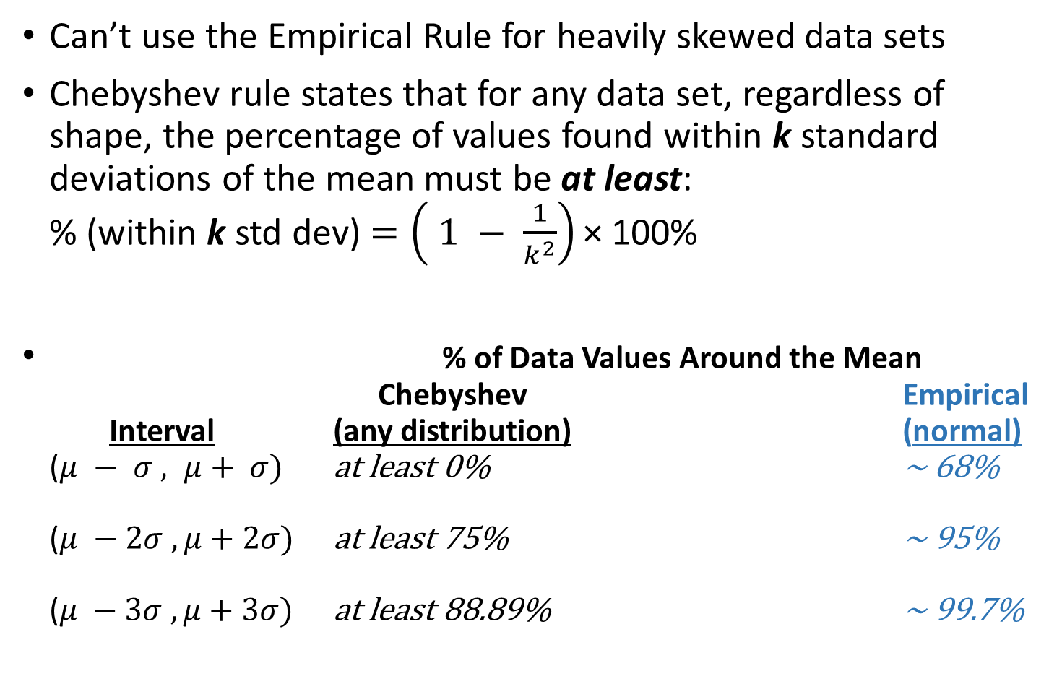



Chebyshev Rule
Can’t use the Empirical Rule for heavily skewed data sets
Chebyshev rule states that for any data set, regardless of shape, the percentage of values found within k standard deviations of the mean must be at least:
% (within k std dev) $=\left( 1 − \frac{1}{k^{2}}\right)\text{×}$ 100%
% of Data Values Around the Mean
Chebyshev Empirical
Interval (any distribution) (normal)
($μ − σ , μ+ σ)$ at least 0% ~ 68%
($μ −2σ , μ+2σ)$ at least 75% ~ 95%
$\text{(}μ −3σ , μ+3σ)$ at least 88.89% ~ 99.7%
($1−\frac{1}{1^{2}}=1−1=0$)
($1−\frac{1}{2^{2}}=1−\frac{1}{4}=0.75$)
($1−\frac{1}{3^{2}}=1−\frac{1}{9}=0.8889$

Slide 35
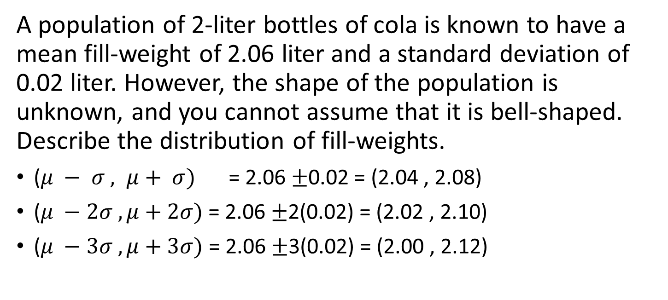
Example:
A population of 2-liter bottles of cola is known to have a mean fill-weight of 2.06 liter and a standard deviation of 0.02 liter. However, the shape of the population is unknown, and you cannot assume that it is bell-shaped. Describe the distribution of fill-weights.
($μ − σ , μ+ σ)$ = 2.06 ±0.02 = (2.04 , 2.08)
($μ −2σ , μ+2σ)$ = 2.06 ±2(0.02) = (2.02 , 2.10)
$\text{(}μ −3σ , μ+3σ)$ = 2.06 ±3(0.02) = (2.00 , 2.12)
0%
75%
88.89%
Is it very likely that a bottle will contain less than 2 liters of cola?
Between 0% and 11.11% of the bottles will contain less than 2 liters

Slide 36
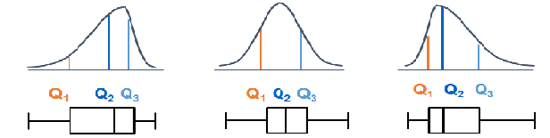
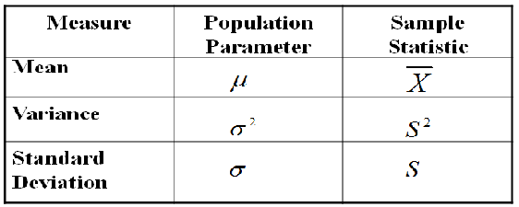
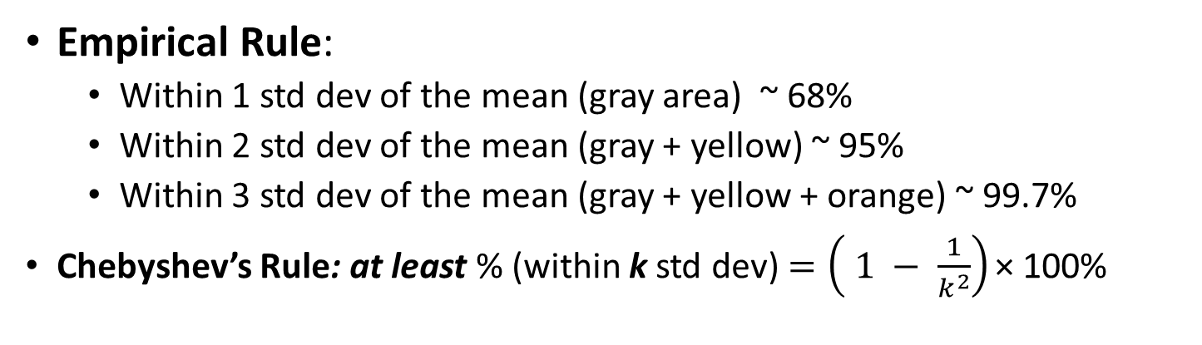
Review:
Empirical Rule:
  Within 1 std dev of the mean (gray area) ~ 68%
  Within 2 std dev of the mean (gray + yellow) ~ 95%
  Within 3 std dev of the mean (gray + yellow + orange) ~ 99.7%
Chebyshev’s Rule: at least % (within k std dev) $=\left( 1 − \frac{1}{k^{2}}\right)\text{×}$ 100%

Slide 37
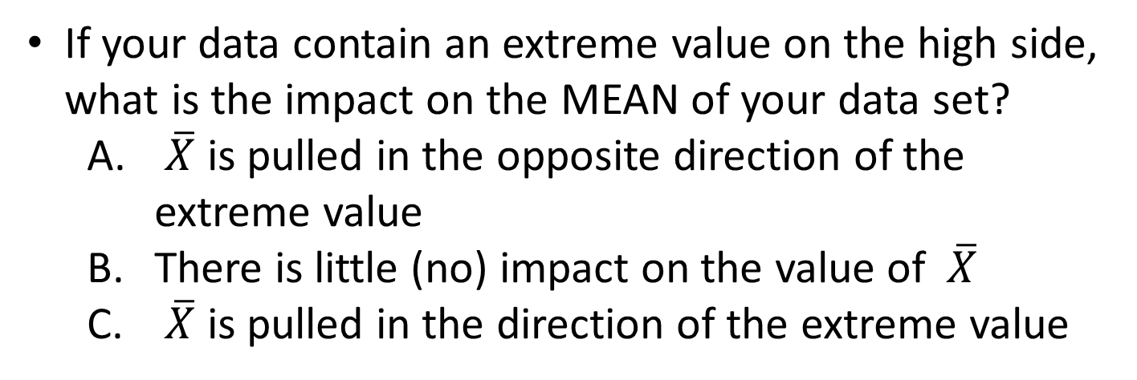
Questions:
If your data contain an extreme value on the high side, what is the impact on the MEAN of your data set?
  $\overline{X}$ is pulled in the opposite direction of the extreme value
  There is little (no) impact on the value of $\overline{X}$
  $\overline{X}$ is pulled in the direction of the extreme value
If your data contain an extreme value on the high side, what is the impact on the MEDIAN of your data set?
  Median is pulled in the opposite direction of the extreme value
  There is little (no) impact on the value of median
  Median is pulled in the direction of the extreme value

Slide 38
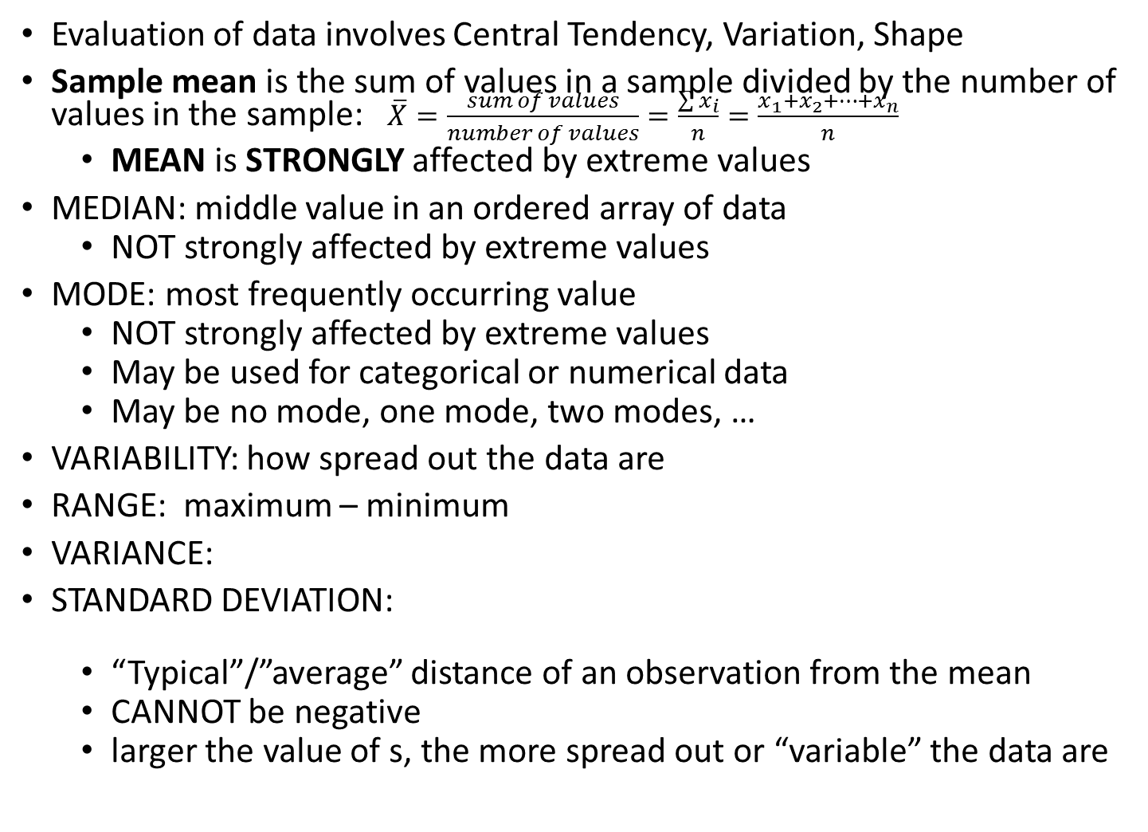

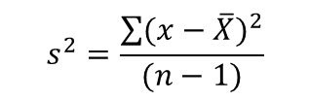
Review:
Evaluation of data involves Central Tendency, Variation, Shape
Sample mean is the sum of values in a sample divided by the number of values in the sample: $\overline{X}=\frac{sum of values}{number of values}=\frac{\sum{x_{i}}}{n}=\frac{x_{1}+x_{2}+…+x_{n}}{n}$
  MEAN is STRONGLY affected by extreme values
MEDIAN: middle value in an ordered array of data
  NOT strongly affected by extreme values
MODE: most frequently occurring value
  NOT strongly affected by extreme values
  May be used for categorical or numerical data
  May be no mode, one mode, two modes, …
VARIABILITY: how spread out the data are
RANGE: maximum – minimum
VARIANCE:
STANDARD DEVIATION:
  “Typical”/”average” distance of an observation from the mean
  CANNOT be negative
  larger the value of s, the more spread out or “variable” the data are
$$s^{2}=\frac{\sum{{(x−\overline{X})}^{2}}}{(n−1)}$$
$$s=\sqrt{s^{2}}=\sqrt{\frac{\sum{{(x−\overline{X})}^{2}}}{(n−1)}}$$

Slide 39
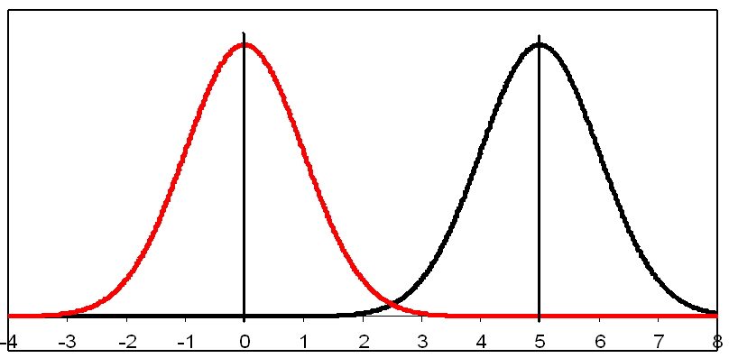
Questions:
Which of the following graphics shows data with the lowest standard deviation?
B. C.
Pictured at the right are two different normal distributions. What is different between the two distributions?
Mean
Standard deviation
Both

Slide 40

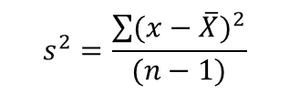
Review:
$$s^{2}=\frac{\sum{{(x−\overline{X})}^{2}}}{(n−1)}$$
$$s=\sqrt{s^{2}}=\sqrt{\frac{\sum{{(x−\overline{X})}^{2}}}{(n−1)}}$$
VARIANCE:
STANDARD DEVIATION:
  “Typical”/”average” distance of an observation from the mean
Z-scores:
  Z is a UNIT OF MEASURE of the number of standard deviations
  In general, Z < -3.00 or Z > 3.00 indicates an outlier value
Skewness:
  Symmetric if right and left sides
  of histogram are mirror images
  Skewed to the right if right “tail”
  extends much farther (high extremes)
  Skewed to the left if left “tail”
  extends much farther (low extremes)
QUARTILES: divide data into four parts
  Q1 = observation at the 25th percentile (median of lower half of data set)
  Q2 = observation at the 50th percentile (median of entire data set)
  Q3 = observation at the 75th percentile (median of upper half of data set)
5-Number Summary: min, Q1, median, Q3, max (visualize with BOXPLOT)
$$Z=\frac{\left(x −\overline{X}\right)}{s}$$

