Slide 1
STAT 206:
Chapter 4
Probability
Basic Probability Concepts
Conditional Probability

Slide 2
4.1 Basic Probability Concepts
Probability –
3 types of probability:
Probability of an occurrence (outcome)
numerical representation of chance,
likelihood,
possibility
an outcome or event will occur
  A priori (theoretical) – determined by knowledge of a process
    Coin toss / roll die / draw a card
  Empirical probability (experimental/observed)
    DO something and COUNT successes
  Subjective (personal)

Slide 3
Definitions:
– collection of unique outcomes of a random circumstance (usually denoted by S)
EXAMPLES:
sample space
Event
Joint Event –
Flip a coin
Roll a die
S:
Heads (H) Tails (T)
S:
1, 2, 3, 4, 5, 6
– an outcome or a set of outcomes in an experiment
EXAMPLES:
ODD NUMBER results from
Roll a die (1, 3, 5)
HEAD results from
Flip of a coin
has two or more characteristics (or outcomes)

Slide 4
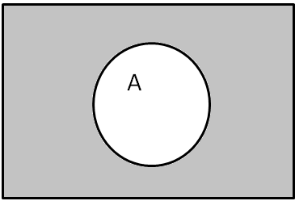
Probability Concepts
Complement of an event A – set of all outcomes that are not in A, denoted by A^{c}
  The probability that
  an event does not occur
  is 1 minus the probability that the event does occur
  This is known as the complement rule.
A
A^{C}
P(“not” A)
= P(A^{C})
= 1 – P(A)
and P(A) = 1 – P(A^{c})
  Question: A random sample of 200 students has been chosen, and of those students, 30 (0.15) are in Honors Statistics. What is the probability that randomly selected student is NOT in Honors Statistics?
    0.15 B. 0.85 C. 0.30 D. 0.70

Slide 5
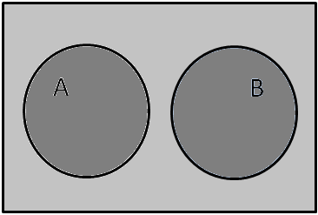
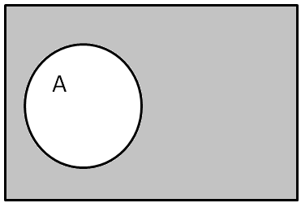
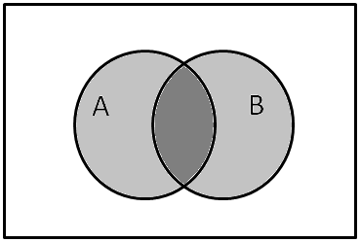
Probability Concepts
Disjoint Events – events A and B are disjoint if they do NOT have any common outcomes
Union of A and B means
everything in A OR B
B
IF A and B are disjoint,
P(A or B) = P(A) + P(B)
Intersection of A and B – consists of outcomes that are in
both A and B
Intersection of A and B – gives us
JOINT PROBABILITY
JOINT PROBABILITY refers to a
probability involving two or more
events (uses AND)
A
B
A and B

Slide 6
Probability Concepts
Union of A and B – consists of outcomes that in A or B
P(A or B) = P(A) + P(B) – P(A and B)
(so we don’t count the
intersection of A and B twice…)
A
B
If A and B are disjoint,
P(A or B) = P(A) + P(B) – P(A and B)
= P(A) + P(B) – 0
= P(A) + P(B)
A or B

Slide 7

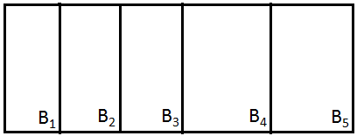
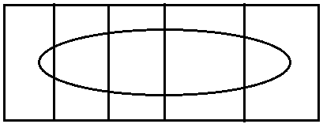
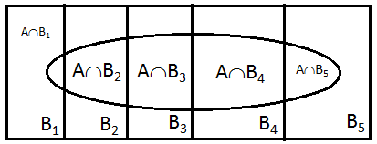
Probability Concepts
Marginal Probability – consists of a set of joint probabilities where B₁, B₂, …B_{k} are k mutually exclusive and collectively exhaustive events:
A
B
B₁
B₂
B₃
B₄
B₅
Remember:
  Mutually exclusive ➔ both events CANNOT occur simultaneously
  Collectively exhaustive ➔ one of the events MUST occur

Slide 8
Example:
Planned to Purchase | Actually Purchased
 | Yes | No | Total
Yes | 200 | 50 | 250
No | 100 | 650 | 750
Total | 300 | 700 | 1000
Probability that the family
“planned to purchase” AND “actually purchased”?
  AND ➔ Intersection
Calculate Marginal probability of “Planned to Purchase”
  Purchased “Yes” and Purchased “No” are
  Mutually Exclusive AND Collectively exhaustive ➔
$$P\left(Planned to Purchase\right)=P\left(Plan and YES\right)+P(NoPlan and YES)$$

Slide 9
UNION Rule
(General Addition Rule)
P(A or B) = P(A) + P(B) – P(A and B)
(so we don’t count the
intersection of A and B twice…)
Planned to Purchase | Actually Purchased
 | Yes | No | Total
Yes | 200 | 50 | 250
No | 100 | 650 | 750
Total | 300 | 700 | 1000
EXAMPLE: Find P(Planned to purchase_OR_Actually Purchased)
OR ➔ UNION
= P(Planned to Purchase) + P(Actually Purchased)
– P(Planned to Purchase AND Actually purchased)

Slide 10
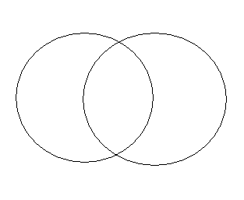
Example w/ Venn Diagram:
The probability a student is in honors math is 0.25,
in honors science is 0.30, and in both is 0.20.
What is the probability a student is in at least one honors class?
  0.55
  0.35
  0.25
  0.30
BOTH
0.20
Math
Science
0.25
0.30
P(A or B)
= P(A) + P(B) – P(A and B)
= P(math) + P(science) – P(both)
= 0.25 + 0.30 – 0.20
= 0.35

Slide 11
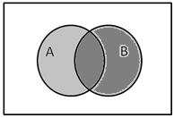
4.2 Conditional Probability
probability of event A, given information about the occurrence of another event, B
Conditional Probability –
Probability of A given B is equal to P(A and B) divided by the P(B). That is,
Since sample space is reduced, only consider the events in A that are ALSO in B ➔ intersection.
Denominator is always the “given” event.
Sample space is “reduced” to only those events in the given event.
Denominator is always the “given” event.
Sample space is “reduced” to only those events in the given event.
Where: P(A and B) = joint probability of A and B
P(A) = marginal probability of A
P(B) = marginal probability of B

Slide 12
Conditional Probability
Example:
Planned to Purchase | Actually Purchased
 | Yes | No | Total
Yes | 200 | 50 | 250
No | 100 | 650 | 750
Total | 300 | 700 | 1000
What is the probability that family
“Actually purchases” GIVEN THAT “Planned to purchase”?
P(Actually Purchase GIVEN THAT Planned to Purchase)
= P(Actually Purchased | Planned to Purchase)

Slide 13

EXAMPLE: Seat belts and deaths
Wore seat belt? | Survived (S) | Died (D) | Total
Yes (Y) | 412,368 | 510 | 412,878
No (N) | 162,527 | 1,601 | 164,128
Total | 574,895 | 2,111 | 577,006
What is the probability that an individual wore a seat belt in the auto accident? That is, P(Y)?
  $P\left(Y\right)=\frac{574,895}{577,006}=0.99634$
  $P\left(Y\right)=\frac{412,878}{577,006}=0.71555$
  $P\left(Y\right)=\frac{412,368}{577,006}=0.71467$
How many people in the study wore a seatbelt?
412,878
How many were in the study?
577,006

Slide 14
EXAMPLE: Seat belts and deaths
Wore seat belt? | Survived (S) | Died (D) | Total
Yes (Y) | 412,368 | 510 | 412,878
No (N) | 162,527 | 1,601 | 164,128
Total | 574,895 | 2,111 | 577,006
What is the probability that an individual survived in the auto accident? That is, P(S)?
  How many people survived?
  574,895
  How many were in the study?
  577,006

Slide 15

EXAMPLE: Seat belts and deaths
Wore seat belt? | Survived (S) | Died (D) | Total
Yes (Y) | 412,368 | 510 | 412,878
No (N) | 162,527 | 1,601 | 164,128
Total | 574,895 | 2,111 | 577,006
What is the probability that an individual did NOT survive the auto accident? That is, P(D)?
  $P\left(D\right)=\frac{510}{577,006}=0.000088$
  $P\left(D\right)=\frac{1,601}{577,006}=0.00277$
  $P\left(D\right)=\frac{2,111}{577,006}=0.00366$
  How many people died?
  2,111
  How many were in the study?
  577,006
Another way:
P(D) = P(died)
= P(S^{c}) = 1 – P(S)
= 1 – 0.99634 = 0.00366

Slide 16
EXAMPLE: Seat belts and deaths
Wore seat belt? | Survived (S) | Died (D) | Total
Yes (Y) | 412,368 | 510 | 412,878
No (N) | 162,527 | 1,601 | 164,128
Total | 574,895 | 2,111 | 577,006
What is the probability that an individual wore a seat belt and survived in the auto accident? That is, P(S and Y)?
  How many people wore a seat belt and survived?
  412,368
  How many were in the study?
  577,006

Slide 17
EXAMPLE: Seat belts and deaths
Wore seat belt? | Survived (S) | Died (D) | Total
Yes (Y) | 412,368 | 510 | 412,878
No (N) | 162,527 | 1,601 | 164,128
Total | 574,895 | 2,111 | 577,006
What is the probability that an individual wore a seat belt or survived in the auto accident? That is, P(S or Y)?
  P(S or Y) = P(S) + P(Y) – P(S and Y)
  = 0.99634 + 0.71555 – 0.71467
  = 1.71189 – 0.71467 = 0.99722
  P(S or Y)
  Check: # seat belt OR survived
  = # wore seat belt + # no seat belt who survived
  = 412,878 + 162,527 = 575,405

Slide 18
EXAMPLE: Seat belts and deaths
Wore seat belt? | Survived (S) | Died (D) | Total
Yes (Y) | 412,368 | 510 | 412,878
No (N) | 162,527 | 1,601 | 164,128
Total | 574,895 | 2,111 | 577,006
What is the probability of surviving GIVEN that the person wore a seatbelt? That is, P(S |Y)?
  Check: How many survived and wore a seat belt?
  412,368
  How many people in the study wore a seatbelt?
  412,878

Slide 19
Independence of events
Two events, A and B, are independent if the outcome of one of the events has no impact on the outcome of the other event
Two events, A and B, are independent if and only if
P(A|B)=P(A), where
P(A|B) = conditional probability of A given B, and
P(A) = marginal probability of A
  If one of the following is true, the all three are true:
    P(A|B) = P(A)
    P(B|A) = P(B)
    P(A and B) = P(A) x P(B)

Slide 20
Example:
Of the 300 households that purchased HDTV, they either purchased a standard refresh rate or a faster refresh rate. The contingency table shows satisfaction.
TV Refresh Rate | Satisfied with Purchase
 | Yes | No | Total
Faster | 64 | 16 | 80
Standard | 176 | 44 | 220
Total | 240 | 60 | 300
What is the probability that a family was satisfied with the purchase?
  P(Satisfied) = 240/300 = 0.80
What is the probability that a family that bought a TV with faster refresh rate was satisfied with the purchase?
Are the events “being satisfied with the purchase” and
the “refresh rate of the TV” independent?
P(Satisfied) = 0.80 = P(Satisfied | Faster) ➔
YES, Independent!

Slide 21
General Multiplication Rule
➔
Example: Previous contingency table, but only considering FASTER rate.
TV Refresh Rate | Satisfied with Purchase
 | Yes | No | Total
Faster | 64 | 16 | 80
Standard | 176 | 44 | 220
Total | 240 | 60 | 300
Suppose 2 households are chosen
at random from the 80 households. Find the probability that both households are satisfied with their purchases. Let:
A = 2nd household is satisfied AND B = 1st household is satisfied
P(1st satisfied) = 64/80 = P(B)
P(2nd satisfied | 1st satisfied) = (64-1)/(80-1) = 63/79 = P(A|B)
P(both satisfied) = P(A and B)
= P(A|B)P(B)

Slide 22
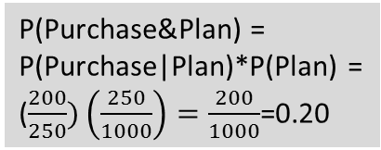
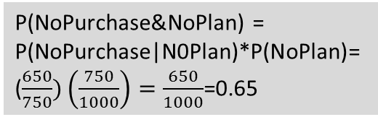
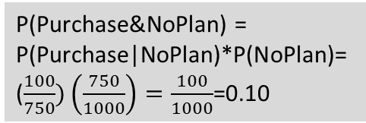
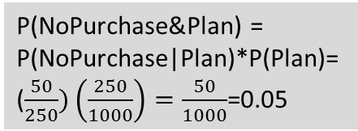
Decision Trees/Tree diagram – alternative to Contingency Tables
Planned to Purchase | Actually Purchased
 | Yes | No | Total
Yes | 200 | 50 | 250
No | 100 | 650 | 750
Total | 300 | 700 | 1000
Purchase|Plan
P(Purchase&Plan) =
P(Purchase|Plan)*P(Plan) =
($\frac{200}{250})\left(\frac{250}{1000}\right)=\frac{200}{1000}$=0.20
200/250
Planned to
to Purchase
P(NoPurchase&Plan) =
P(NoPurchase|Plan)*P(Plan)=
($\frac{50}{250})\left(\frac{250}{1000}\right)=\frac{50}{1000}$=0.05
250/1000
50/250
NoPurchase|Plan
All
households
Purchase|NoPlan
P(Purchase&NoPlan) =
P(Purchase|NoPlan)*P(NoPlan)=
($\frac{100}{750})\left(\frac{750}{1000}\right)=\frac{100}{1000}$=0.10
100/750
750/1000
No Plan to
to Purchase
P(NoPurchase&NoPlan) =
P(NoPurchase|N0Plan)*P(NoPlan)=
($\frac{650}{750})\left(\frac{750}{1000}\right)=\frac{650}{1000}$=0.65
650/750
NoPurchase|NoPlan

Slide 23
4.4 Counting Rules
RULE 1: If any of k different mutually exclusive and collectively exhaustive evens can occur on each of n trials, the number of possible outcomes is equal to k^{n}
Example: How many different
outcomes are there from
tossing a 2-sided coin 3 times?
  2 outcomes (heads/tails)
  3 trials
  2³ = 8
S: HHH /
HHT / HTH / THH /
HTT / THT / TTH /
TTT
Rule 2: If there are k₁ events on the first trial, k2 events on the second trial, … and k_{n} events on the nth trial, then the number of possible outcomes is (k₁)(k₂)…(k_{n})
Example: SC produces license plates with 3 letters and 3 numbers. How many possible outcomes are there?
  26 letters and 10 digits
  (26)(26)(26)(10)(10)(10) = 17,576,000

Slide 24
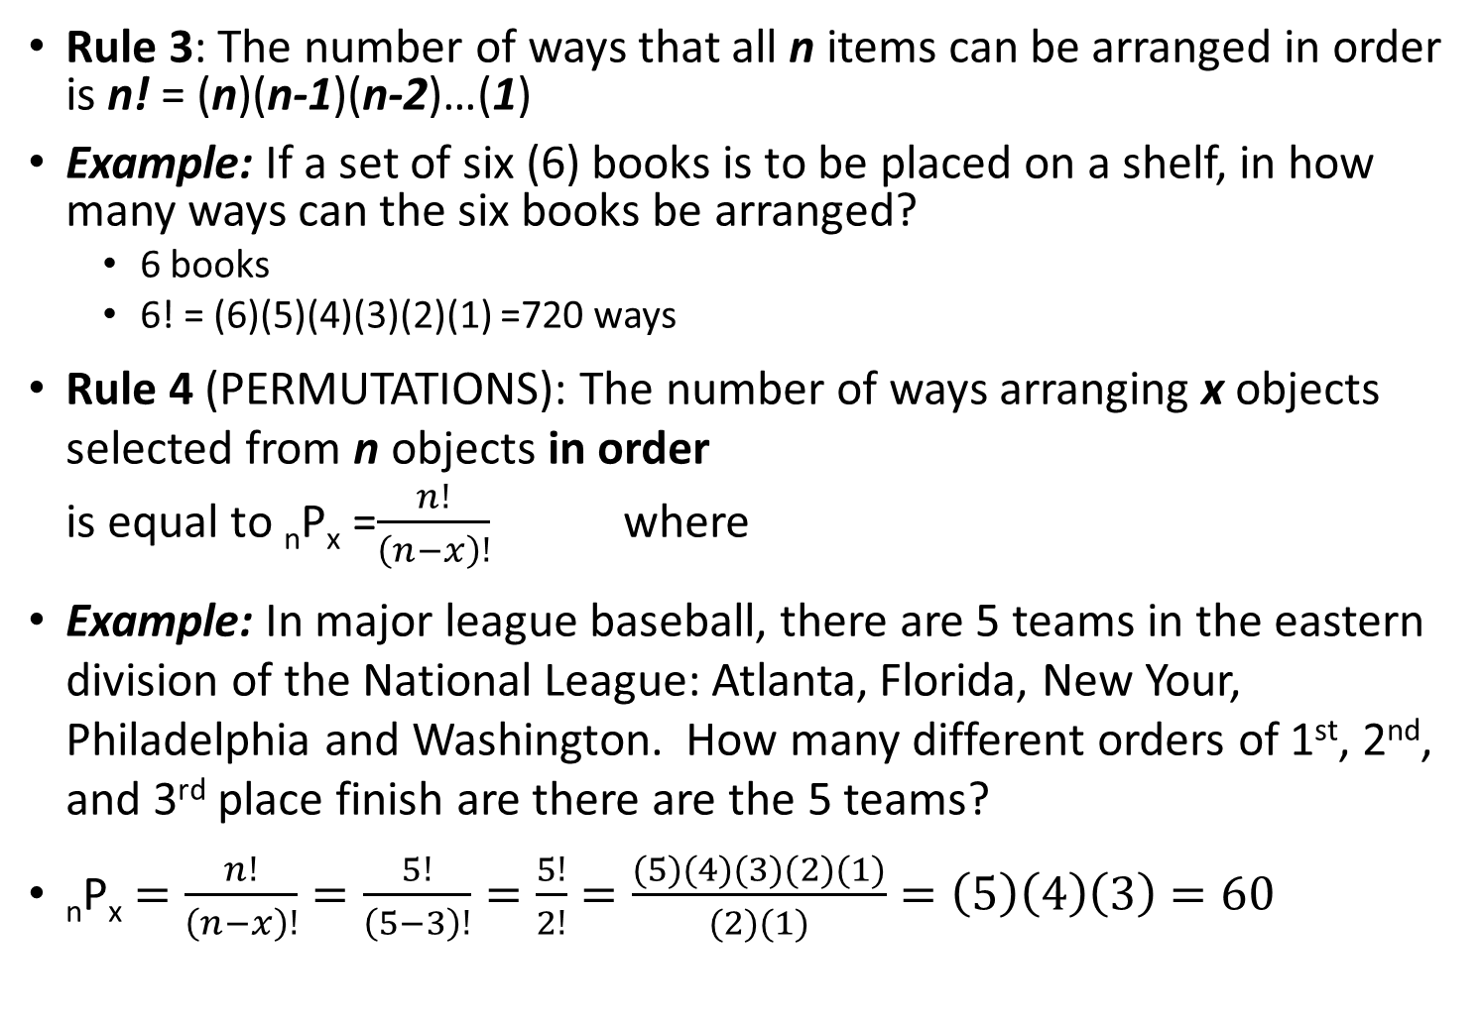
4.4 Counting Rules
Rule 3: The number of ways that all n items can be arranged in order is n! = (n)(n-1)(n-2)…(1)
Example: If a set of six (6) books is to be placed on a shelf, in how many ways can the six books be arranged?
  6 books
  6! = (6)(5)(4)(3)(2)(1) =720 ways
Rule 4 (PERMUTATIONS): The number of ways arranging x objects selected from n objects in order
is equal to _{n}P_{x} =$\frac{n!}{\left(n−x\right)!}$ where
Example: In major league baseball, there are 5 teams in the eastern division of the National League: Atlanta, Florida, New Your, Philadelphia and Washington. How many different orders of 1st, 2nd, and 3rd place finish are there are the 5 teams?
_{n}P_{x} $=\frac{n!}{\left(n−x\right)!}=\frac{5!}{\left(5−3\right)!}=\frac{5!}{2!}=\frac{(5)(4)(3)(2)(1)}{(2)(1)}=\left(5\right)\left(4\right)\left(3\right)=60$
n = total number of objects
x = number of objects to be arranged
n! = n factorial = n(n-1)(n-2)…(1)
P = symbol for permutations

Slide 25
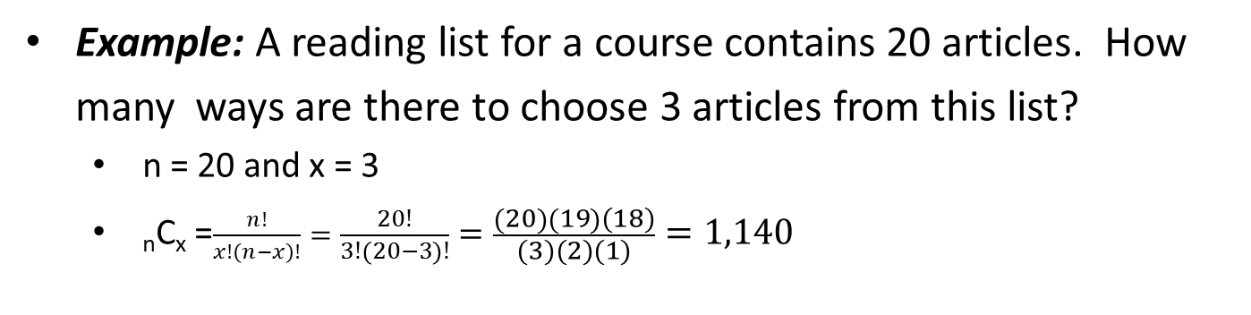
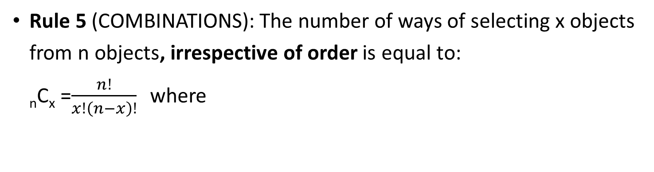
4.4 Counting Rules
Rule 5 (COMBINATIONS): The number of ways of selecting x objects from n objects, irrespective of order is equal to:
_{n}C_{x} =$\frac{n!}{x!\left(n−x\right)!}$ where
n = total number of objects
x = number of objects to be chosen
n! = n factorial = n(n-1)(n-2)…(1)
C = symbol for combinations
Example: A reading list for a course contains 20 articles. How many ways are there to choose 3 articles from this list?
  n = 20 and x = 3
  _{n}C_{x} =$\frac{n!}{x!\left(n−x\right)!}=\frac{20!}{3!\left(20−3\right)!}=\frac{\left(20\right)\left(19\right)(18)}{(3)(2)(1)}=1,140$

Slide 26
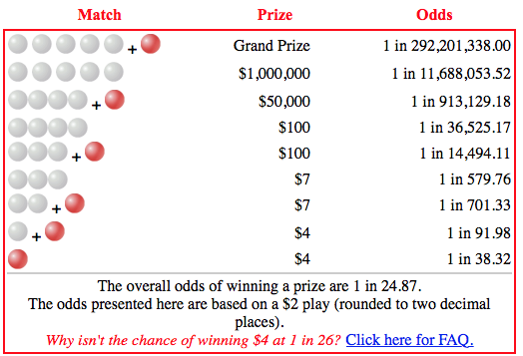
4.5 Ethical Issues and Probability
Consider the lottery:
  Powerball – draw five white balls out of a drum with 69 balls and one red ball out of a drum with 26 red balls
  Jackpot – won by matching all five white balls in any order and the red Powerball
  Second prize – won by matching
  five white balls in any order
  – is $1,000,000 paid in cash
  (no annuity option)
  Win something by matching
  at least three white ball numbers
  and any time match the
  red Powerball
  Overall odds of winning a prize
  in the game are approximately
  1 in 25
Is it okay to have people spending money on things they don’t understand?

Slide 27
ANNOUNCEMENTS
“Late” HW password is “toolate”
HW3 (Chapter 3) due TODAY, 09/19, @11:59pm
HW4 (Chapter 4) due Monday, 09/25, @11:59pm
Today’s lecture – Continue Chapter 4
Thursday’s lecture – Exam topic review
EXAM1 (Chapters 1-4), Tuesday, 09/26/17

Slide 28
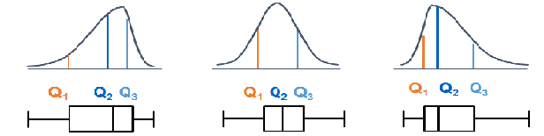
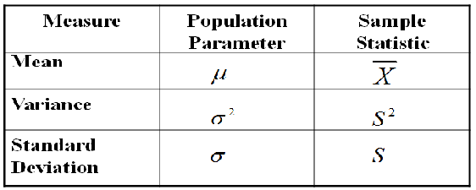
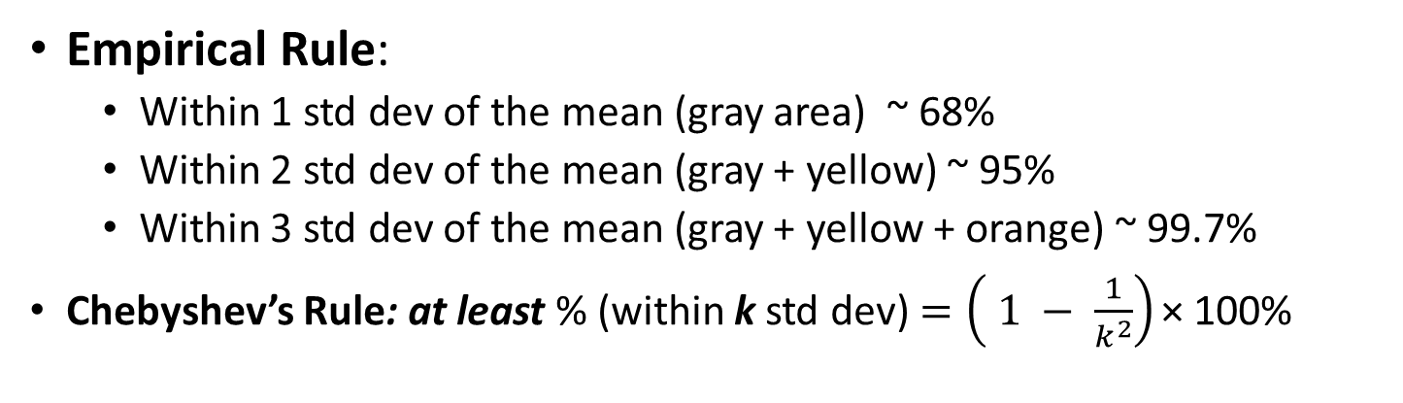
Review:
Empirical Rule:
  Within 1 std dev of the mean (gray area) ~ 68%
  Within 2 std dev of the mean (gray + yellow) ~ 95%
  Within 3 std dev of the mean (gray + yellow + orange) ~ 99.7%
Chebyshev’s Rule: at least % (within k std dev) $=\left( 1 − \frac{1}{k^{2}}\right)\text{×}$ 100%

Slide 29
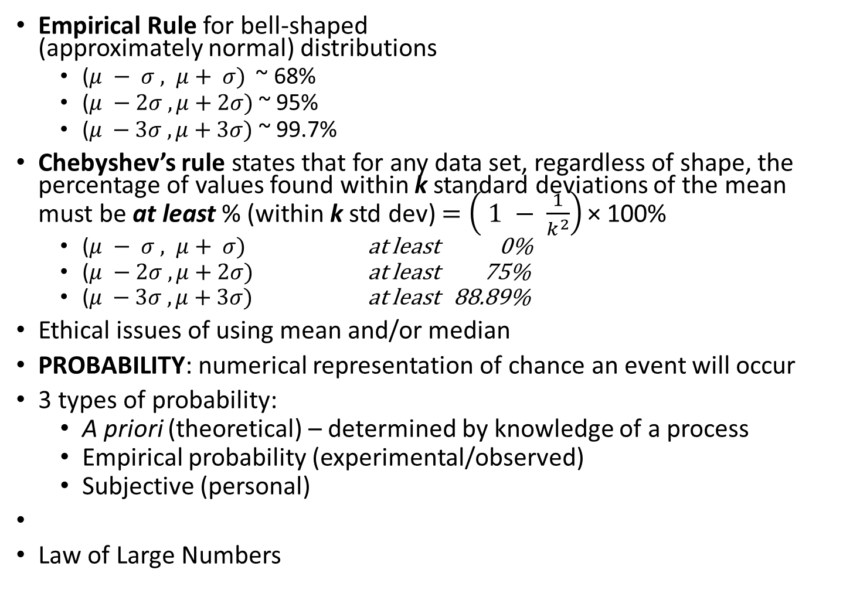
Review:
Empirical Rule for bell-shaped
(approximately normal) distributions
  ($μ − σ , μ+ σ)$ ~ 68%
  ($μ −2σ , μ+2σ)$~ 95%
  $\text{(}μ −3σ , μ+3σ)$~ 99.7%
Chebyshev’s rule states that for any data set, regardless of shape, the percentage of values found within k standard deviations of the mean must be at least % (within k std dev) $=\left( 1 − \frac{1}{k^{2}}\right)\text{×}$ 100%
  ($μ − σ , μ+ σ)$ at least 0%
  ($μ −2σ , μ+2σ)$ at least 75%
  $\text{(}μ −3σ , μ+3σ)$ at least 88.89%
Ethical issues of using mean and/or median
PROBABILITY: numerical representation of chance an event will occur
3 types of probability:
  A priori (theoretical) – determined by knowledge of a process
  Empirical probability (experimental/observed)
  Subjective (personal)
Law of Large Numbers

Slide 30
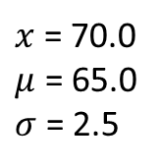
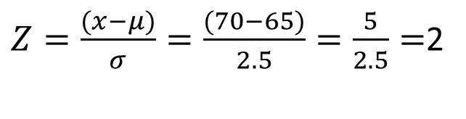
Question:
HANES: heights follow a normal distribution with the following:
Women Mean (μ): 65.0 in. standard deviation (σ): 2.5 in.
What is the standard score (Z-score) for a woman whose height is 70 inches?
  2
  95%
  75%
  – 2
$x$ = 70.0
$μ$ = 65.0
$σ$ = 2.5
$Z=\frac{(x−μ)}{σ}=\frac{(70−65)}{2.5}=\frac{5}{2.5}=$2

Slide 31
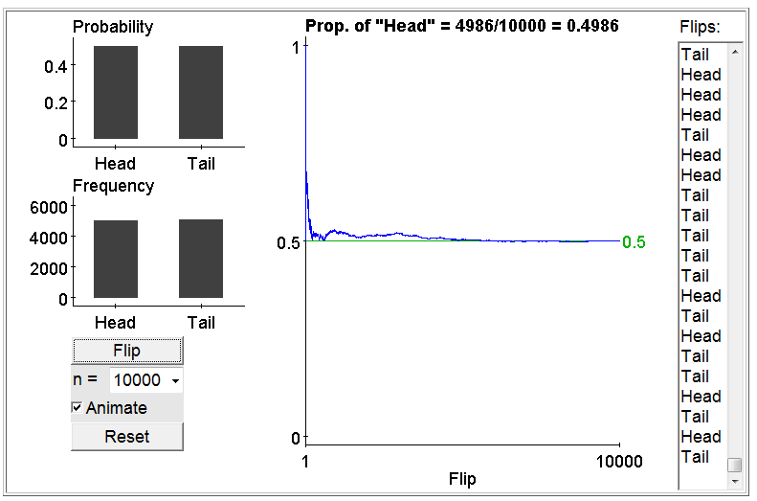
Law of Large Numbers (not in our text…)
Connection between empirical and a priori…
Law of Large Numbers (LLN) If a random phenomenon with numerical outcomes is repeated many times independently, the mean of the observed outcomes (sample mean) approaches the expected value (population mean).
  In a large number of “independent” repetitions of a random phenomenon (such as coin tossing), averages (or proportions, which really are averages) are likely to become more stable as the number of trials increases.
  The Law of Large Numbers is
  a statement about means
  and proportions,
  not sums and counts.
Question: Suppose you toss a
fair coin 9 times and get “Tails”
all 9 times. What is the probability
you’ll get another “Tails” on the
10th flip?
Highly Likely
Not likely at all
0.50

Slide 32
Review:
Sample Space: collection of unique outcomes of a random circumstance (usually denoted by S)
Event: an outcome or a set of outcomes in an experiment
Joint Event: has two or more outcomes
Complement Rule:
Disjoint Events: events that do NOT have any common outcomes
Intersection of A and B: outcomes that are in both A and B
Union of A and B: outcomes that in A or B or both
P(A or B) = P(A)+P(B)-P(A and B)
Marginal Probability:
Conditional Probability: probability of event A, given information about the occurrence of another event, B
P(“not” A)
= P(A^{C})
= 1 – P(A)
and P(A) = 1 – P(A^{c})

Slide 33
Conditional Probability
Planned to Purchase | Actually Purchased
 | Yes | No | Total
Yes | 200 | 50 | 250
No | 100 | 650 | 750
Total | 300 | 700 | 1000
What is the probability that family
“Planned to purchase” GIVEN THAT “Actually purchases”?
  0.80
  0.20
  0.67
  1.5
P(Planned to Purchase GIVEN THAT Actually Purchase)
= P(Planned to Purchase |Actually Purchased )

