Slide 1
STAT 206:
Chapter 5
Discrete Probability Distributions

Slide 2
5.1 Probability Distribution for a Discrete Variable
Have numerical values that arise from a counting process
Mutually exclusive list of all the possible numerical outcomes along with the probability of each outcome
Discrete variables:
Probability distribution for a discrete random variable:
Types Of
Variables
Ch. 5
Discrete
Variable
Continuous
Variable
Ch. 5
Ch. 5
Ch. 6
Ch. 6
Ch. 6

Slide 3
Example:
Number of interruptions per day in a large computer network
Interruptions in a day | Probability
0 | 0.35
1 | 0.25
2 | 0.20
3 | 0.10
4 | 0.05
5 | 0.05
Counting Process?
Yes
Mutually Exclusive?
Yes
Valid Probabilities?
Yes
Sum to one (1)?
Yes

Slide 4
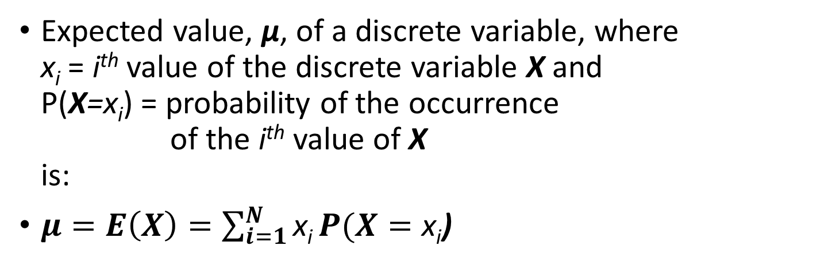

Expected value, µ, of a Discrete Variable
Expected value, µ, of a discrete variable, where
x_{i} = i^{th} value of the discrete variable X and
P(X=x_{i}) = probability of the occurrence
of the i^{th} value of X
is:
$μ=E\left(X\right)=\sum_{i=1}^{N}{\text{x}\text{i}}P(X=\text{x}\text{i}$)
Interruptions in a day | Probability | _{(xi)(P(X=xi))}
0 | 0.35 | 0(0.35) = | 0.00
1 | 0.25 | 1(0.25) = | 0.25
2 | 0.20 | 2(0.20) = | 0.40
3 | 0.10 | 3(0.10) = | 0.30
4 | 0.05 | 4(0.05) = | 0.20
5 | 0.05 | 5(0.05) = | 0.25
 | 1.00 |  | 1.40
Excel Functions: | General (if A & B):
=0*0.35 | =A2*B2
=1*0.25 | =A3*B3
=2*0.20 | =A4*B4
=3*0.10 | =A5*B5
=4*0.05 | =A6*B6
=5*0.05 | =A7*B7
=sum(<string>)
$$=μ=E\left(X\right)$$

Slide 5
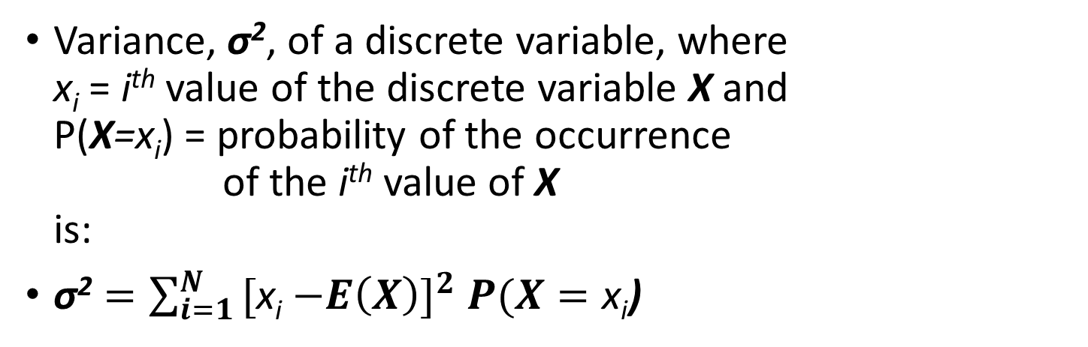

Variance of a Discrete Variable
Variance, σ², of a discrete variable, where
x_{i} = i^{th} value of the discrete variable X and
P(X=x_{i}) = probability of the occurrence
of the i^{th} value of X
is:
$\text{σ}\text{2}=\sum_{i=1}^{N}{\text{[}\text{x}\text{i}}{−E\left(X\right)]}^{2}P(X=\text{x}\text{i}$)
Interruptions in a day | Probability | x_{i} P(X=x_{i}) | [x_{i}-E(x)]² |  | [x_{i}-E(x)]²P(X=x_{i})
0 | 0.35 | 0.00 | (0-1.40) ² | 1.96 | (1.96)(0.35) | 0.686
1 | 0.25 | 0.25 | (1-1.40) ² | 0.16 | (0.16)(0.25) | 0.04
2 | 0.20 | 0.40 | (2-1.40) ² | 0.36 | (0.36)(0.20) | 0.072
3 | 0.10 | 0.30 | (3-1.40) ² | 2.56 | (2.56)(0.10) | 0.256
4 | 0.05 | 0.20 | (4-1.40) ² | 6.76 | (6.76)(0.05) | 0.338
5 | 0.05 | 0.25 | (5-1.40)² | 12.96 | (12.96)(0.05) | 0.648
 | 1.00 | 1.40 |  |  |  | 2.04
$$=\text{σ}\text{2}$$

Slide 6
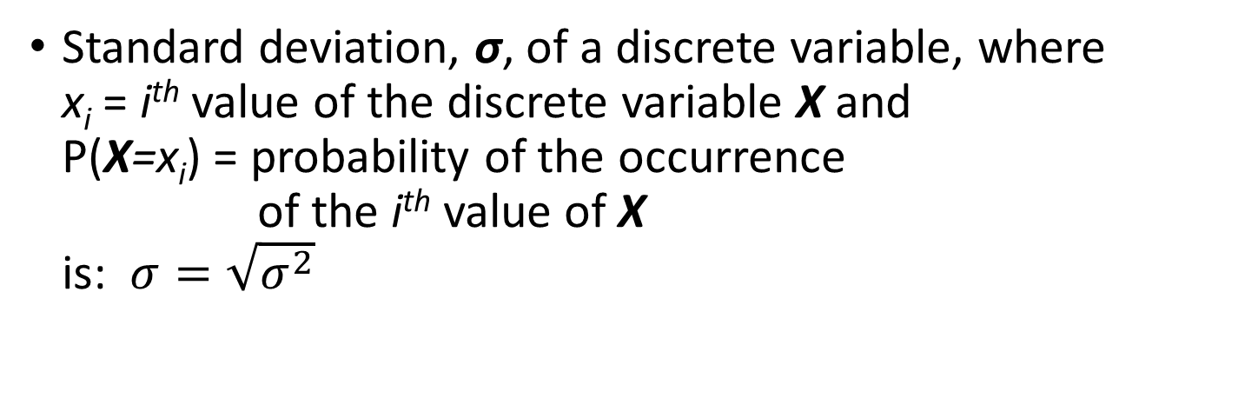

Standard Deviation of a Discrete Variable
Standard deviation, σ, of a discrete variable, where
x_{i} = i^{th} value of the discrete variable X and
P(X=x_{i}) = probability of the occurrence
of the i^{th} value of X
is: $σ=\sqrt{σ^{2}}$
Interruptions in a day | Probability | x_{i} P(X=x_{i}) | [x_{i}-E(x)]² |  | [x_{i}-E(x)]²P(X=x_{i})
0 | 0.35 | 0.00 | (0-1.40) ² | 1.96 | (1.96)(0.35) | 0.686
1 | 0.25 | 0.25 | (1-1.40) ² | 0.16 | (0.16)(0.25) | 0.04
2 | 0.20 | 0.40 | (2-1.40) ² | 0.36 | (0.36)(0.20) | 0.072
3 | 0.10 | 0.30 | (3-1.40) ² | 2.56 | (2.56)(0.10) | 0.256
4 | 0.05 | 0.20 | (4-1.40) ² | 6.76 | (6.76)(0.05) | 0.338
5 | 0.05 | 0.25 | (5-1.40) ² | 12.96 | (12.96)(0.05) | 0.648
 | 1.00 | 1.40 |  |  |  | 2.04 | 1.4283
$$=\text{σ}$$

Slide 7
Useful Excel Functions:
Add: =<value or reference>+<value or reference>
Summation: =SUM(<data string>)
Subtract: =<value or reference>–<value or reference>
Multiply: =<value or reference>*<value or reference>
Divide: =<value or reference>/<value or reference>
Raise to a power: =POWER(<data string>,<exponent>)
Square Root: =SQRT(<value or reference>)
Always use Order of Operations (Please Excuse My Dear Aunt Sally):
  Parentheses
  Exponents
  Multiply and/or Divide (left to right)
  Add and/or Subtract (left to right)

Slide 8
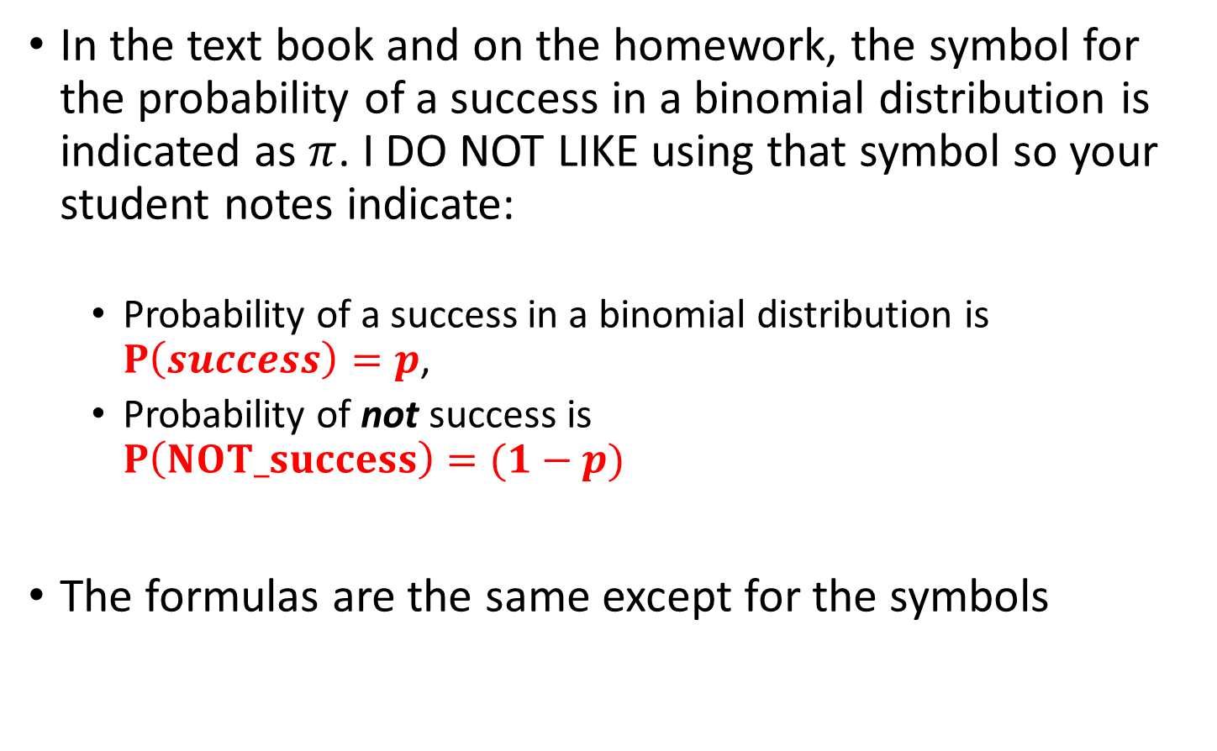
PLEASE NOTE:
In the text book and on the homework, the symbol for the probability of a success in a binomial distribution is indicated as $π$. I DO NOT LIKE using that symbol so your student notes indicate:
  Probability of a success in a binomial distribution is $P\left(success\right)=p$,
  Probability of not success is
  $P\left(NOT_success\right)=(1−p)$
The formulas are the same except for the symbols

Slide 9
5.3 Binomial Distribution: Properties
A fixed number of observations, n
  e.g., 15 tosses of a coin; ten light bulbs taken from a warehouse
Each observation is categorized as to whether or not the “event of interest” occurred
  e.g., head or tail in each toss of a coin; defective or not defective light bulb
  Since these two categories are mutually exclusive and collectively exhaustive
    When the probability of the event of interest is represented as p, then the probability of the event of interest not occurring is 1 - p
Constant probability for the event of interest occurring (p) for each observation
  Probability of getting a tail is the same each time we toss the coin

Slide 10
Examples of business applications:
A manufacturing plant labels items as either defective or acceptable
A firm bidding for contracts will either get a contract or not
A marketing research firm receives survey responses of “yes I will buy” or “no I will not”
New job applicants either accept the offer or reject it

Slide 11
Counting Techniques for Binomial
Suppose the event of interest is obtaining heads on the toss of a fair coin. You are to toss the coin three times. In how many ways can you get two heads?
Possible ways: HHT, HTH, THH, so there are three ways you can getting two heads
This situation is fairly simple. We need to be able to count the number of ways for more complicated situations
COMBINATIONS!
The number of combinations of selecting x objects out of n objects is
Where:
n! =(n)(n - 1)(n - 2) . . . (2)(1)
x! = (X)(X - 1)(X - 2) . . . (2)(1)
0! = 1 (by definition)

Slide 12






Example:
How many possible 3 scoop combinations could you create at an ice cream parlor if you have 31 flavors to select from and no flavor can be used more than once in the 3 scoops?
The total choices is n = 31, and we select X = 3

Slide 13
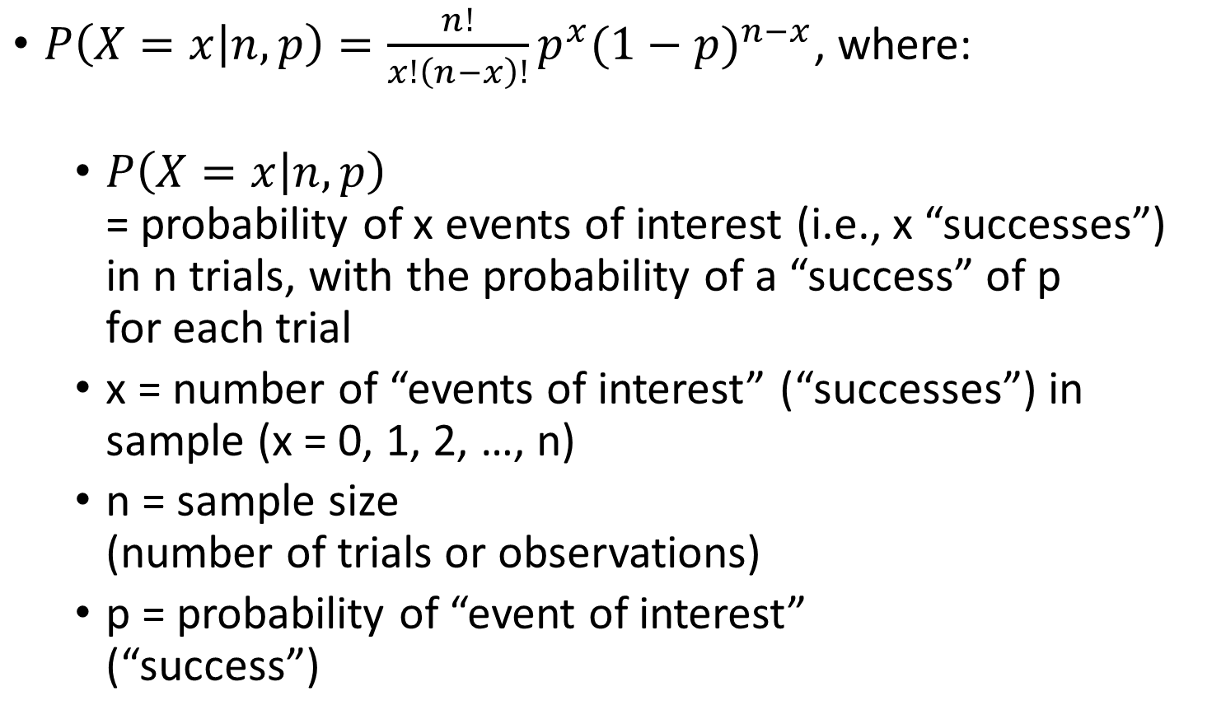
Binomial Distribution
$P\left(X=x | n,p\right)=\frac{n!}{x!\left(n−x\right)!}p^{x}{(1−p)}^{n−x}$, where:
  $P\left(X=x | n,p\right)$
  = probability of x events of interest (i.e., x “successes”) in n trials, with the probability of a “success” of p
  for each trial
  x = number of “events of interest” (“successes”) in sample (x = 0, 1, 2, …, n)
  n = sample size
  (number of trials or observations)
  p = probability of “event of interest”
  (“success”)
Example: Flip a coin four times, let x = # heads:
n = 4
p = 0.5
1 - p = (1 - 0.5) = 0.5
X = 0, 1, 2, 3, 4

Slide 14
EXAMPLES
You observe the sex of the next 50 children born at a local hospital; X is the number of girls among them.
Binomial

Slide 15
EXAMPLES
A couple decides to continue to have children until their first girl is born; X is the total number of children the couple has.
Not Binomial

Slide 16
EXAMPLES
You want to know what percent of married people believe that mothers of young children should not be employed outside the home. You plan to interview 50 people, and for the sake of convenience you decide to interview both the husband and the wife in 25 married couples. The random variable X is the number among the 50 persons interviewed who think mothers should not be employed.
Not Binomial

Slide 17
EXAMPLES
The pool of potential jurors for a murder case contains 100 persons chosen at random from the adult residents of a large city. Each person in the pool is asked whether he or she opposes the death penalty; X is the number who say “Yes”
Binomial

Slide 18
EXAMPLES
Joe buys a ticket in his state’s “Pick 3” lottery game every week; X is the number of times in a year that he wins a prize. (Assume 52 weeks in a year)
Binomial

Slide 19
Combination Rules
Example: A major electronics manufacturer has determined that when one of its DVD player is sold, there is 0.05 chance that the DVD player will need service before the warranty period expires.

Slide 20
EXAMPLE
How many different ways to need two repairs?
How many different ways to need three repairs?

Slide 21
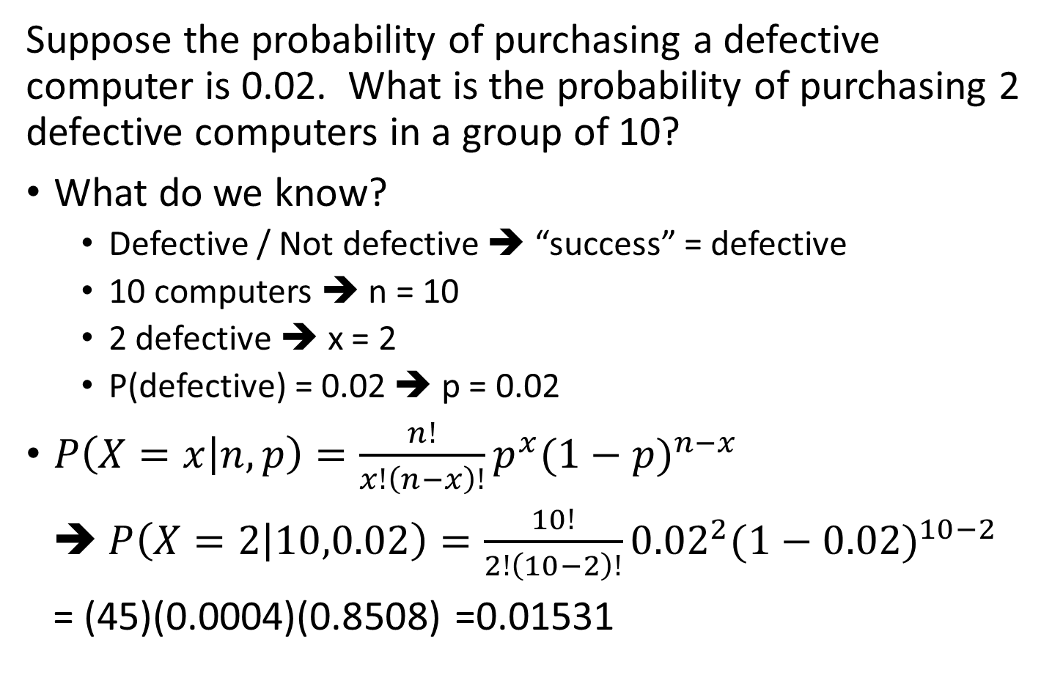

Example:
Suppose the probability of purchasing a defective computer is 0.02. What is the probability of purchasing 2 defective computers in a group of 10?
What do we know?
  Defective / Not defective ➔ “success” = defective
  10 computers ➔ n = 10
  2 defective ➔ x = 2
  P(defective) = 0.02 ➔ p = 0.02
$P\left(X=x | n,p\right)=\frac{n!}{x!\left(n−x\right)!}p^{x}{(1−p)}^{n−x}$
$P\left(X=2 | 10,0.02\right)=\frac{10!}{2!\left(10−2\right)!}{0.02}^{2}{(1−0.02)}^{10−2}$
= (45)(0.0004)(0.8508) =0.01531
Where did 45 come from?
$\frac{10!}{2!\left(10−2\right)!}=\frac{10!}{2!\left(8\right)!}$
$=\frac{8!(9)(10)}{2\left(8\right)!}=\frac{(9)(10)}{2}$
$=\frac{90}{2}=45$

Slide 22
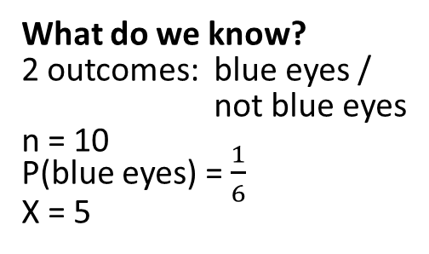
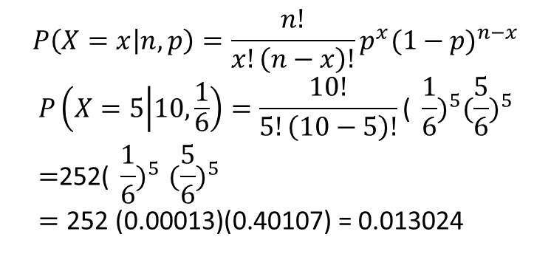
Example:
Blue eyes: According to a Boston Globe story, only about 1 in 6 Americans have blue eyes, whereas a 1900 about half had blue eyes (Source: Data from The Boston Globe, October 17, 2006). For a random sample of 10 living Americans, what is the probability of finding 5 Americans with blue eyes?
What do we know?
2 outcomes: blue eyes / not blue eyes
n = 10
P(blue eyes) = $\frac{1}{6}$
X = 5
$$P\left(X=x | n,p\right)=\frac{n!}{x!\left(n−x\right)!}p^{x}{(1−p)}^{n−x}$$
$$P\left(X=5 | 10,\frac{1}{6}\right)=\frac{10!}{5!\left(10−5\right)!}{\text{( }\frac{1}{6})}^{5}{(\frac{5}{6})}^{5}$$
$${\text{=}\text{252( }\frac{1}{6})}^{5}{(\frac{5}{6})}^{5}$$
$=\text{252 (0.00013)(0.40107)}$ = 0.013024

Slide 23
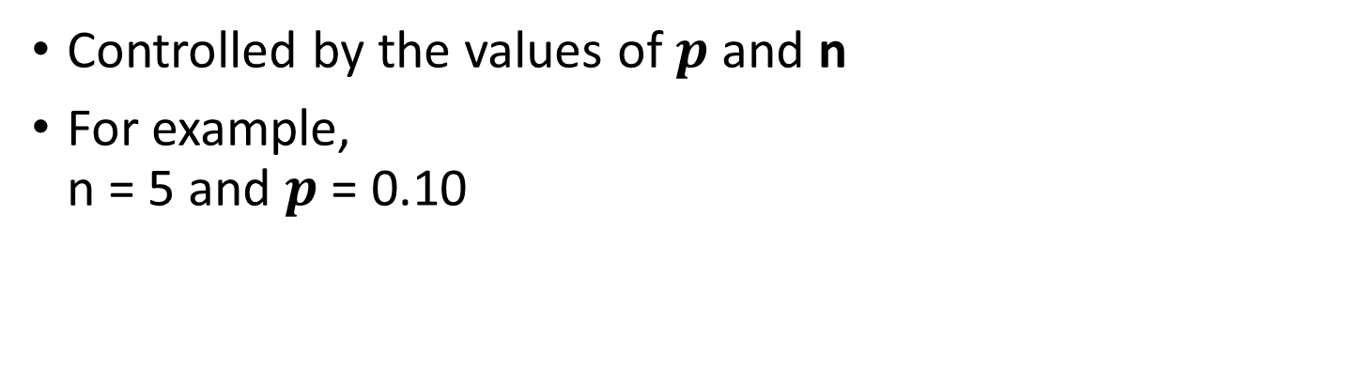
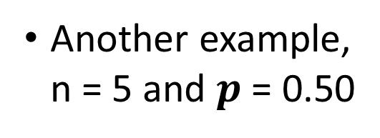
Shape of the Binomial Distribution
Controlled by the values of $p$ and n
For example,
n = 5 and $p$ = 0.10
P(X=x|5, 0.1)
.6
.4
.2
0
0
1
2
3
4
5
x
Another example,
n = 5 and $p$ = 0.50
P(X=x|5, 0.5)
.6
.4
.2
0
0
1
2
3
4
5
x

Slide 24
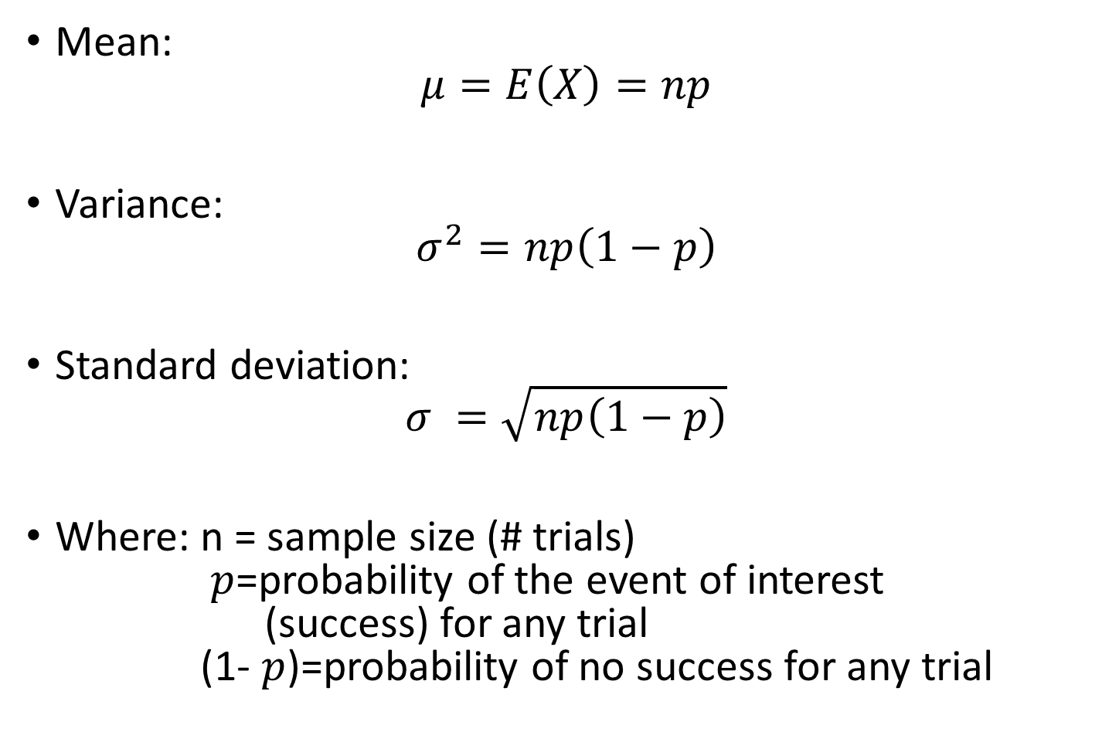
Binomial Distribution Characteristics
Mean:
$μ=E\left(X\right)=np$
Variance:
$σ^{2}=np\left(1−p\right)$
Standard deviation:
$σ =\sqrt{np\left(1−p\right)}$
Where: n = sample size (# trials)
$p$=probability of the event of interest
(success) for any trial
(1- $p$)=probability of no success for any trial

Slide 25
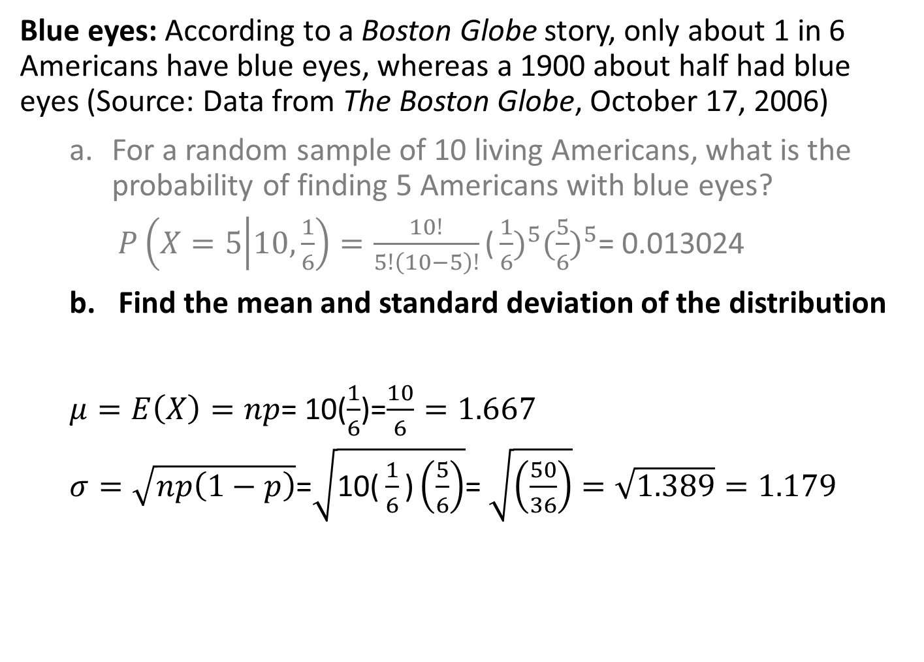
STAT 201 Textbook examples:
Blue eyes: According to a Boston Globe story, only about 1 in 6 Americans have blue eyes, whereas a 1900 about half had blue eyes (Source: Data from The Boston Globe, October 17, 2006)
For a random sample of 10 living Americans, what is the probability of finding 5 Americans with blue eyes?
$P\left(X=5 | 10,\frac{1}{6}\right)=\frac{10!}{5!\left(10−5\right)!}{\text{(}\frac{1}{6})}^{5}{(\frac{5}{6})}^{5}$= 0.013024
Find the mean and standard deviation of the distribution
$μ=E\left(X\right)=np$= 10($\frac{1}{6}$)=$\frac{10}{6}=1.667$
$σ=\sqrt{np\left(1−p\right)}$=$\sqrt{\text{10(}\frac{1}{6}\text{)}\left(\frac{5}{6}\right)}$= $\sqrt{\left(\frac{50}{36}\right)}=\sqrt{1.389}=1.179$

Slide 26
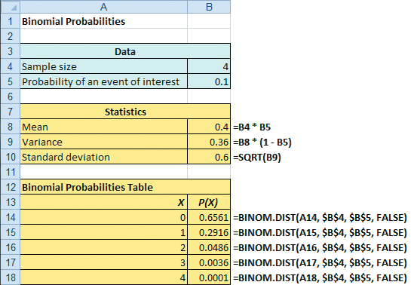
Excel Can Be Used To Calculate The Binomial Distribution
=BINOM.DIST(<#successes>,<#trials>,<probability_success>,<cumulative?>)

Slide 27
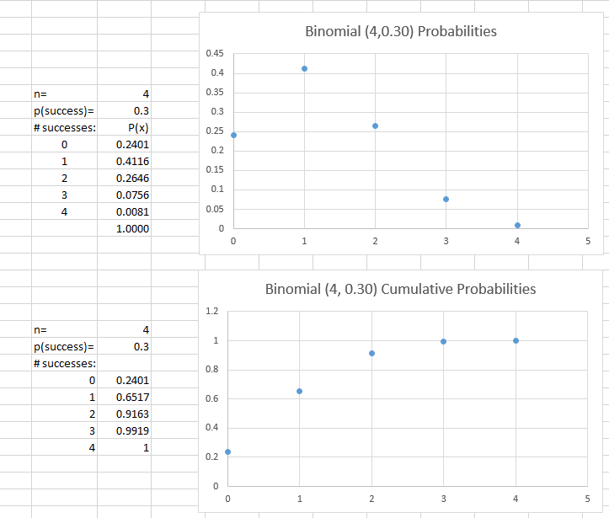
=BINOM.DIST(x,4,0.30,cumulative?)
“cumulative?” = FALSE
“cumulative?” = TRUE

Slide 28
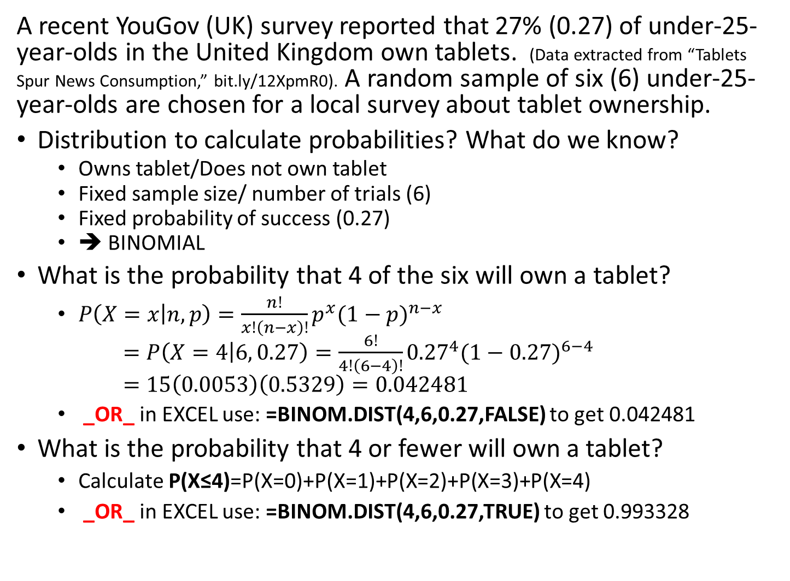
Example:
A recent YouGov (UK) survey reported that 27% (0.27) of under-25-year-olds in the United Kingdom own tablets. (Data extracted from “Tablets Spur News Consumption,” bit.ly/12XpmR0). A random sample of six (6) under-25-year-olds are chosen for a local survey about tablet ownership.
Distribution to calculate probabilities? What do we know?
  Owns tablet/Does not own tablet
  Fixed sample size/ number of trials (6)
  Fixed probability of success (0.27)
  ➔ BINOMIAL
What is the probability that 4 of the six will own a tablet?
  $P\left(X=x | n,p\right)=\frac{n!}{x!\left(n−x\right)!}p^{x}{(1−p)}^{n−x}$
  $=P\left(X=4 | 6, 0.27\right)=\frac{6!}{4!\left(6−4\right)!}{0.27}^{4}{(1−0.27)}^{6−4}$
  $=15\left(0.0053\right)\left(0.5329\right)=0.0424$81
  _OR_ in EXCEL use: =BINOM.DIST(4,6,0.27,FALSE) to get 0.042481
What is the probability that 4 or fewer will own a tablet?
  Calculate P(X≤4)=P(X=0)+P(X=1)+P(X=2)+P(X=3)+P(X=4)
  _OR_ in EXCEL use: =BINOM.DIST(4,6,0.27,TRUE) to get 0.993328

Slide 29

Review:
Discrete Probability distributions:
DISCRETE variables – numerical values from a counting process
PROBABILITY DISTRIBUTION – possible outcomes and probabilities of each (Mutually exclusive and collectively exhaustive)
  $μ=E\left(X\right)=\sum_{i=1}^{N}{\text{x}\text{i}}P(X=\text{x}\text{i}$)
  $\text{σ}\text{2}=\sum_{i=1}^{N}{\text{[}\text{x}\text{i}}{−E\left(X\right)]}^{2}P(X=\text{x}\text{i}$)
  $σ=\sqrt{σ^{2}}$
Binomial Probability Distribution
Fixed number of observations, n
Each observation: two categories outcomes – success/failure
Mutually exclusive and collectively exhaustive
Constant probability for “event of interest” (success) occurring $P\left(X=x | n,p\right)=\frac{n!}{x!\left(n−x\right)!}p^{x}{(1−p)}^{n−x}$
$\frac{n!}{x!\left(n−x\right)!}$ is the number of ways the value of x can occur (combinations)

Slide 30
Question:
Marital Status of a Random Sample
of Women Ages 25 to 29
Is this a valid probability distribution?
  Yes
  No
Probabilities all between 0 and 1, inclusive?
  Yes…
  Sum of probabilities equal to one?
  0.386 + 0.555 + 0.004 + 0.055 = 1.000
  Yes…

Slide 31
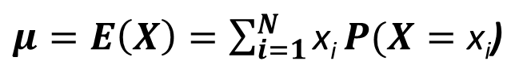
Question:
# books read/year
x | P(x)
6 | 0.05
12 | 0.12
24 | 0.65
36 | 0.15
48 | 0.03
A hypothetical book club polled its members
to ask how many books each member read in
the last 12 months. The table shows the results:
What is the expected number of books
read by a randomly selected member
in the book club in a year?
  (6+12+24+36+48)/5 = 126/5 = 25.2
  (6*.05+12*.12+24*.65+36*.15+48*.03)/5=24.18/5=4.836
  6*0.05+12*0.12+24*0.65+36*0.15+48*0.03) = 24.18
  (6+12+24+36+48)*0.65 = 81.9
$μ=E\left(X\right)=\sum_{i=1}^{N}{\text{x}\text{i}}P(X=\text{x}\text{i}$)

Slide 32
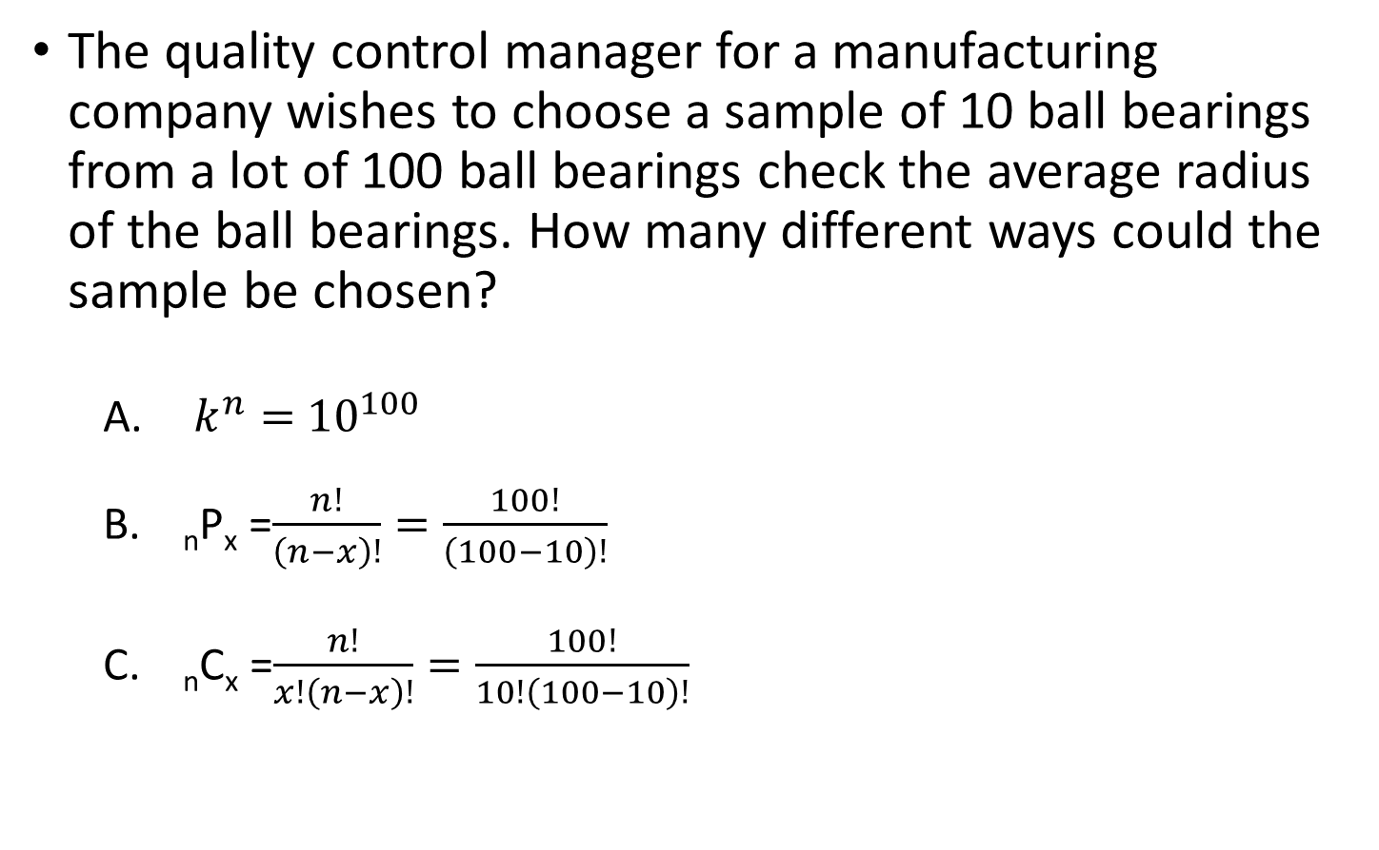

Question:
The quality control manager for a manufacturing company wishes to choose a sample of 10 ball bearings from a lot of 100 ball bearings check the average radius of the ball bearings. How many different ways could the sample be chosen?
  $k^{n}=$ ${10}^{100}$
  _{n}P_{x} =$\frac{n!}{\left(n−x\right)!}=\frac{100!}{\left(100−10\right)!}$
  _{n}C_{x} =$\frac{n!}{x!\left(n−x\right)!}=\frac{100!}{10!\left(100−10\right)!}$
$$=17,310,309,456,440$$

Slide 33
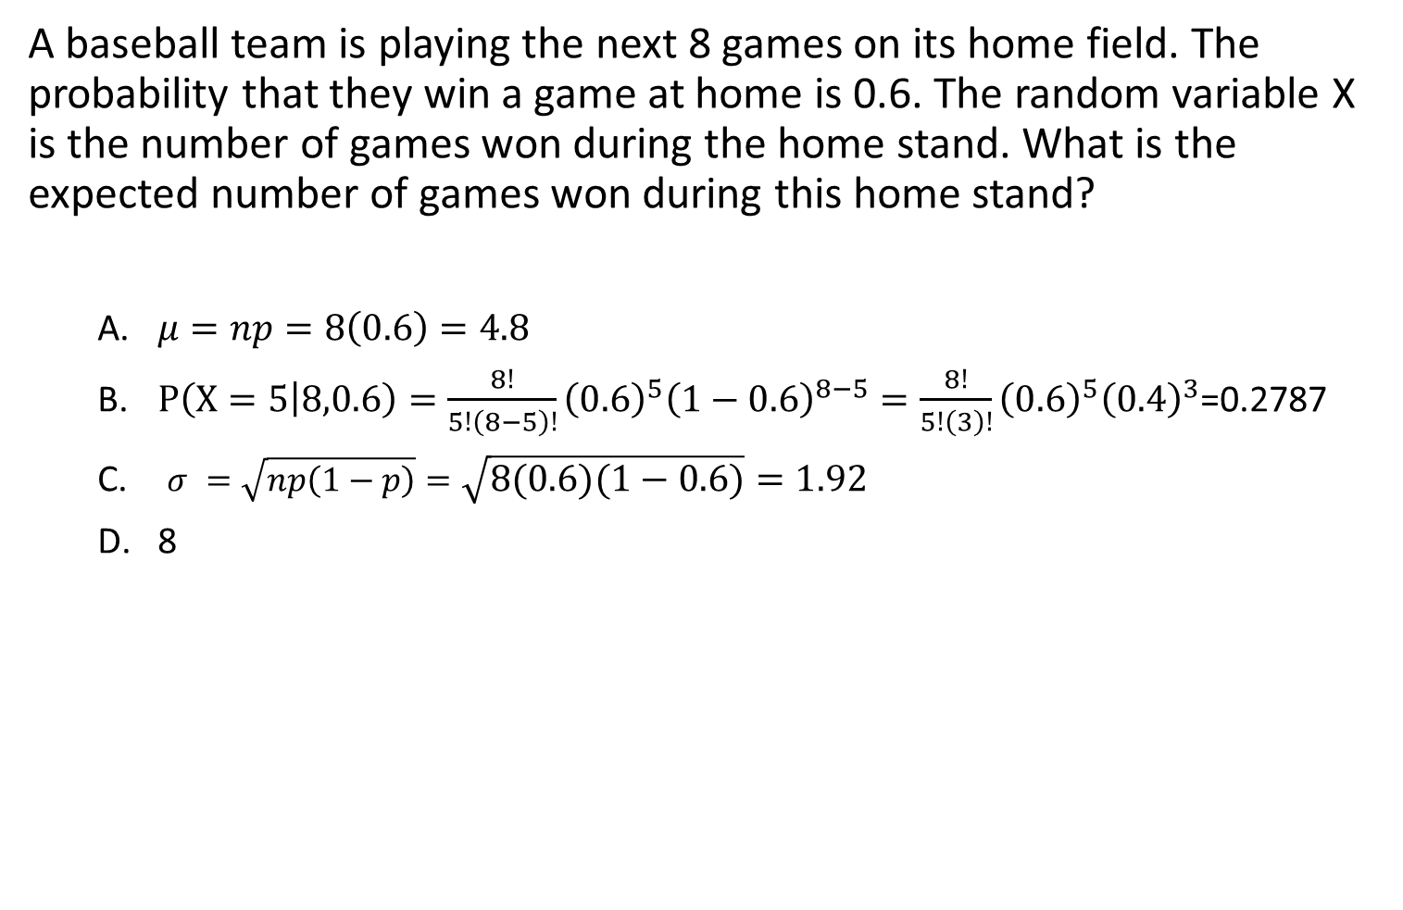
Question:
A baseball team is playing the next 8 games on its home field. The probability that they win a game at home is 0.6. The random variable X is the number of games won during the home stand. What is the expected number of games won during this home stand?
$μ=np=8\left(0.6\right)=4.8$
$P\left(X=5 | 8,0.6\right)=\frac{8!}{5!\left(8−5\right)!}{\left(0.6\right)}^{5}{\left(1−0.6\right)}^{8−5}=\frac{8!}{5!\left(3\right)!}{\left(0.6\right)}^{5}{\left(0.4\right)}^{3}$=0.2787
$σ =\sqrt{np\left(1−p\right)}=\sqrt{8\left(0.6\right)\left(1−0.6\right)}=1.92$
8

