Slide 1
STAT 206:
Chapter 6
Normal Distribution

Slide 2
Ideas in Chapter 6
Normal distribution
  Compute probabilities from the normal distribution
  How to use the normal distribution to solve business problems
  (Maybe) How to use the normal probability plot to determine whether a set of data is approximately normally distributed
Brief look at and discussion of:
  Computing probabilities from the uniform distribution
  Computing probabilities from the exponential distribution
Important to remember:
What is a continuous numeric variable?

Slide 3
6.1 Continuous Probability Distributions
Continuous random variable – can assume any value on a continuum (can assume an uncountable number of values)
  thickness of an item
  time required to complete a task
  temperature of a solution
  height, in inches
These can potentially take on any value depending only on the ability to precisely and accurately measure

Slide 4
6.2 Normal Distribution
Bell Shaped
Symmetrical
Mean, Median and Mode
are Equal
Location is determined by the
standard deviation, σ
The random variable has an
infinite theoretical range
- ∞ to + ∞
Empirical Rule (68%, 95%, 99.7%)
f(X)
σ
X
μ
Mean
= Median
= Mode

Slide 5
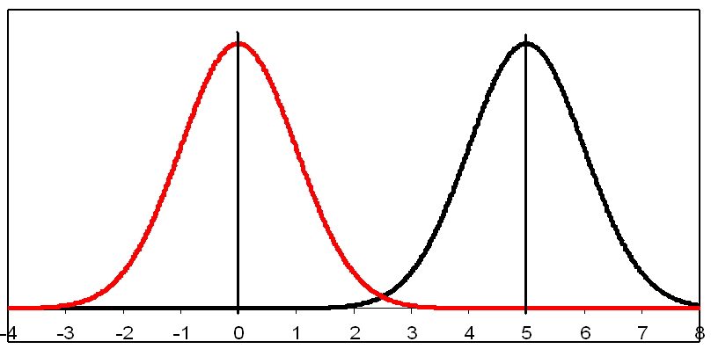
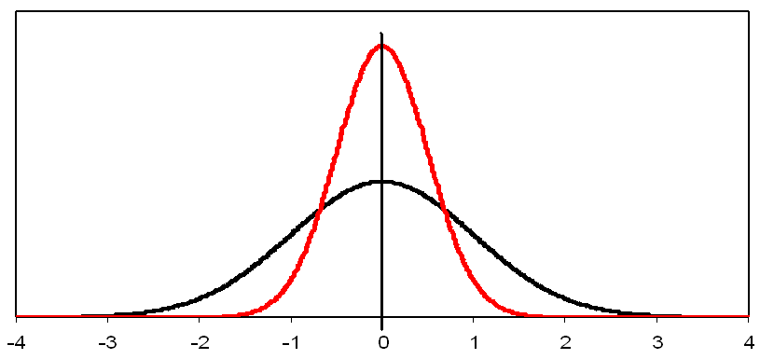
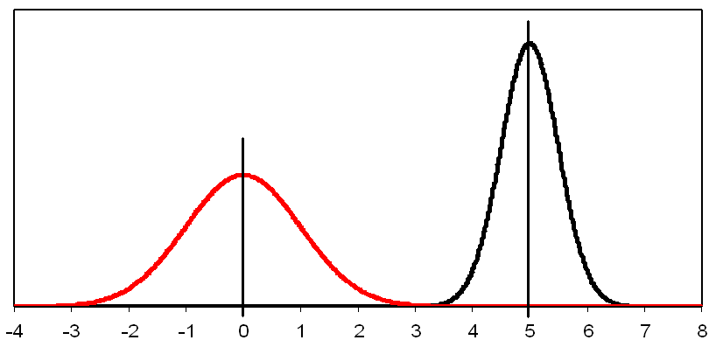
Questions:
Pictured at the right are two different normal distributions. Which is different between the two distributions?
Mean
Standard deviation
Both
Which is different between the two normal distributions to the right?
Mean
Standard deviation
Both
Which is different between the two normal distributions to the right?
Mean
Standard deviation
Both

Slide 6
Normal Probability Density Function
Formula for the normal probability density function is:
Where:
  e = the mathematical constant approximated by 2.71828
  π = the mathematical constant approximated by 3.14159
  μ = the population mean
  σ = the population standard deviation
  X = any value of the continuous variable

Slide 7

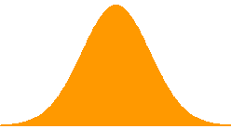
Standard Normal Curve
The standard normal curve is a normal curve with:
  MEAN (µ) = 0,
  VARIANCE (σ²) = 1 and
  STANDARD DEVIATION (σ) = 1
Denoted by N(µ , σ²) = N(0, 1)
When calculate z-score, you are “transforming” your normal curve into a standard normal curve
µ = 16
σ = 2
µ = 0
σ = 1
16
Notice we are using the
POPULATION PARAMETER values μ and σ
0

Slide 8



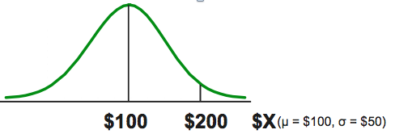
EXAMPLE
If X is distributed normally with mean of $100 and standard deviation of $50 what is the Z value for
x = $200?
This says that x = $200 is 2 standard deviations above the mean of $100

Slide 9
Finding Normal Probabilities
Probability is measured by AREA UNDER THE CURVE
NOTE: PROBABILITY of an individual point is zero
f(X)
P
(
a
≤
X
≤
b
)
=
P
(
a
<
X
<
b
)
a
b
X

Slide 10
Probability under the curve
TOTAL area under any density curve = 1
Normal distribution is symmetric so…
f(X)
0.5
0.5
μ
X

Slide 11
Standardized Normal Table
Cumulative Standardized Normal table in the textbook (Appendix table E.2) gives the probability less than a desired value of Z (i.e., from negative infinity to Z)
EXAMPLE: P(Z < 2.00)
0.9772
0
2.00
Z
Pearson slide (Chapter 6, #16)

Slide 12
The Standardized Normal Table
(continued)
The column gives the value of Z to the second decimal point
Z 0.00 0.01 0.02 …
0.0
0.1
The row shows the value of Z to the first decimal point
.
.
.
The value within the table gives the probability from Z = − ∞ up to the desired Z value
2.0
.9772
P(Z < 2.00) = 0.9772
2.0
Pearson slide (Chapter 6, #17)

Slide 13
(General) Procedures for Finding Normal Probabilities
To find P(a < X < b) when X is distributed normally:
  Draw the normal curve for the problem in terms of X
  Translate X-values to Z-values
  Use the Standardized Normal Table
EXAMPLE: Let X represent the time it takes (in seconds) to download an image file from the internet. Suppose X is normal with a mean, μ = 18.0 seconds and a standard deviation, σ = 5.0 seconds. Find the probability that it takes less than 18.6 seconds to download an image file. That is, find P(X < 18.6).
μ = 18
σ = 5
P(Z < 0.12)
μ = 0
σ = 1
18
18.6
X
P(X < 18.6)
0
0.12
Z

Slide 14
Solution: Finding P(Z < 0.12)
Standardized Normal Probability
Table (Portion)
P(X < 18.6)
= P(Z < 0.12)
Z
.00
.01
.02
0.5478
0.0
.5000
.5040
.5080
0.1
.5398
.5438
.5478
0.2
.5793
.5832
.5871
Z
0.3
.6179
.6217
.6255
0.00
0.12
Pearson slide (Chapter 6, #21)

Slide 15
But what if we want to know P(X ≥ 18.6)?
μ = 18 and σ = 5
X
18.0
18.6
0.5478
1.0 - 0.5478 = 0.4522
1.000
Z
0
0.12
Z
P(X > 18.6) = P(Z > 0.12) = 1.0 - P(Z ≤ 0.12)
= 1.0 - 0.5478 = 0.4522
0
0.12

Slide 16
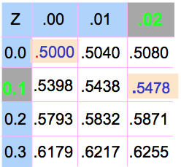
Finding a Normal Probability Between Two Values
Suppose X is normal with mean 18.0 and standard deviation 5.0. Find P(18 < X < 18.6)
Calculate Z-values:
18
18.6
X
0
0.12
Z
P(18 < X < 18.6)
= P(0 < Z < 0.12)
= P(Z < 0.12) – P(Z ≤ 0)
= 0.5478 - 0.5000
= 0.0478

Slide 17
Probabilities in the Lower Tail
Suppose X is normal with μ = 18 and σ = 5
Find P(17.4 < X < 18)
Calculate Z-scores
X
18.0
P(17.4 < X < 18)
= P(-0.12 < Z < 0)
= P(Z < 0) – P(Z ≤ -0.12)
= 0.5000 - 0.4522 = 0.0478
17.4
0.0478
0.4522
The Normal distribution is symmetric, so this probability is the same as P(0 < Z < 0.12)
17.4
18.0
X
-0.12
0
Z

Slide 18
Empirical Rule
What can we say about the distribution of values around the mean? For any normal distribution:
f(X)
μ ± 1σ encloses about 68% of X’s
σ
σ
X
μ-1σ
μ
μ+1σ
68%
Pearson slide (Chapter 6, #28)

Slide 19
Empirical Rule
(continued)
μ ± 2σ covers about 95% of X’s
μ ± 3σ covers about 99.7% of X’s
2σ
2σ
3σ
3σ
μ
x
μ
x
95%
99.7%
Pearson slide (Chapter 6, #29)

Slide 20
What if you are given a Normal Probability, and you need to find x?
(multiply both sides by σ)
➔ Z (σ) = (x – μ) (add μ to both sides)
➔ Zσ + μ = x ➔ x = μ + Zσ
Steps to find the X value for a known probability:
1. Find the Z value for the known probability
2. Convert to X units using the formula:
x = μ + Zσ

Slide 21
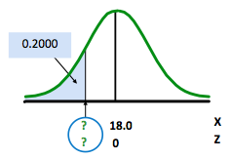
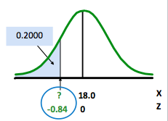
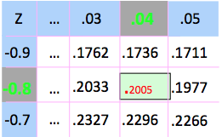
EXAMPLE
Let X represent the time it takes (in seconds) to download an image file from the internet. Suppose X is normal with mean 18.0 and standard deviation 5.0. Find X such that 20% of download times are less than X.
20% (0.2000) area in the lower tail is
consistent with a Z value of -0.84
Find the Z value for the known
probability
  Convert to X units using the formula x = μ + Zσ
    x = μ + Zσ = 18.0 + (-0.84)(5.0) = 18.0 – 4.2 = 13.8
  So 20% of the values from a distribution with mean 18.0 and standard deviation 5.0 are less than 13.80 seconds

Slide 22
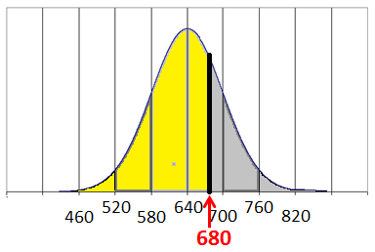
Question:
Example: The average college student produces 640 pounds of solid waste each year. (source: www.dumpandrun.org/garbage.htm ) Assume the distribution of waste per college student is approximately normal with a mean of 640 pounds and a standard deviation of 60 pounds. If the z-score for 680 pounds of garbage per year is z=0.67, (using table E2) what is the probability that a college student produces less than 680 pounds of garbage each year?
  P(Z>0.67) = 0.2514
  P(Z<0.67) = 0.7486
  P(Z=0.67) = 67%
0.7486
X
0 0.67 Z
22

Slide 23
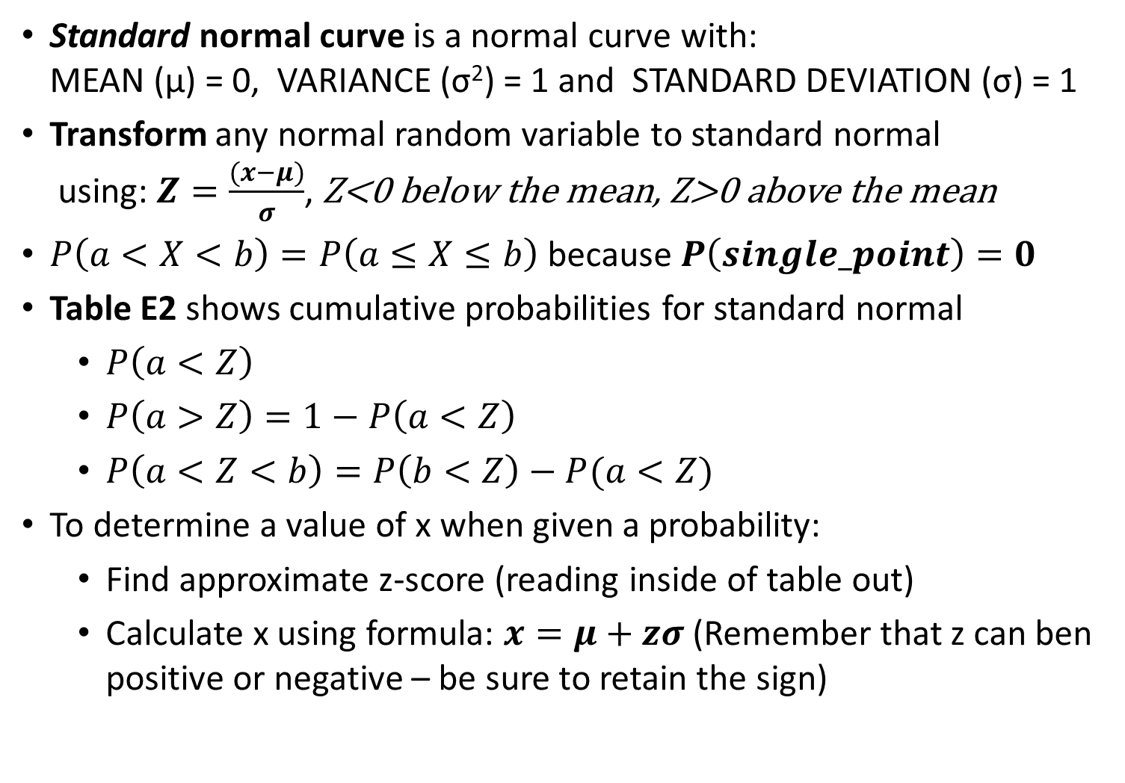
Review:
Standard normal curve is a normal curve with:
MEAN (µ) = 0, VARIANCE (σ²) = 1 and STANDARD DEVIATION (σ) = 1
Transform any normal random variable to standard normal
using: $Z=\frac{(x−μ)}{σ}$, Z<0 below the mean, Z>0 above the mean
$P\left(a<X<b\right)=P\left(a≤X≤b\right)$ because $P\left(single_point\right)=0$
Table E2 shows cumulative probabilities for standard normal
  $P\left(a<Z\right)$
  $P\left(a>Z\right)=1−P\left(a<Z\right)$
  $P\left(a<Z<b\right)=P\left(b<Z\right)−P(a<Z)$
To determine a value of x when given a probability:
  Find approximate z-score (reading inside of table out)
  Calculate x using formula: $x=μ+zσ$ (Remember that z can ben positive or negative – be sure to retain the sign)

Slide 24
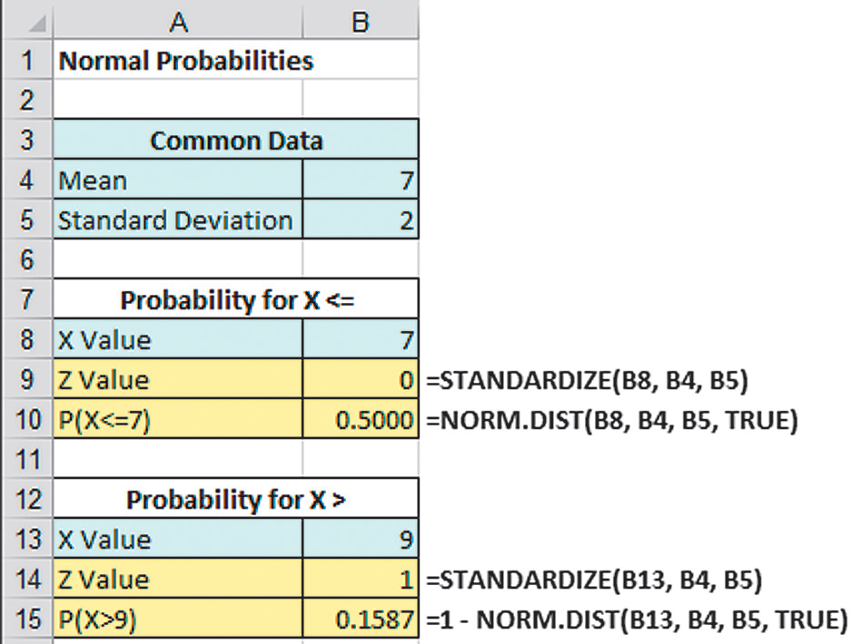
Excel Can Be Used To Find Normal Probabilities
Find P(X < 9) where X is normal with a mean of 7 and standard deviation of 2
x
µ
σ
x
µ
σ

Slide 25
6.3 Evaluating Normality
Not all continuous distributions are normal
➔ important to evaluate how well data are approximated by a normal distribution
Normally distributed data should approximate the theoretical normal distribution:
  Bell-shaped (symmetrical) where the mean is equal to the median
  Empirical rule applies
  Interquartile range ~ 1.33 standard deviations

Slide 26
Comparing data characteristics to theoretical properties
Construct charts or graphs
  For small- or moderate-sized data sets, construct
  stem-and-leaf or boxplot to check for symmetry
  For large data sets, does the histogram or polygon appear bell-shaped?
Compute descriptive summary measures
  Do the mean, median and mode have similar values?
  Is the interquartile range approximately 1.33σ?
  Is the range approximately 6σ?
Observe the distribution of the data set
  Do approximately 2/3 of the observations lie within mean ±1 standard deviation?
  Do approximately 80% of the observations lie within mean ±1.28 standard deviations?
  Do approximately 95% of the observations lie within mean ±2 standard deviations?

Slide 27
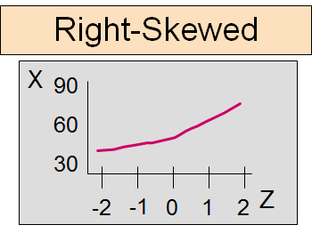
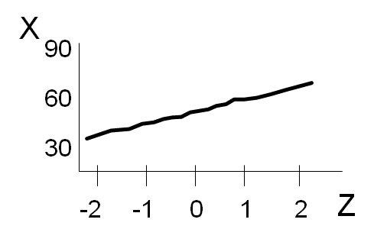
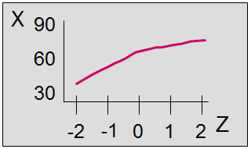
Comparing data characteristics to theoretical properties
Evaluate normal probability plot
  Quantile-Quantile plot (Q-Q) plot
  Is the normal probability plot approximately linear (i.e., a straight line) with positive slope?
Approx. Normal
Left-Skewed
See Figure 6.19, page 235 in the Berenson book for better pictures.

Slide 28
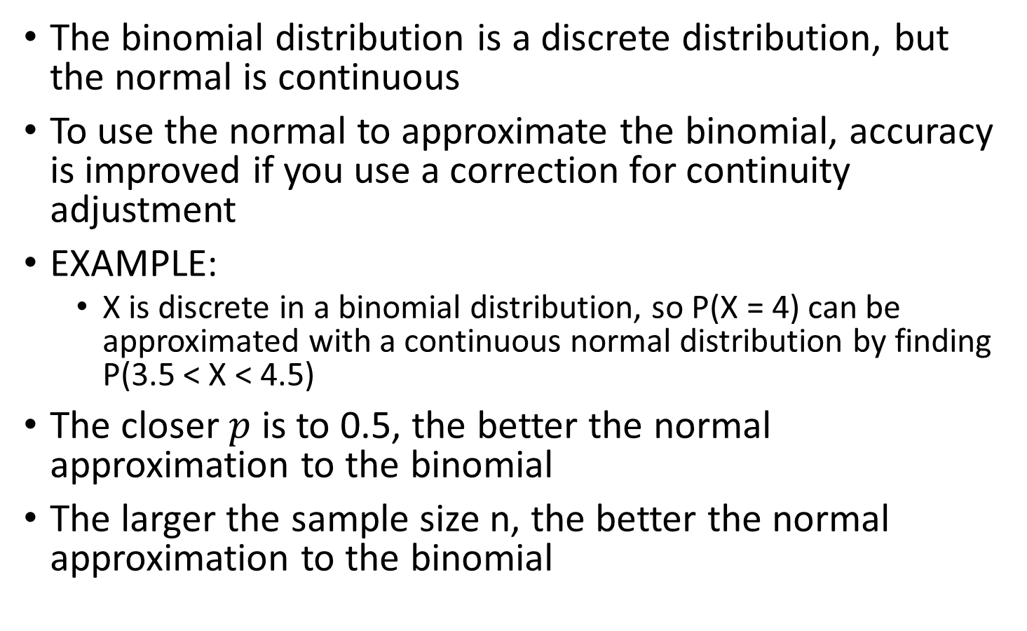
6.6 Normal Approximation to Binomial
The binomial distribution is a discrete distribution, but the normal is continuous
To use the normal to approximate the binomial, accuracy is improved if you use a correction for continuity adjustment
EXAMPLE:
  X is discrete in a binomial distribution, so P(X = 4) can be approximated with a continuous normal distribution by finding P(3.5 < X < 4.5)
The closer $p$ is to 0.5, the better the normal approximation to the binomial
The larger the sample size n, the better the normal approximation to the binomial

Slide 29
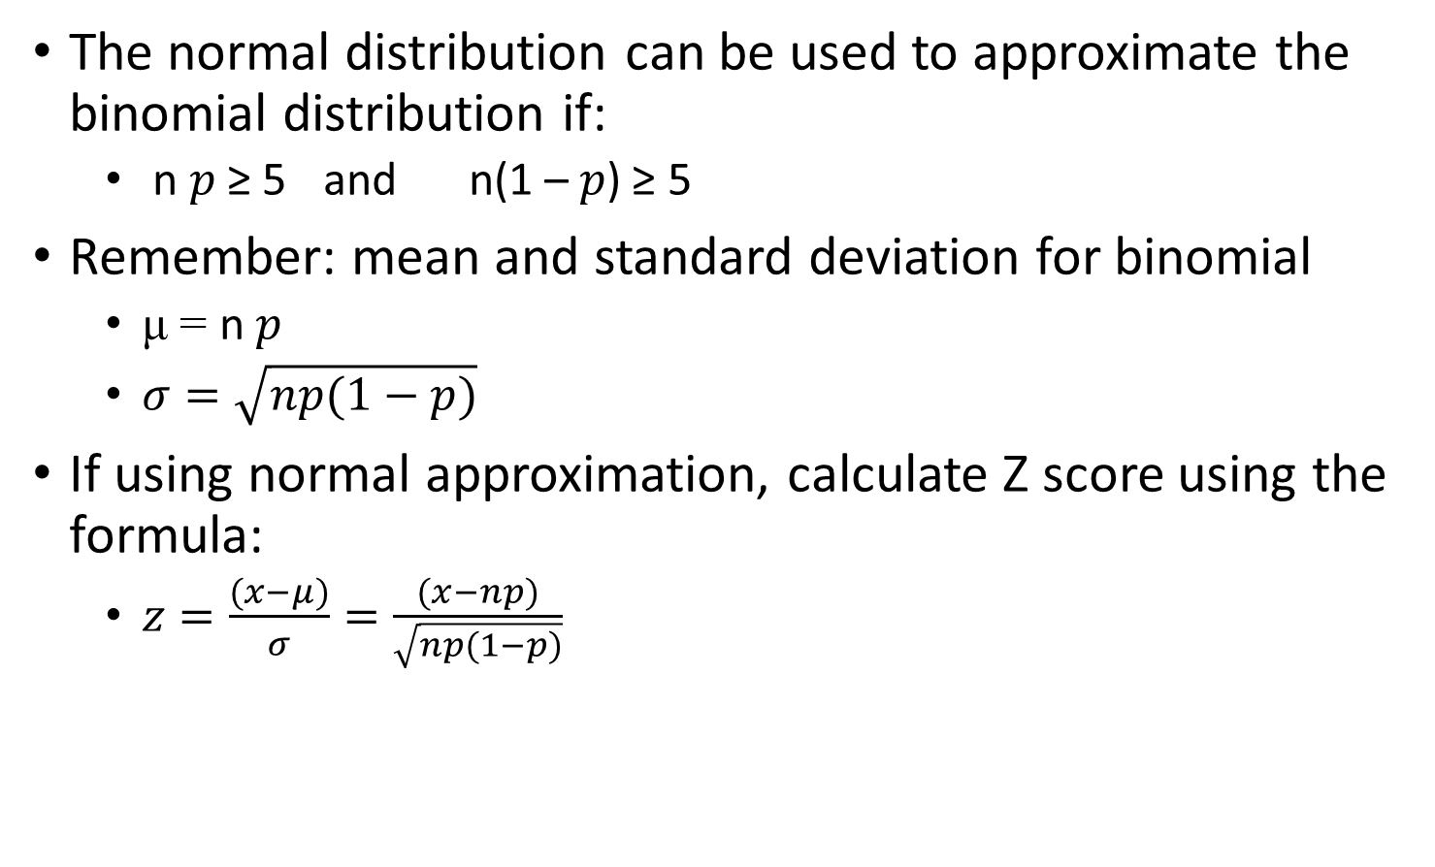
General Rule
The normal distribution can be used to approximate the binomial distribution if:
  n $p$ ≥ 5 and n(1 – $p$) ≥ 5
Remember: mean and standard deviation for binomial
  μ = n $p$
  $σ=\sqrt{np(1−p)}$
If using normal approximation, calculate Z score using the formula:
  $z=\frac{(x−μ)}{σ}=\frac{(x−np)}{\sqrt{np(1−p)}}$

Slide 30
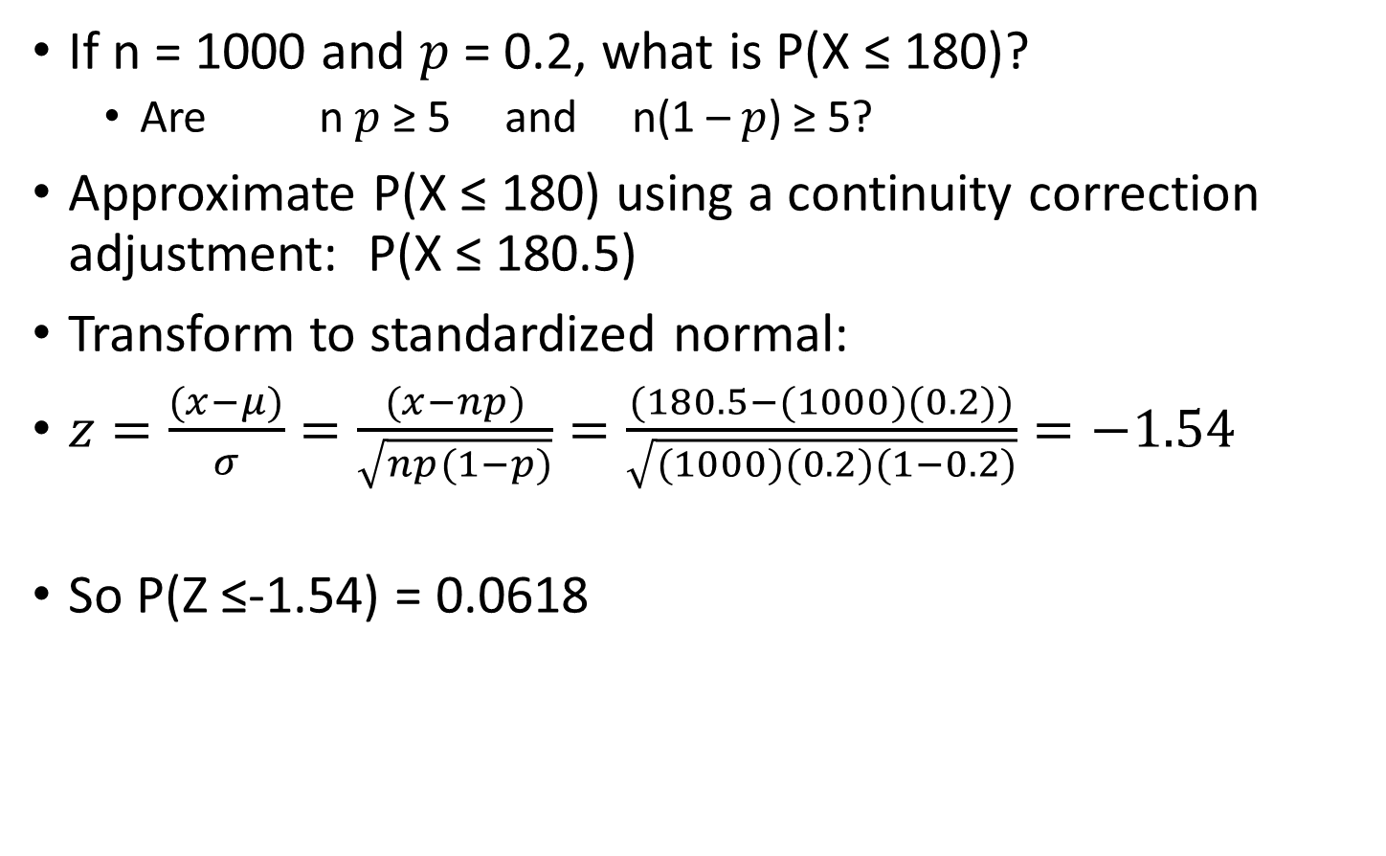
EXAMPLE
If n = 1000 and $p$ = 0.2, what is P(X ≤ 180)?
  Are n $p$ ≥ 5 and n(1 – $p$) ≥ 5?
Approximate P(X ≤ 180) using a continuity correction adjustment: P(X ≤ 180.5)
Transform to standardized normal:
$z=\frac{(x−μ)}{σ}=\frac{(x−np)}{\sqrt{np(1−p)}}=\frac{(180.5−(1000)(0.2))}{\sqrt{(1000)(0.2)(1−0.2)}}=−1.54$
So P(Z ≤-1.54) = 0.0618
180.5
200
X
-1.54
0
Z

Slide 31
Question:
Example: As player salaries have increased, the cost of attending baseball games has increased dramatically. The following data characteristics were found by collecting data for the cost of 4 tickets, two beers, 4 soft drinks, 4 hot dogs, 2 game programs, 2 baseball caps, and the parking fee for one car for each of the 30 Major League Baseball teams in 2012. Using the data characteristics, do the data appear to be normally distributed?
  Mean ≠ Median and
  Range < 6*std deviation
  ➔ probably normally distributed
  Mean ≠ Median and
  Range < 6*std deviation
  ➔ probably NOT normally distributed
31

Slide 32
Normal Probability Plot from Question:
According to the normal probability plot, the data appear to be right skewed. That is, the plot is slightly convex.

Slide 33
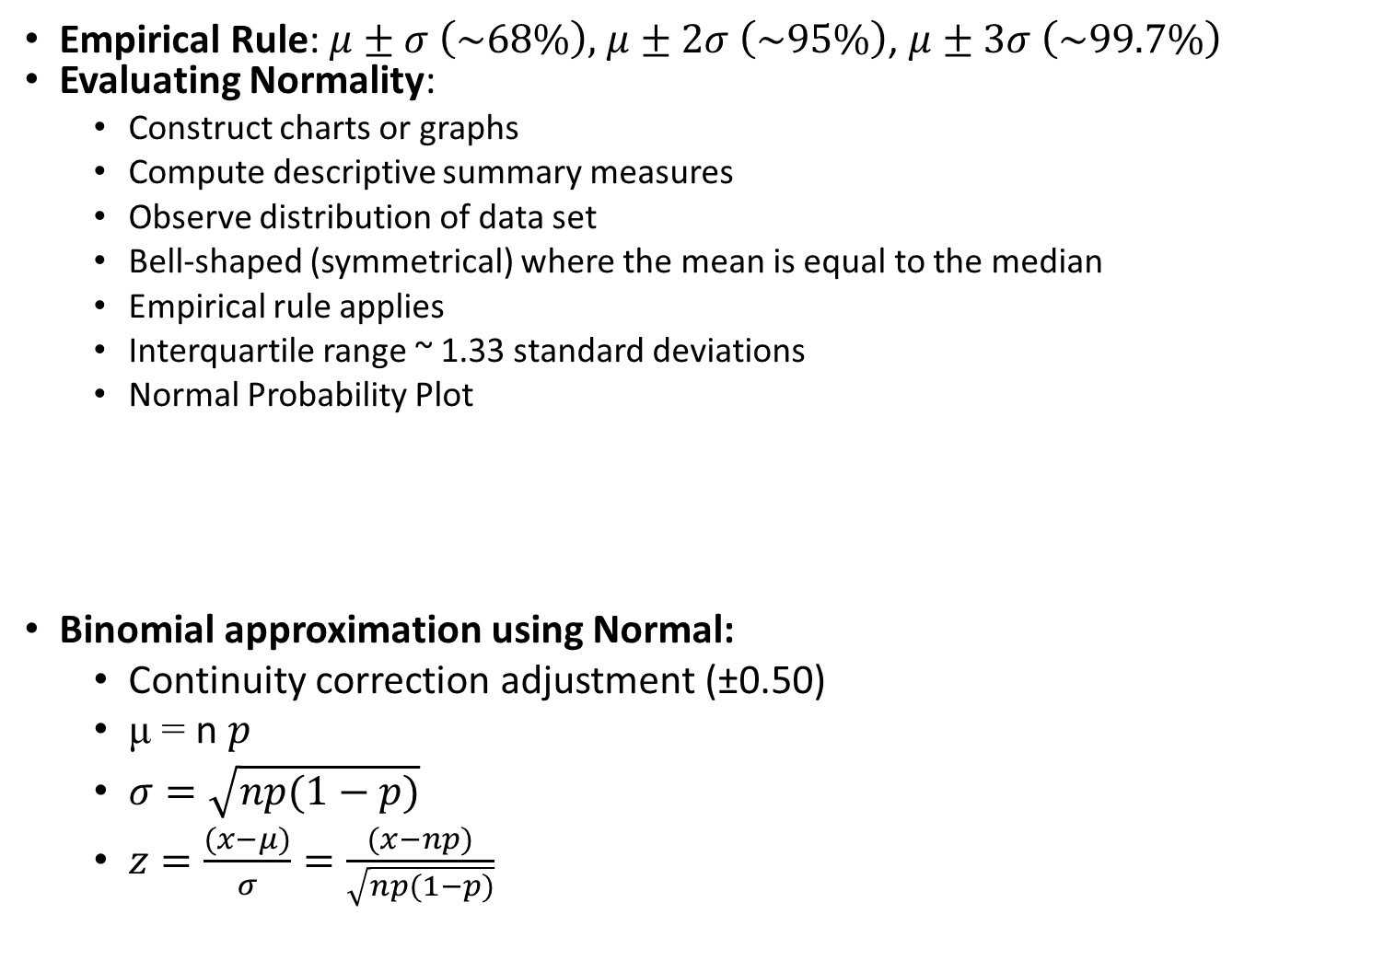
Review:
Empirical Rule: $μ±σ \left(\sim 68\%\right),$ $μ±2σ \left(\sim 95\%\right)$, $μ±3σ \left(\sim 99.7\%\right)$
Evaluating Normality:
  Construct charts or graphs
  Compute descriptive summary measures
  Observe distribution of data set
  Bell-shaped (symmetrical) where the mean is equal to the median
  Empirical rule applies
  Interquartile range ~ 1.33 standard deviations
  Normal Probability Plot
Binomial approximation using Normal:
  Continuity correction adjustment (±0.50)
  μ = n $p$
  $σ=\sqrt{np(1−p)}$
  $z=\frac{(x−μ)}{σ}=\frac{(x−np)}{\sqrt{np(1−p)}}$

