Slide 1
STAT 206:
Chapter 7
Sampling Distributions

Slide 2
Ideas in Chapter 7
The concept of the sampling distribution
To compute probabilities related to the sample mean and the sample proportion
The importance of the Central Limit Theorem
Remember a previous question?

Slide 3
7.1 Sampling Distributions
SAMPLING DISTRIBUTION is a distribution of all of the possible values of a sample statistic for a given sample size selected from a population
EXAMPLE: Cereal plant Operations Manager (OM) monitors the amount of cereal in each box. Main plant fills thousands of boxes of cereal during each shift. Speed of process produces variability. Average weight must be 368 grams of cereal. To maintain quality control, does OM take just ONE sample?
  No… Takes many samples!
  How many different sample means would the OM have?
  How are the sample mean values distributed?
EXAMPLE: Suppose you sample 50 students from USC regarding their mean GPA. If you obtained many different samples of size 50, you will compute a different mean for each sample.
We are interested in the distribution of all potential means for a particular sample size (n is the same for each sample)

Slide 4
Developing a Sampling Distribution
Assume there is a population …
  Population size N=4
  Random variable, X,
  is age of individuals
  Values of X:
  18, 20, 22, 24 (years)
D
A
B
C
P(x)
.3
.2
.1
18 20 22 24
A B C D
Pearson slide (Chapter 7, slides 4-5)
0
x

Slide 5
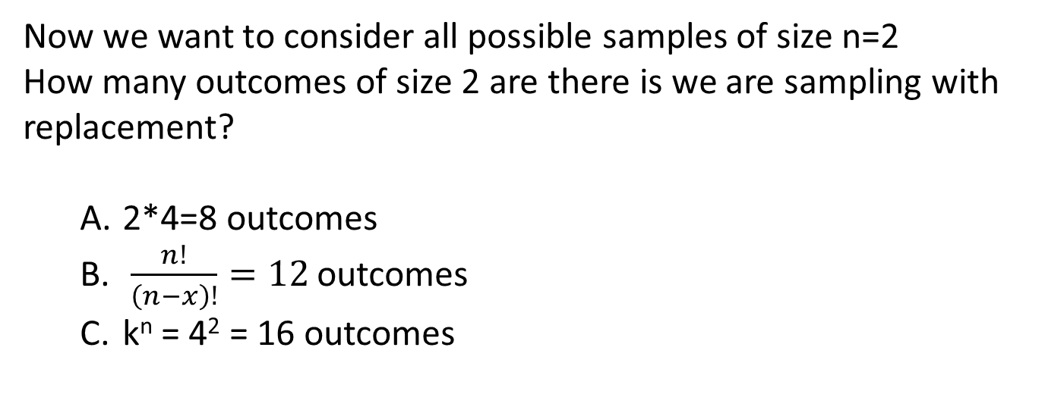
Developing a Sampling Distribution
Now we want to consider all possible samples of size n=2
How many outcomes of size 2 are there is we are sampling with replacement?
  2*4=8 outcomes
  $\frac{n!}{\left(n−x\right)!}=12$ outcomes
  k^{n} = 4² = 16 outcomes
v

Slide 6
Now consider all possible samples of size n=2
Developing a Sampling Distribution
16 Sample Means
Counting Rule 1: k^{n} = 4² = 16 outcomes
1st Obs | 2nd Observation
 | 18 | 20 | 22 | 24
18 | 18,18 | 18,20 | 18,22 | 18,24
20 | 20,18 | 20,20 | 20,22 | 20,24
22 | 22,18 | 22,20 | 22,22 | 22,24
24 | 24,18 | 24,20 | 24,22 | 24,24
Sample Means Distribution
_
P(X)
16 possible samples (sampling with replacement)
.3
.2
.1
0
_
Pearson slide (Chapter 7, slides 6-7)
18 19 20 21 22 23 24
X
(no longer uniform)

Slide 7





Summary Measures of this Sampling Distribution:
Developing A Sampling Distribution
Note: Here we divide by 16 because there are 16 different samples
(i.e. population) of n=2
Population, N = 4
Sample Means Distribution, n = 2
P(X)
P(x)
.3
.3
.2
.2
.1
.1
0
0
_
18 20 22 24
A B C D
x
18 19 20 21 22 23 24
X
Pearson slide (Chapter 7, slides 8-9)

Slide 8
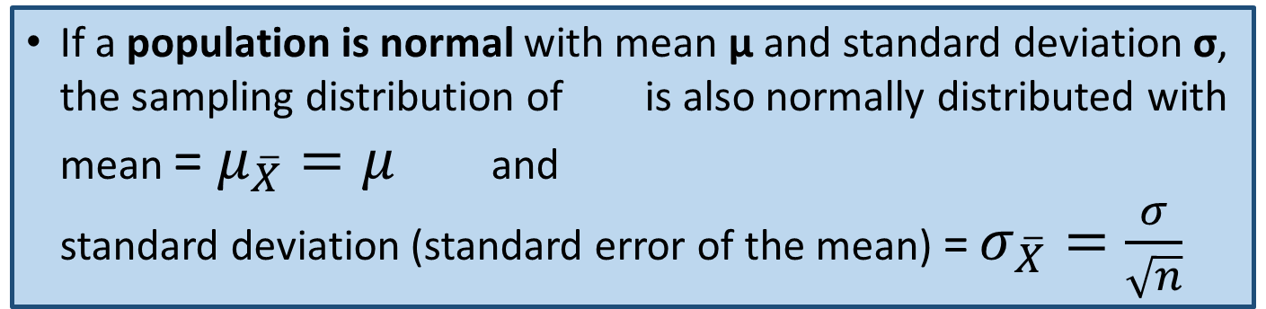
7.2 Sampling Distributions of the Mean
SAMPLING DISTRIBUTION is a distribution of all of the possible values of a sample statistic for a given sample size selected from a population. We’re going to look at the statistic – SAMPLE MEAN
Different samples of the SAME SIZE from the SAME POPULATION will yield different SAMPLE MEANS (that is, there is sampling error due to chance involved in choosing the different samples)
Mean of all possible sample means (same sample size=n) is μ, which is the population mean (that is, )
Since we have sampling error for our many calculated means, we are able to calculate the standard deviation of the sample means, called STANDARD ERROR OF THE MEAN
If a population is normal with mean μ and standard deviation σ, the sampling distribution of is also normally distributed with mean = $μ_{\overline{X}}=μ$ and
standard deviation (standard error of the mean) = $σ_{\overline{X}}=\frac{σ}{\sqrt{n}}$

Slide 9
Z-value for Sampling Distribution of the Mean
Pearson slide (Chapter 7, slides 12-13)
Z-value for the sampling distribution of :
where: = sample mean
= population mean
= population standard deviation
n = sample size
(i.e. is unbiased )
Normal Sampling Distribution
(has the same mean)
Normal Population Distribution

Slide 10
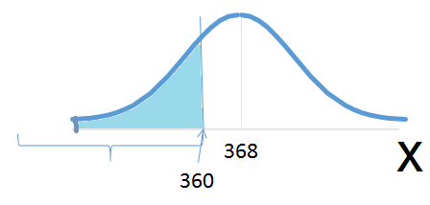
EXAMPLE:
Cereal plant Operations Manager (OM) monitors the amount of cereal in each box. Amount of cereal in boxes (X) is approximately normal with mean = 368 grams and standard deviation = 15.
What is the probability that a randomly chosen box contains less than 360 grams of cereal?
What do we know?
~ normal
μ = 368
σ = 15
x = 360
368
360
What is the value of Z for x= 360 grams of cereal?
  z=-1.00
P(Z<–0.53)=0.2981

Slide 11
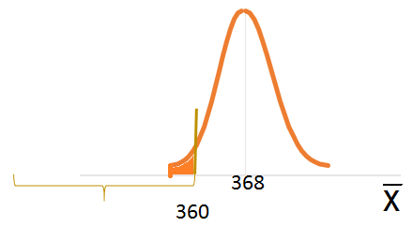
EXAMPLE:
Cereal plant Operations Manager (OM) monitors the amount of cereal in each box. Amount of cereal in boxes (X) is approximately normal with mean = 368 grams and standard deviation = 15.
What is the probability that a random sample of size 25 has a mean of less than 360 grams of cereal?
What do we know?
~ normal
Sample with n=25
368
360
P(Z<–2.67)=0.0038

Slide 12
Question:
Cereal plant Operations Manager (OM) monitors the amount of cereal in each box. Amount of cereal in boxes (X) is approximately normal with mean = 368 grams and standard deviation = 15. The OM is interested in determining whether a random sample of size 25 has a mean of less than 360 grams of cereal.
What is the standard error of the mean?

Slide 13
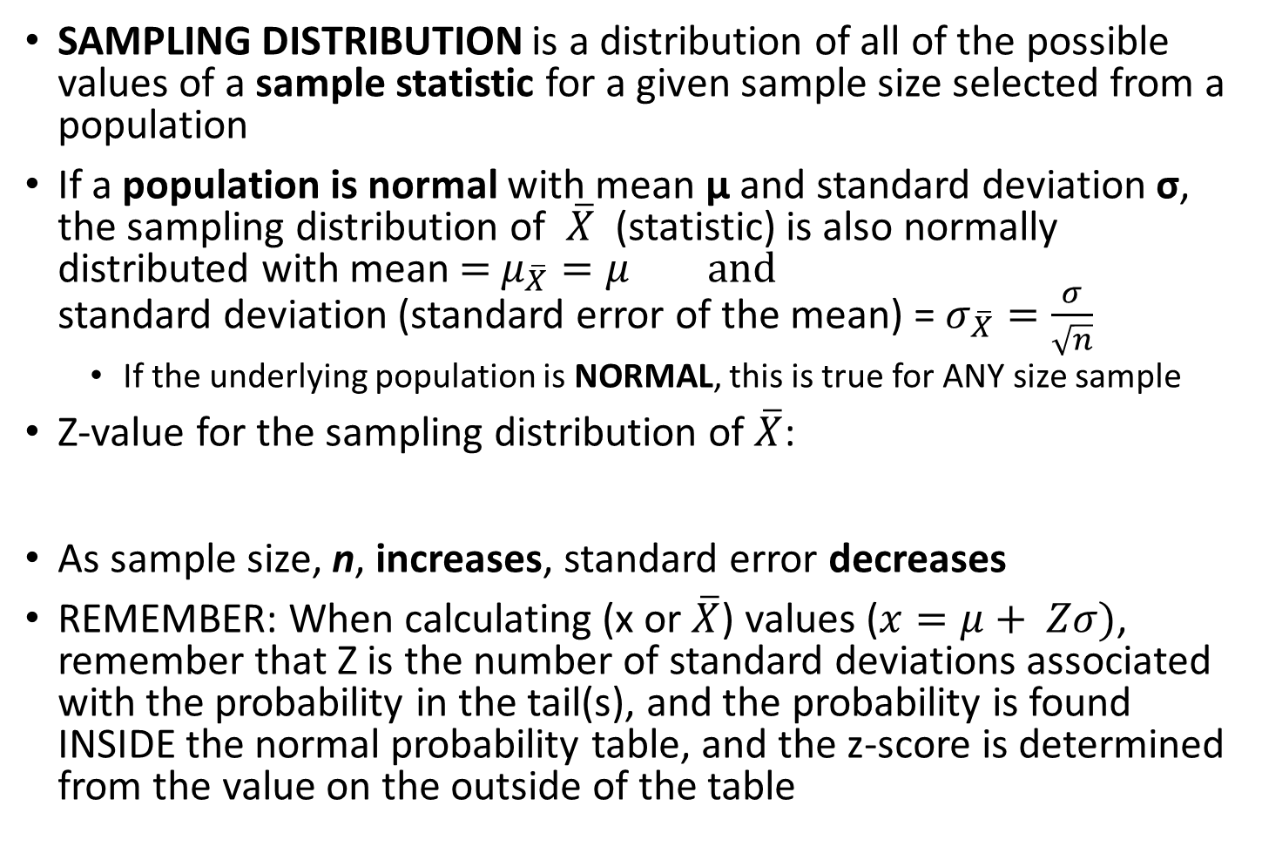
Review:
SAMPLING DISTRIBUTION is a distribution of all of the possible values of a sample statistic for a given sample size selected from a population
If a population is normal with mean μ and standard deviation σ, the sampling distribution of $\overline{X}$ (statistic) is also normally distributed with mean = $μ_{\overline{X}}=μ$ and
standard deviation (standard error of the mean) = $σ_{\overline{X}}=\frac{σ}{\sqrt{n}}$
  If the underlying population is NORMAL, this is true for ANY size sample
Z-value for the sampling distribution of $\overline{X}$:
As sample size, n, increases, standard error decreases
REMEMBER: When calculating (x or $\overline{X}$) values ($x=μ+ Zσ)$, remember that Z is the number of standard deviations associated with the probability in the tail(s), and the probability is found INSIDE the normal probability table, and the z-score is determined from the value on the outside of the table

Slide 14
Sampling Distribution Properties
  As n increases,
  decreases
Larger sample size
Smaller sample size
Pearson slide (Chapter 7, slides 14)

Slide 15
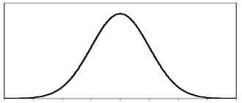
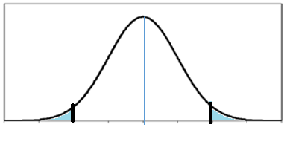

Interval Including A Fixed Proportion of the Sample Means?
For the distribution with
find interval (symmetrically) around µ that will include 95% of the sample means.
From the standardized normal table, the Z score with 2.5% (0.0250) below it is -1.96 and the Z score with 2.5% (0.0250) above it is 1.96
$$\frac{0.05}{2}=0.025$$
0.95
359
362
365
368
371
374
377
0.05
-1.96
1.96
95% of all sample means of sample size 25 are between 362.12 and 373.88

Slide 16
But what if our population is NOT normal?
CENTRAL LIMIT THEOREM!
Even if the population is not normal,
…sample means from the population will be approximately normal as long as the sample size is large enough
Properties:

Slide 17
Central Limit Theorem
the sampling distribution of the sample mean becomes almost normal regardless of shape of population
As the sample size gets large enough…
n↑
Pearson slide (Chapter 7, slides 18)

Slide 18
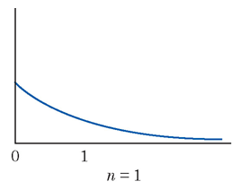
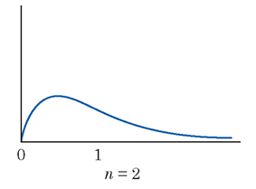
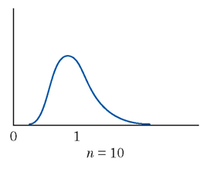
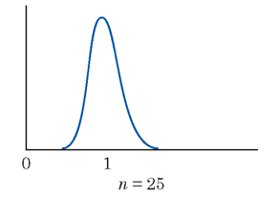
The Sampling Distribution of a Sample Mean
A remarkable statistical fact, called the central limit theorem, says that as we take more and more observations at random from any population, the distribution of the mean of these observations eventually gets close to a Normal distribution.
Concepts and Controversies slide (Chapter 21, slide 21)

Slide 19
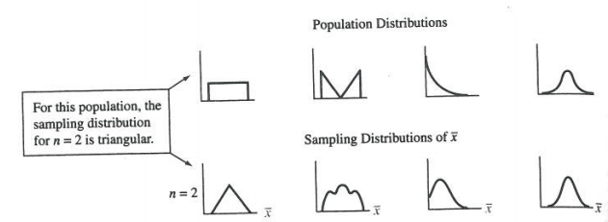

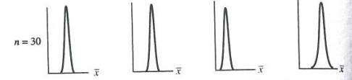
Show overhead from Agresti and Franklin, Statistics: The Art and Science of Learning from Data, 3rd edition, p. 322

Slide 20
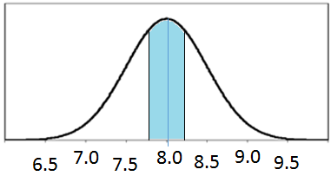
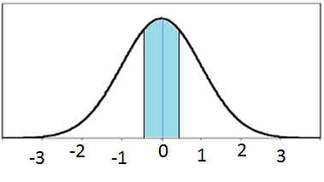
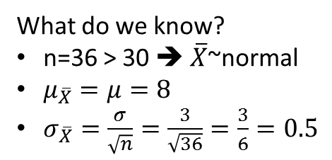
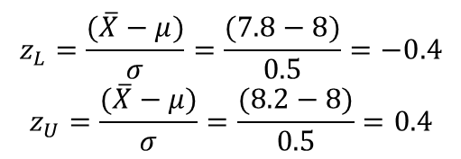
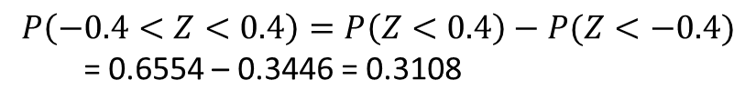
How large is “large enough”?
For most distributions, n > 30 will give a sampling distribution that is nearly normal
For fairly symmetric distributions, n > 15
For a normal population distribution, the sampling distribution of the mean is always normally distributed
EXAMPLE: Suppose a population has mean μ = 8 and standard deviation σ = 3. Suppose a random sample of size n = 36 is selected. What is the probability that the sample mean is between 7.8 and 8.2?
What do we know?
n=36 > 30 ➔ $\overline{X}$~normal
$μ_{\overline{X}}=μ=8$
$σ_{\overline{X}}=\frac{σ}{\sqrt{n}}=\frac{3}{\sqrt{36}}=\frac{3}{6}=0.5$
6.5
7.0
7.5
8.0
8.5
9.0
9.5
$$z_{L}=\frac{(\overline{X}−μ)}{σ}=\frac{(7.8−8)}{0.5}=−0.4$$
$$z_{U}=\frac{(\overline{X}−μ)}{σ}=\frac{(8.2−8)}{0.5}=0.4$$
7.8
8.2
-0.4
0.4
$$P\left(−0.4<Z<0.4\right)=P\left(Z<0.4\right)−P(Z<−0.4)$$
= 0.6554 – 0.3446 = 0.3108

Slide 21


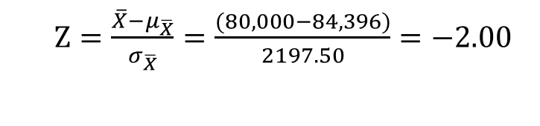
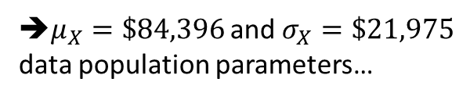
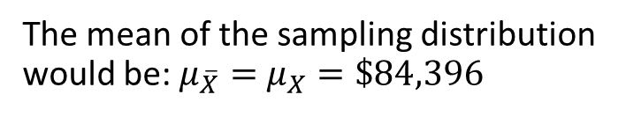
Example:
Physicians’ assistants The 2006 AAPA survey of the population of physicians’ assistants who were working full time reported a mean annual income of $84,396 and standard deviation of $21,975. (Source: Data from 2006 AAPA survey [ www.aapa.org])
Suppose the AAPA had randomly sampled 100 physicians’ assistants instead of collecting data for all of them. Describe the mean, standard deviation, and shape of the sampling distribution of the sample mean.
What do we know?
  n=100
  Salary ➔ quantitative
  ➔ mean and standard deviation
➔$μ_{X}=\$84,396$ and $σ_{X}=\$21,975$
data population parameters…
The mean of the sampling distribution would be: $μ_{\overline{X}}=$ $μ_{X}=\$84,396$
The standard error would be:
The sampling distribution would have a bell shape because the sample size is greater than 30.
Using this sampling distribution, find the z-score for a sample mean of $80,000.
$\overline{X}$ = $80,000 and $Z=\frac{\overline{X}−μ_{\overline{X}}}{σ_{\overline{X}}}$
$Z=\frac{\overline{X}−μ_{\overline{X}}}{σ_{\overline{X}}}=\frac{(80,000−84,396)}{2197.50}=−2.00$

Slide 22
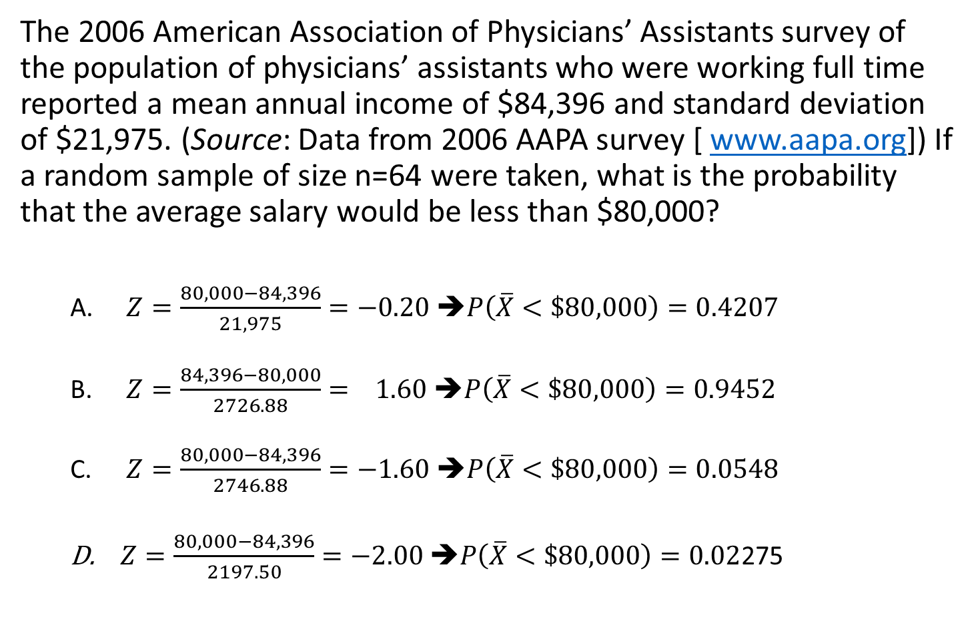
Question:
The 2006 American Association of Physicians’ Assistants survey of the population of physicians’ assistants who were working full time reported a mean annual income of $84,396 and standard deviation of $21,975. (Source: Data from 2006 AAPA survey [ www.aapa.org]) If a random sample of size n=64 were taken, what is the probability that the average salary would be less than $80,000?
  $Z=\frac{80,000−84,396}{21,975}=−0.20$ ➔$P\left(\overline{X}<\$80,000\right)=0.4207$
  $Z=\frac{84,396−80,000}{2726.88}= 1.60$ ➔$P\left(\overline{X}<\$80,000\right)=0.9452$
  $Z=\frac{80,000−84,396}{2746.88}=−1.60$ ➔$P\left(\overline{X}<\$80,000\right)=0.0548$
  $Z=\frac{80,000−84,396}{2197.50}=−2.00$ ➔$P\left(\overline{X}<\$80,000\right)=0.02$275

Slide 23
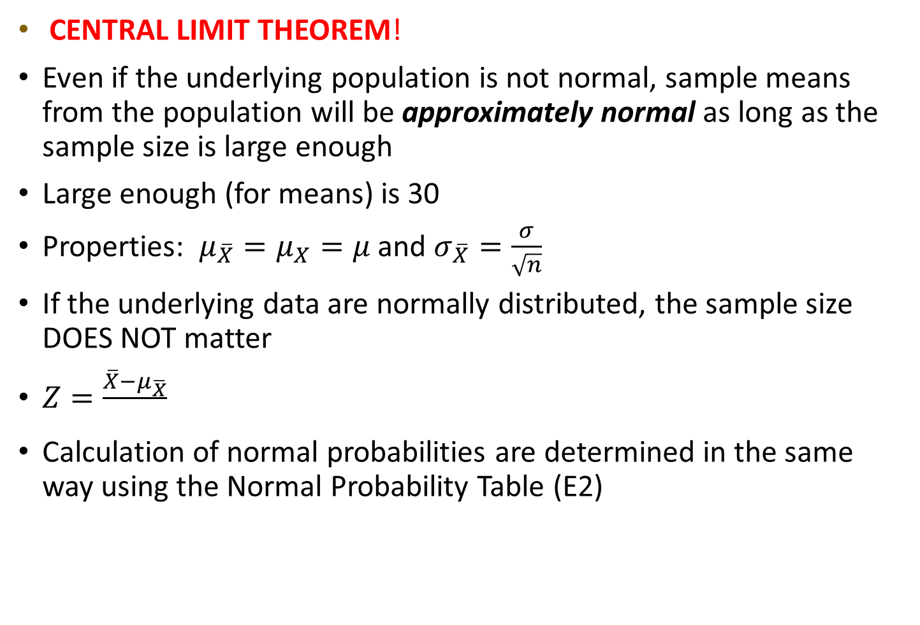
Review:
CENTRAL LIMIT THEOREM!
Even if the underlying population is not normal, sample means from the population will be approximately normal as long as the sample size is large enough
Large enough (for means) is 30
Properties: $μ_{\overline{X}}=μ_{X}=μ$ and $σ_{\overline{X}}=\frac{σ}{\sqrt{n}}$
If the underlying data are normally distributed, the sample size DOES NOT matter
$Z=\frac{\overline{X}−μ_{\overline{X}}}{}$
Calculation of normal probabilities are determined in the same way using the Normal Probability Table (E2)

Slide 24
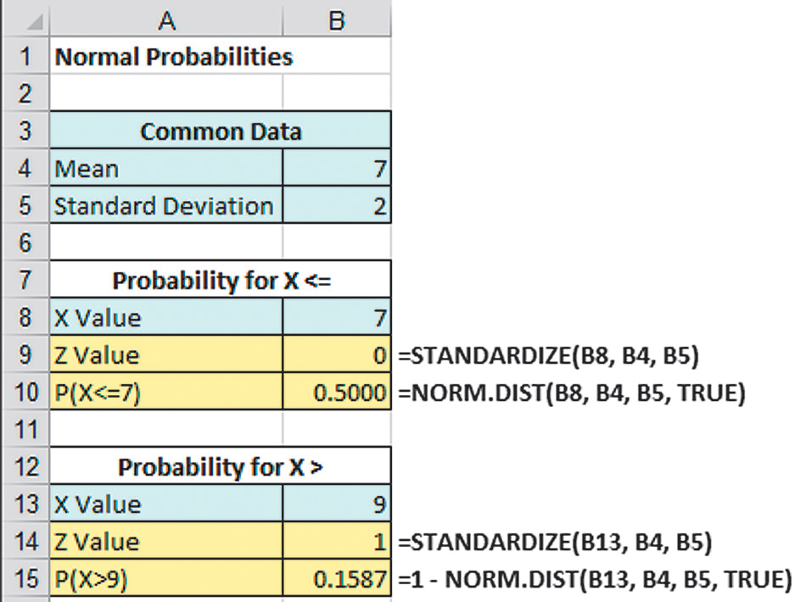
Excel Can Be Used To Find Normal Probabilities
REMINDER:
Find P(X < 9) where X is normal with a mean of 7 and standard deviation of 2
x
µ
σ
x
µ
σ

Slide 25
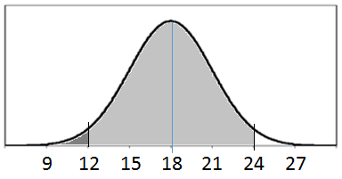

Textbook example:
7.38 Physicians’ assistants The 2006 AAPA survey of the population of physicians’ assistants who were working full time reported a mean annual income of $84,396 and standard deviation of $21,975. (Source: Data from 2006 AAPA survey [ www.aapa.org])
Using parts a and b, find the probability that the sample mean would fall within approximately $4000 of the population mean.
What is the probability that the sample average salary is less than $80,396?
($84,396-4000 , 84,396+4,000)
($80,396 , $88,396)
± z = ±(x ± µ)/σ
± 4000/2197.5 = ± 1.82
➔ P(-1.82 ≤ z ≤ 1.82)
= P(z ≤ 1.82) – P(z ≤ -1.82)
= 0.9656 – 0.0344
= 0.9312
$$\frac{0.0688}{2}=0.0344$$
0.9312
P(x<$80,396) = P(z<-1.82)=0.0344
-1.82
1.82
1.0000 - 0.9312 = 0.0688

Slide 26
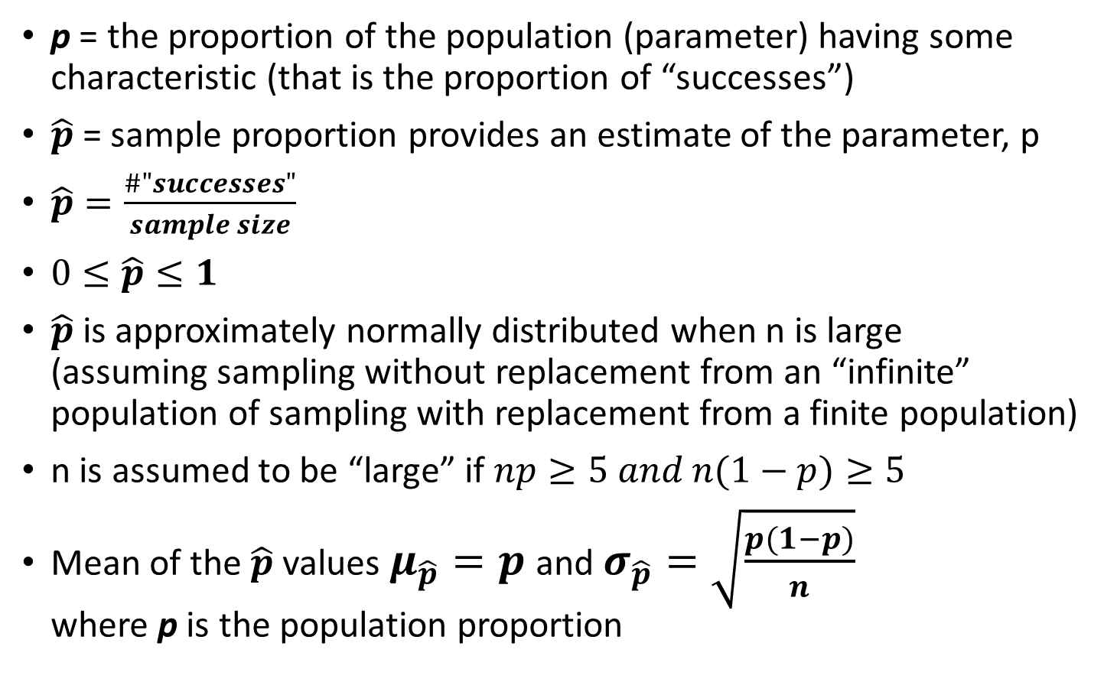
Proportions
p = the proportion of the population (parameter) having some characteristic (that is the proportion of “successes”)
$\hat{p}$ = sample proportion provides an estimate of the parameter, p
$\hat{p}=\frac{\#"successes"}{sample size}$
$0≤\hat{p}≤1$
$\hat{p}$ is approximately normally distributed when n is large
(assuming sampling without replacement from an “infinite” population of sampling with replacement from a finite population)
n is assumed to be “large” if $np≥5 and n(1−p)≥5$
Mean of the $\hat{p}$ values $μ_{\hat{p}}=p$ and $σ_{\hat{p}}=\sqrt{\frac{p(1−p)}{n}}$
where p is the population proportion

Slide 27
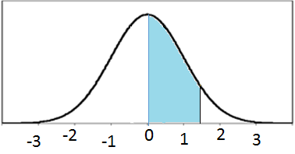


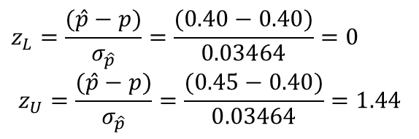
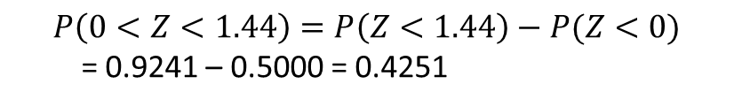
Z-value for Proportions
To standardize a value of $\hat{p}$ calculated from a sample:
$Z=\frac{(\hat{p}−p)}{σ_{\hat{p}}}=\frac{(\hat{p}−p)}{\sqrt{\frac{p(1−p)}{n}}}$
EXAMPLE: If the true proportion of voters who support a particular candidate is p = 0.40, what is the probability that a sample of size 200 yields a sample proportion ($\hat{p}$) between 0.40 and 0.45?
What do we know?
n=200
$p=0.40$
Check: np=80 and n(1-p)=120
$σ_{\hat{p}}=\sqrt{\frac{p(1−p)}{n}}=\sqrt{\frac{0.4(1−0.4)}{200}}=0.03464$
$$z_{L}=\frac{(\hat{p}−p)}{σ_{\hat{p}}}=\frac{(0.40−0.40)}{0.03464}=0$$
$$z_{U}=\frac{(\hat{p}−p)}{σ_{\hat{p}}}=\frac{(0.45−0.40)}{0.03464}=1.44$$
$$P\left(0<Z<1.44\right)=P\left(Z<1.44\right)−P(Z<0)$$
= 0.9241 – 0.5000 = 0.4251

Slide 28
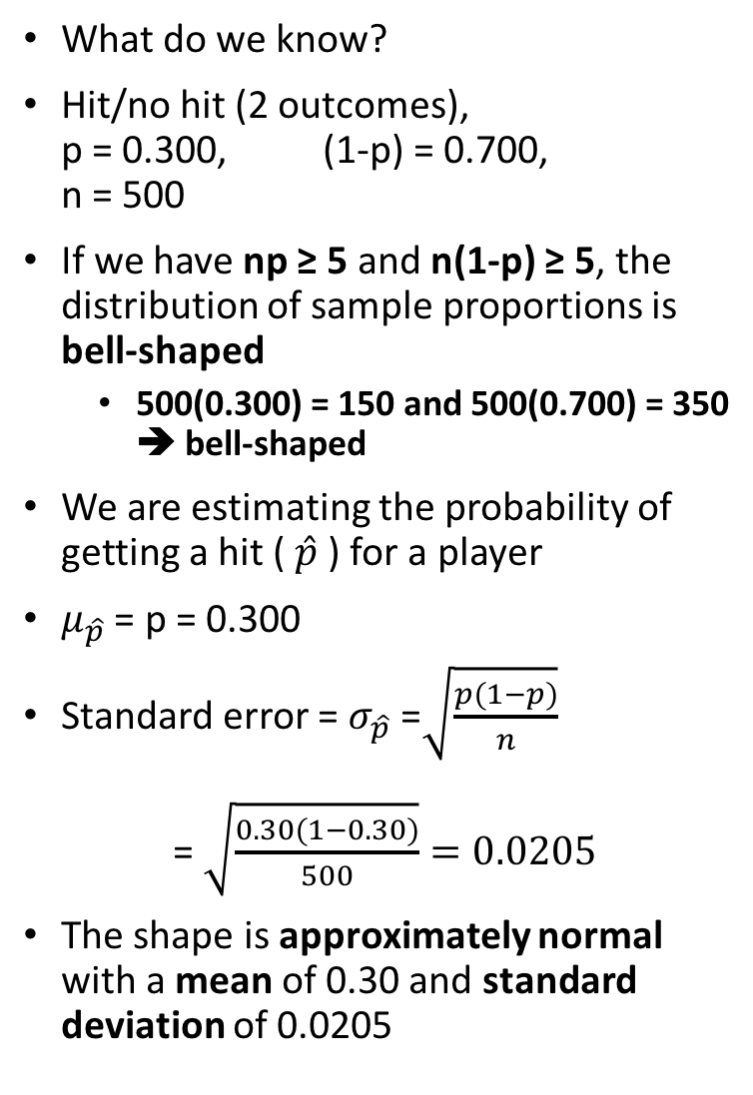
Example:
What do we know?
Hit/no hit (2 outcomes),
p = 0.300, (1-p) = 0.700,
n = 500
If we have np ≥ 5 and n(1-p) ≥ 5, the distribution of sample proportions is bell-shaped
  500(0.300) = 150 and 500(0.700) = 350
  ➔ bell-shaped
We are estimating the probability of getting a hit ( $\hat{p}$) for a player
$μ_{\hat{p}}$ = p = 0.300
Standard error = $σ_{\hat{p}}$ =$\sqrt{\frac{p(1−p)}{n}}$
= $\sqrt{\frac{0.30(1−0.30)}{500}}=0.0205$
The shape is approximately normal with a mean of 0.30 and standard deviation of 0.0205
Random variability in baseball A baseball player in the major leagues who plays regularly will have about 500 at-bats (that is, about 500 times, he can be the hitter in a game) during the season. Suppose a player has a 0.300 probability of getting a hit in an at-bat. His batting average at the end of the season is the number of hits divided by the number of at-bats. This batting average is a sample proportion, so it has a sampling distribution describing where it is likely to fall.
Describe the shape, mean and standard deviation of the sampling distribution of the player’s batting average after a season of 500 at-bats.

Slide 29
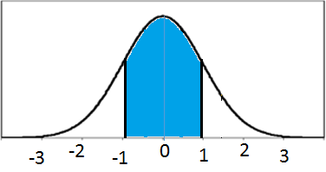
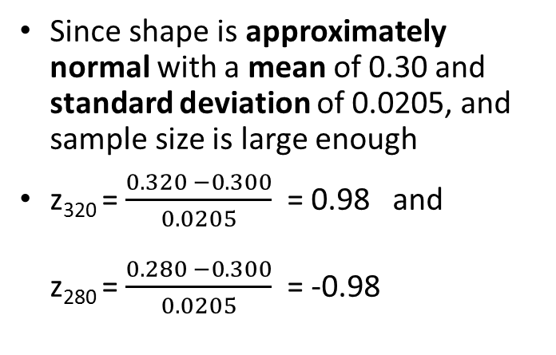
Example:
Since shape is approximately normal with a mean of 0.30 and standard deviation of 0.0205, and sample size is large enough
z₃₂₀ = $\frac{0.320 −0.300}{0.0205}$ = 0.98 and
z₂₈₀ = $\frac{0.280 −0.300}{0.0205}$ = -0.98
Random variability in baseball A baseball player in the major leagues who plays regularly will have about 500 at-bats (that is, about 500 times, he can be the hitter in a game) during the season. Suppose a player has a 0.300 probability of getting a hit in an at-bat. His batting average at the end of the season is the number of hits divided by the number of at-bats. This batting average is a sample proportion, so it has a sampling distribution describing where it is likely to fall.
Explain why a batting average of 0.320 or of 0.280 would or would not be especially unusual for this player’s year-end batting average.
Since both 0.32 and 0.280 are about a standard deviation from the mean (0.300), they would not be considered unusual for this player’s year-end batting average
(That is, you should not conclude that someone with a batting average of 0.320 one year is necessarily a better hitter than a player with a batting average of 0.280.)

Slide 30
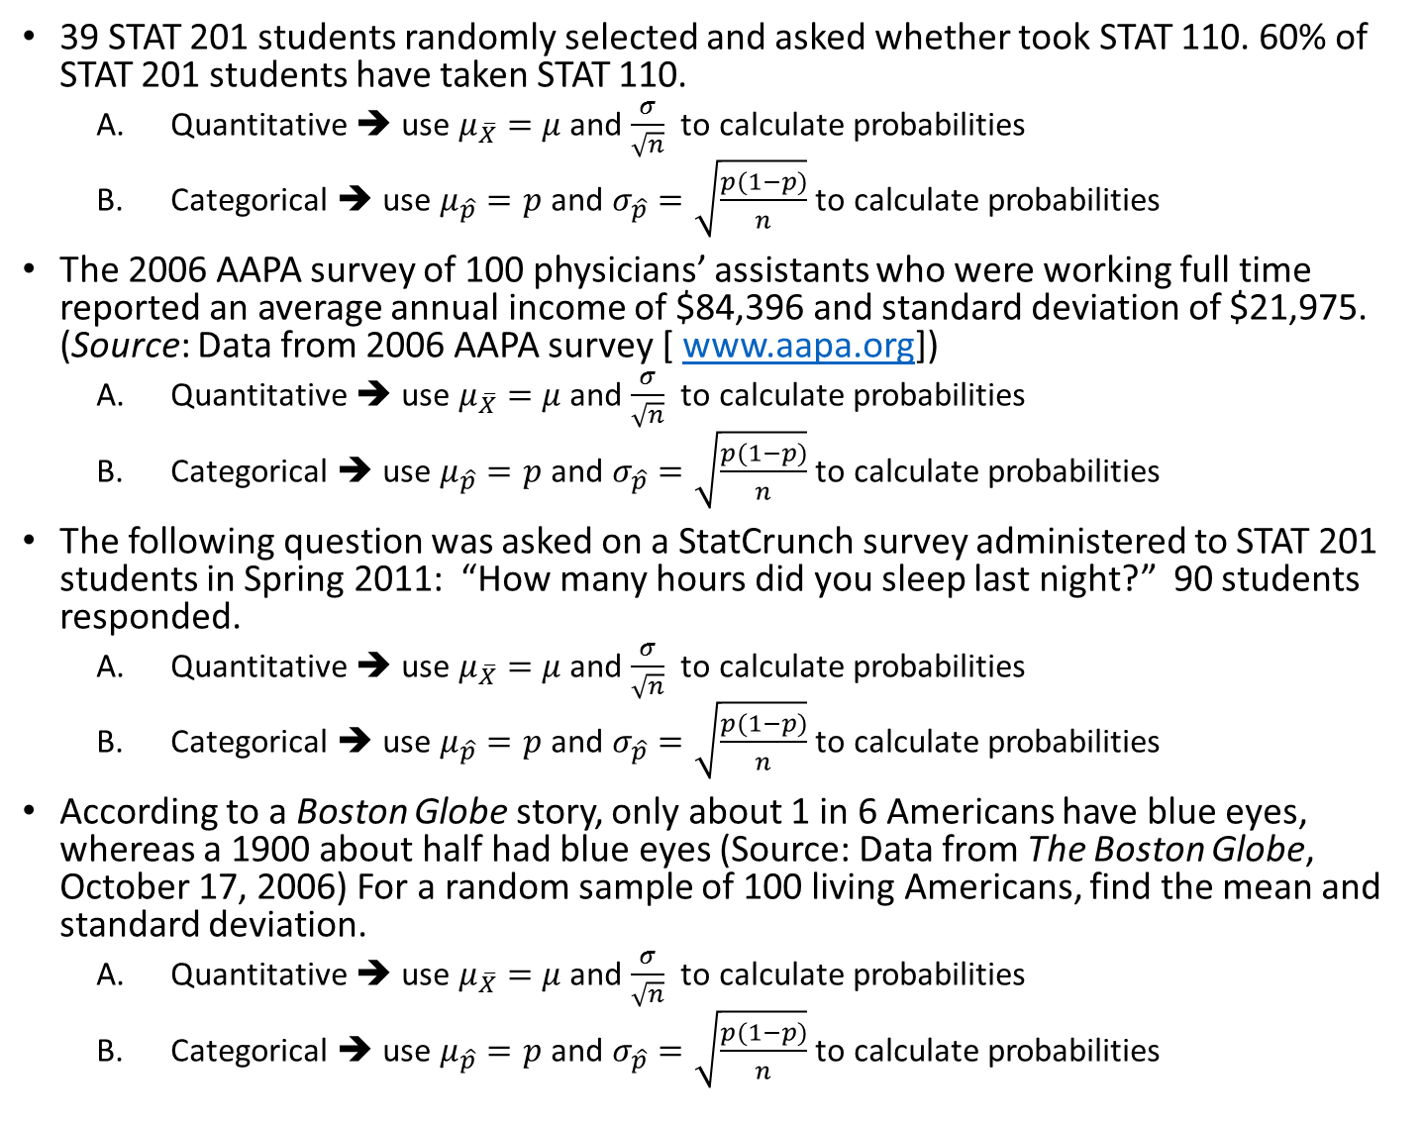
39 STAT 201 students randomly selected and asked whether took STAT 110. 60% of STAT 201 students have taken STAT 110.
  Quantitative ➔ use $μ_{\overline{X}}=$ $μ$and $\frac{σ}{\sqrt{n}}$ to calculate probabilities
  Categorical ➔ use $μ_{\hat{p}}=p$ and $σ_{\hat{p}}=\sqrt{\frac{p(1−p)}{n}}$ to calculate probabilities
The 2006 AAPA survey of 100 physicians’ assistants who were working full time reported an average annual income of $84,396 and standard deviation of $21,975. (Source: Data from 2006 AAPA survey [ www.aapa.org])
  Quantitative ➔ use $μ_{\overline{X}}=$ $μ$and $\frac{σ}{\sqrt{n}}$ to calculate probabilities
  Categorical ➔ use $μ_{\hat{p}}=p$ and $σ_{\hat{p}}=\sqrt{\frac{p(1−p)}{n}}$ to calculate probabilities
The following question was asked on a StatCrunch survey administered to STAT 201 students in Spring 2011: “How many hours did you sleep last night?” 90 students responded.
  Quantitative ➔ use $μ_{\overline{X}}=$ $μ$and $\frac{σ}{\sqrt{n}}$ to calculate probabilities
  Categorical ➔ use $μ_{\hat{p}}=p$ and $σ_{\hat{p}}=\sqrt{\frac{p(1−p)}{n}}$ to calculate probabilities
According to a Boston Globe story, only about 1 in 6 Americans have blue eyes, whereas a 1900 about half had blue eyes (Source: Data from The Boston Globe, October 17, 2006) For a random sample of 100 living Americans, find the mean and standard deviation.
  Quantitative ➔ use $μ_{\overline{X}}=$ $μ$and $\frac{σ}{\sqrt{n}}$ to calculate probabilities
  Categorical ➔ use $μ_{\hat{p}}=p$ and $σ_{\hat{p}}=\sqrt{\frac{p(1−p)}{n}}$ to calculate probabilities

Slide 31
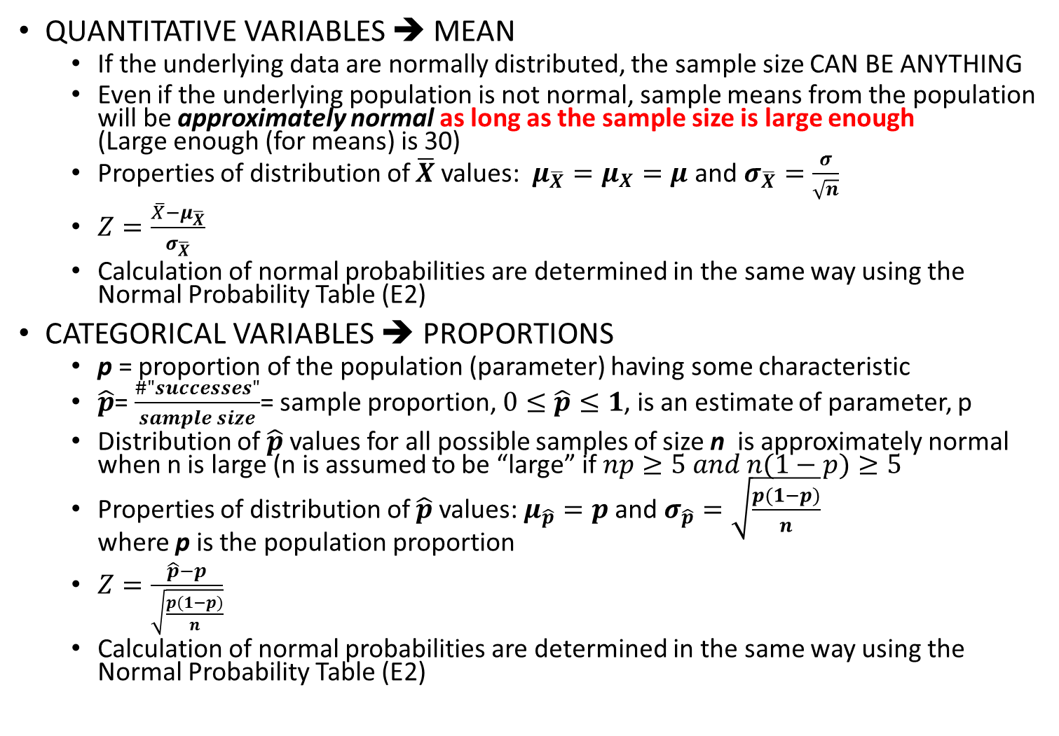
Review: CENTRAL LIMIT THEOREM!
QUANTITATIVE VARIABLES ➔ MEAN
  If the underlying data are normally distributed, the sample size CAN BE ANYTHING
  Even if the underlying population is not normal, sample means from the population will be approximately normal as long as the sample size is large enough
  (Large enough (for means) is 30)
  Properties of distribution of $\overline{X}$ values: $μ_{\overline{X}}=μ_{X}=μ$ and $σ_{\overline{X}}=\frac{σ}{\sqrt{n}}$
  $Z=\frac{\overline{X}−μ_{\overline{X}}}{σ_{\overline{X}}}$
  Calculation of normal probabilities are determined in the same way using the Normal Probability Table (E2)
CATEGORICAL VARIABLES ➔ PROPORTIONS
  p = proportion of the population (parameter) having some characteristic
  $\hat{p}$= $\frac{\#"successes"}{sample size}$= sample proportion, $0≤\hat{p}≤1$, is an estimate of parameter, p
  Distribution of $\hat{p}$ values for all possible samples of size n is approximately normal when n is large (n is assumed to be “large” if $np≥5 and n(1−p)≥5$
  Properties of distribution of $\hat{p}$ values: $μ_{\hat{p}}=p$ and $σ_{\hat{p}}=\sqrt{\frac{p(1−p)}{n}}$
  where p is the population proportion
  $Z=\frac{\hat{p}−p}{\sqrt{\frac{p(1−p)}{n}}}$
  Calculation of normal probabilities are determined in the same way using the Normal Probability Table (E2)

Slide 32


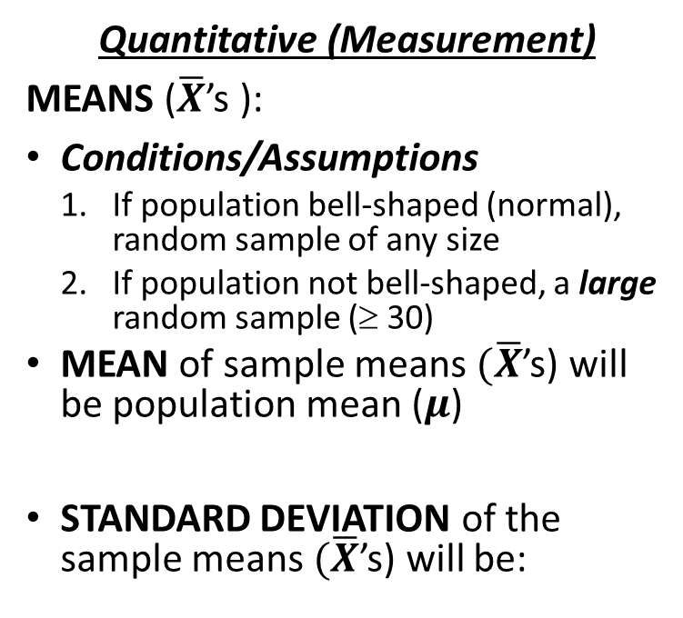

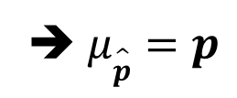
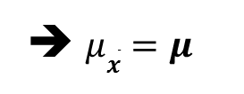
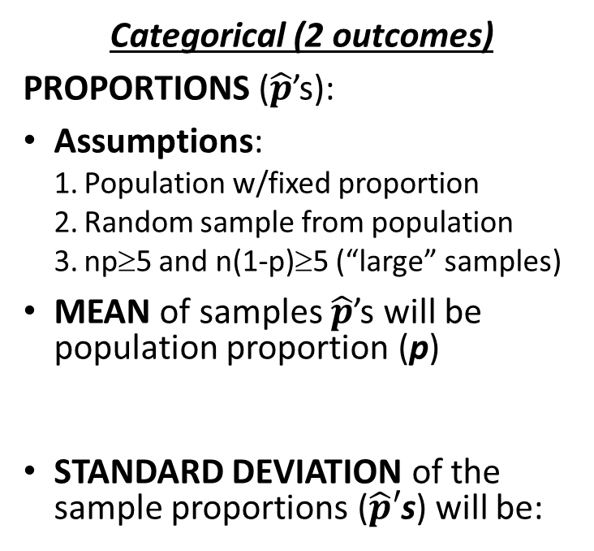
Central Limit Theorem: Proportions AND Means
RULE: If many samples or repetitions of the SAME SIZE are taken, the frequency curve made from STATISTICS from the SAMPLES will be approximately normally distributed
Categorical (2 outcomes)
PROPORTIONS ($\hat{p}$’s):
Assumptions:
  Population w/fixed proportion
  Random sample from population
  np≥5 and n(1-p)≥5 (“large” samples)
MEAN of samples $\hat{p}$’s will be
population proportion (p)
STANDARD DEVIATION of the sample proportions ($\hat{p}′$s) will be:
Quantitative (Measurement)
MEANS ($\overline{X}$’s ):
Conditions/Assumptions
  If population bell-shaped (normal), random sample of any size
  If population not bell-shaped, a large random sample (≥ 30)
  MEAN of sample means$(\overline{X}$’s) will be population mean ($μ$)
  STANDARD DEVIATION of the sample means $(\overline{X}$’s) will be:
➔ $μ\hat{p}=p$
➔ $μ\overline{x}=μ$
$$\hat{p}$$

