Slide 1
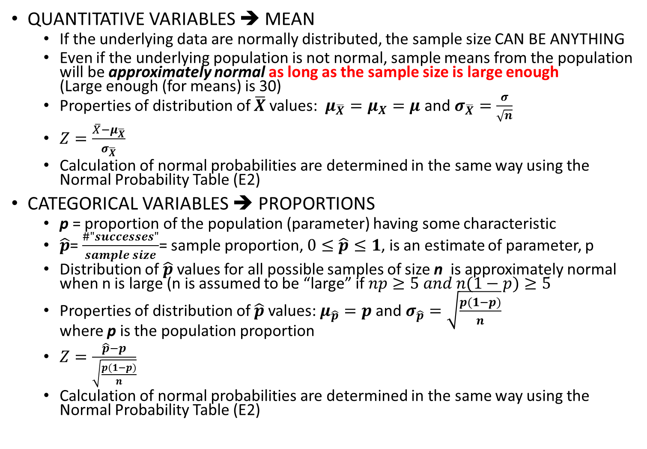
Review: CENTRAL LIMIT THEOREM!
QUANTITATIVE VARIABLES ➔ MEAN
  If the underlying data are normally distributed, the sample size CAN BE ANYTHING
  Even if the underlying population is not normal, sample means from the population will be approximately normal as long as the sample size is large enough
  (Large enough (for means) is 30)
  Properties of distribution of $\overline{X}$ values: $μ_{\overline{X}}=μ_{X}=μ$ and $σ_{\overline{X}}=\frac{σ}{\sqrt{n}}$
  $Z=\frac{\overline{X}−μ_{\overline{X}}}{σ_{\overline{X}}}$
  Calculation of normal probabilities are determined in the same way using the Normal Probability Table (E2)
CATEGORICAL VARIABLES ➔ PROPORTIONS
  p = proportion of the population (parameter) having some characteristic
  $\hat{p}$= $\frac{\#"successes"}{sample size}$= sample proportion, $0≤\hat{p}≤1$, is an estimate of parameter, p
  Distribution of $\hat{p}$ values for all possible samples of size n is approximately normal when n is large (n is assumed to be “large” if $np≥5 and n(1−p)≥5$
  Properties of distribution of $\hat{p}$ values: $μ_{\hat{p}}=p$ and $σ_{\hat{p}}=\sqrt{\frac{p(1−p)}{n}}$
  where p is the population proportion
  $Z=\frac{\hat{p}−p}{\sqrt{\frac{p(1−p)}{n}}}$
  Calculation of normal probabilities are determined in the same way using the Normal Probability Table (E2)

Slide 2
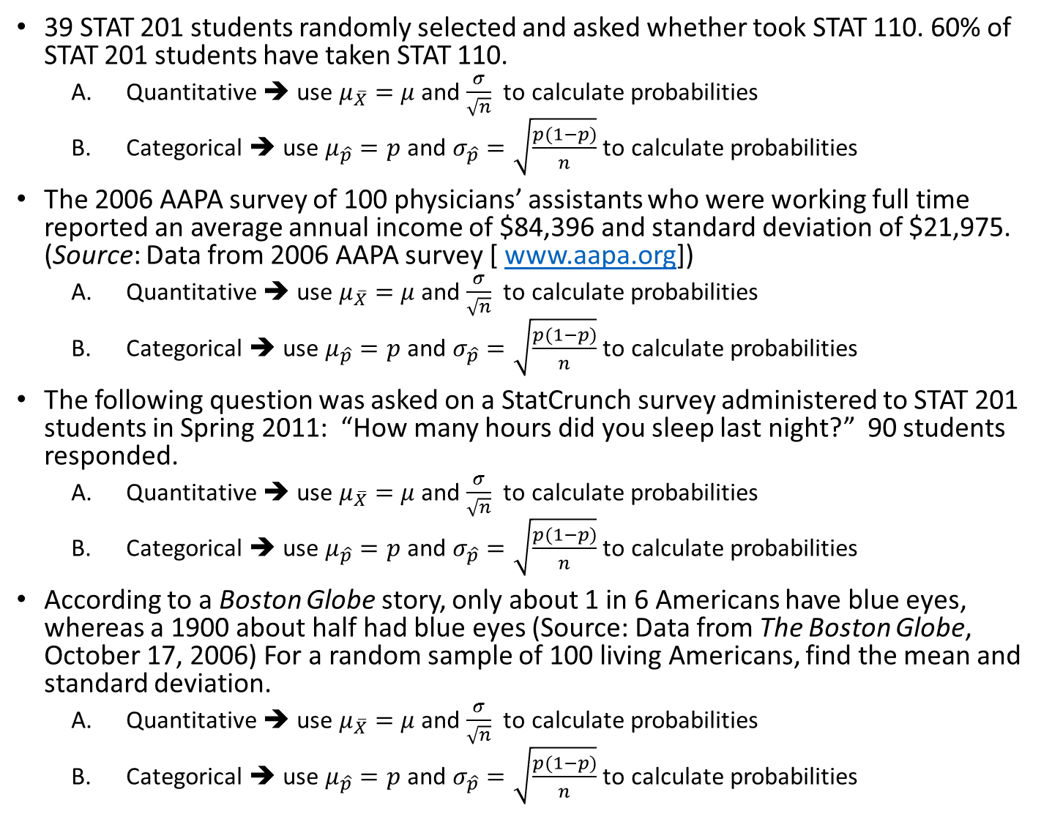
39 STAT 201 students randomly selected and asked whether took STAT 110. 60% of STAT 201 students have taken STAT 110.
  Quantitative ➔ use $μ_{\overline{X}}=$ $μ$and $\frac{σ}{\sqrt{n}}$ to calculate probabilities
  Categorical ➔ use $μ_{\hat{p}}=p$ and $σ_{\hat{p}}=\sqrt{\frac{p(1−p)}{n}}$ to calculate probabilities
The 2006 AAPA survey of 100 physicians’ assistants who were working full time reported an average annual income of $84,396 and standard deviation of $21,975. (Source: Data from 2006 AAPA survey [ www.aapa.org])
  Quantitative ➔ use $μ_{\overline{X}}=$ $μ$and $\frac{σ}{\sqrt{n}}$ to calculate probabilities
  Categorical ➔ use $μ_{\hat{p}}=p$ and $σ_{\hat{p}}=\sqrt{\frac{p(1−p)}{n}}$ to calculate probabilities
The following question was asked on a StatCrunch survey administered to STAT 201 students in Spring 2011: “How many hours did you sleep last night?” 90 students responded.
  Quantitative ➔ use $μ_{\overline{X}}=$ $μ$and $\frac{σ}{\sqrt{n}}$ to calculate probabilities
  Categorical ➔ use $μ_{\hat{p}}=p$ and $σ_{\hat{p}}=\sqrt{\frac{p(1−p)}{n}}$ to calculate probabilities
According to a Boston Globe story, only about 1 in 6 Americans have blue eyes, whereas a 1900 about half had blue eyes (Source: Data from The Boston Globe, October 17, 2006) For a random sample of 100 living Americans, find the mean and standard deviation.
  Quantitative ➔ use $μ_{\overline{X}}=$ $μ$and $\frac{σ}{\sqrt{n}}$ to calculate probabilities
  Categorical ➔ use $μ_{\hat{p}}=p$ and $σ_{\hat{p}}=\sqrt{\frac{p(1−p)}{n}}$ to calculate probabilities

Slide 3
STAT 206:
Chapter 8
Confidence Interval Estimation

Slide 4
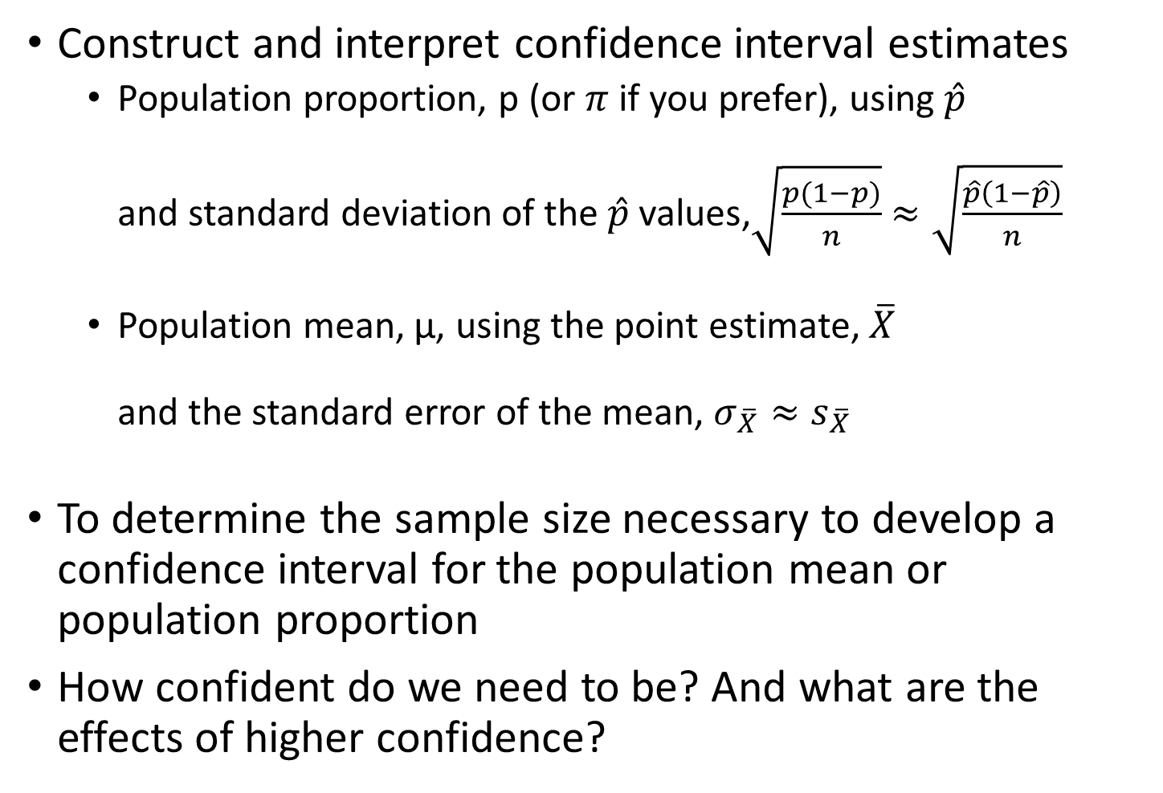
Ideas in Chapter 8
Construct and interpret confidence interval estimates
  Population proportion, p (or $π$ if you prefer), using $\hat{p}$
  and standard deviation of the $\hat{p}$ values,$\sqrt{\frac{p(1−p)}{n}}$ $≈\sqrt{\frac{\hat{p}\left(1−\hat{p}\right)}{n}}$
  Population mean, µ, using the point estimate, $\overline{X}$
  and the standard error of the mean, $σ_{\overline{X}}≈s_{\overline{X}}$
To determine the sample size necessary to develop a confidence interval for the population mean or population proportion
How confident do we need to be? And what are the effects of higher confidence?

Slide 5
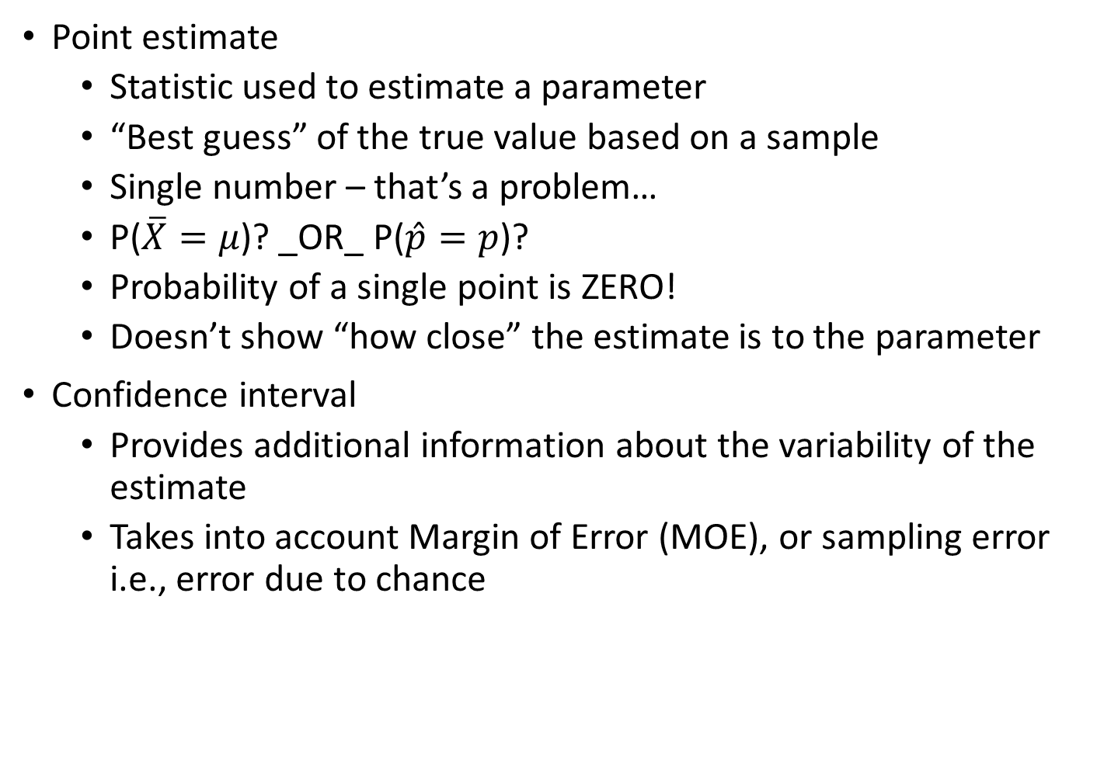
Confidence Intervals – General discussion
Point estimate
  Statistic used to estimate a parameter
  “Best guess” of the true value based on a sample
  Single number – that’s a problem…
  P($\overline{X}=μ$)? _OR_ P($\hat{p}=p$)?
  Probability of a single point is ZERO!
  Doesn’t show “how close” the estimate is to the parameter
Confidence interval
  Provides additional information about the variability of the estimate
  Takes into account Margin of Error (MOE), or sampling error
  i.e., error due to chance

Slide 6
So… What is a Confidence Interval?
Confidence Interval (CI) – interval containing the
“most believable” values for a parameter
  Confidence level – probability that this method produces an interval that contains (covers) the parameter
  Confidence level is usually close to 1.00
  (most commonly 0.95 or 95%, but depends on criticality of the decision)
Margin of Error – measures how accurate the point estimate is likely to be
  Multiple of the standard deviation (e.g. 1.96 * std dev)
Confidence Interval is constructed by taking a point estimate and adding and subtracting the margin of error (that is, critical z-score times the standard error)

Slide 7
Lower
Confidence Limit
Upper
Confidence Limit
Point Estimate
Width of
confidence interval
That is, CI = point estimate ± (Critical Value)(Std Error)
  Where:
  Point Estimate is the sample statistic estimating the population parameter of interest
  Critical Value is a table value based on the sampling distribution of the point estimate and the desired confidence level
  Standard Error is the standard deviation of the point estimate
How confident are we that the interval covers the unknown population parameter?
  Some percentage (less than 100%)
  95% confident (probably most common), 99%, 90%
  Desired level of confidence defines the “critical value” or z-score
But that means, we are NEVER sure…

Slide 8
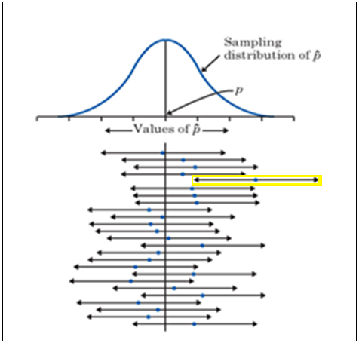
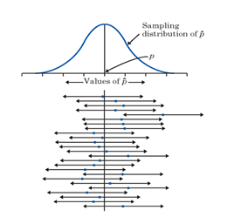
Understanding Confidence Intervals
CI = point estimate ± (Critical Value)(Std Error)
**A 95% confidence interval is formed under the knowledge:
95% of all the possible intervals based on every possible sample from the population
Would cover the parameter and the other 5% would miss
Figure 21.4 Twenty-five samples from the same population give these 95% confidence intervals. In the long run, 95% of all such intervals cover the true population proportion, marked by the vertical line.
(Statistics: Concepts and Controversies (8th Edition), by Moore and Notz, W.H. Freeman and Company, 2013 p. 495 )

Slide 9
Confidence Level, (1-α)
Suppose confidence level = 95%
Also written (1 - α) = 0.95, (so α = 0.05)
A relative frequency interpretation:
  95% of all the confidence intervals that can be constructed will contain the unknown true parameter
A specific interval
either will contain
or will not contain
the true parameter
  No probability
  involved in a
  specific interval
Confidence Coefficient,
Confidence Level
Z_{α/2} value
80%
90%
95%
98%
99%
99.8%
99.9%
0.80
0.90
0.95
0.98
0.99
0.998
0.999
1.28
1.645
1.96
2.33
2.58
3.08
3.27
Pearson slides
(Chapter 8, slides 14&18)

Slide 10


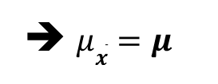
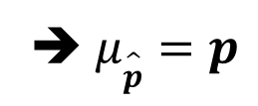

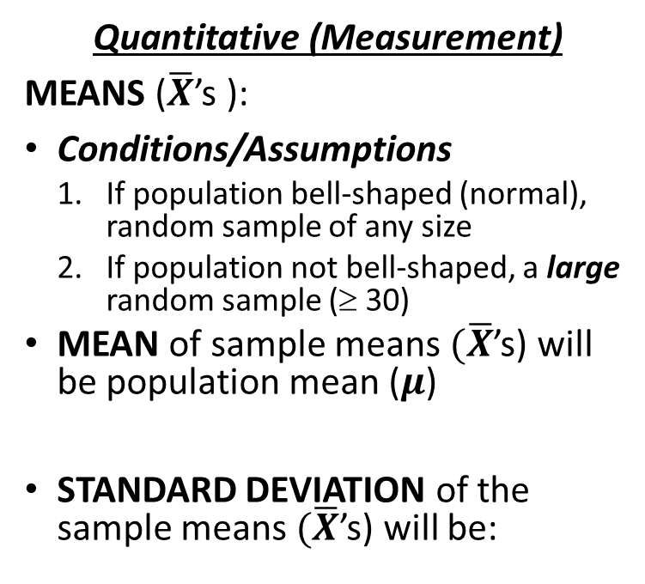
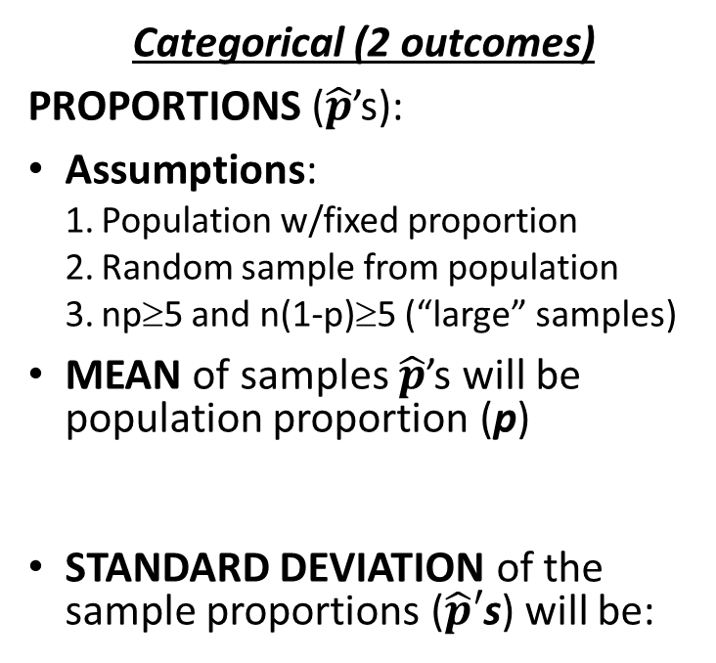
Central Limit Theorem: Proportions AND Means
RULE: If many samples or repetitions of the SAME SIZE are taken, the frequency curve made from STATISTICS from the SAMPLES will be approximately normally distributed
Categorical (2 outcomes)
PROPORTIONS ($\hat{p}$’s):
Assumptions:
  Population w/fixed proportion
  Random sample from population
  np≥5 and n(1-p)≥5 (“large” samples)
MEAN of samples $\hat{p}$’s will be
population proportion (p)
STANDARD DEVIATION of the sample proportions ($\hat{p}′$s) will be:
Quantitative (Measurement)
MEANS ($\overline{X}$’s ):
Conditions/Assumptions
  If population bell-shaped (normal), random sample of any size
  If population not bell-shaped, a large random sample (≥ 30)
  MEAN of sample means$(\overline{X}$’s) will be population mean ($μ$)
  STANDARD DEVIATION of the sample means $(\overline{X}$’s) will be:
➔ $μ\hat{p}=p$
➔ $μ\overline{x}=μ$
$$\hat{p}$$

Slide 11

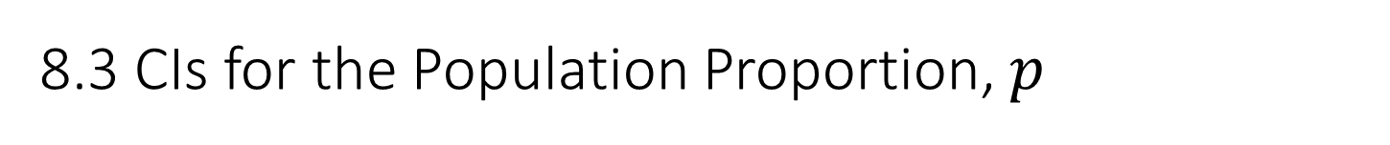
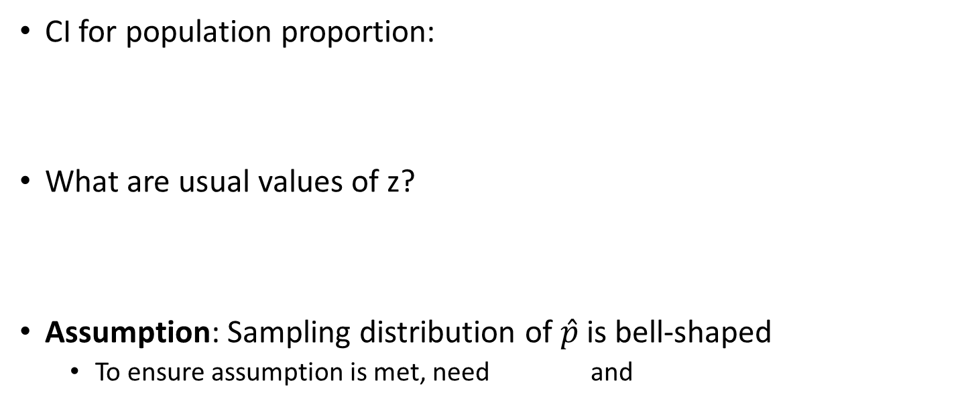
8.3 CIs for the Population Proportion, $p$
CI for population proportion:
What are usual values of z?
Assumption: Sampling distribution of $\hat{p}$is bell-shaped
  To ensure assumption is met, need and
Margin
of Error
Standard Error
or
Standard Deviation
of the Sampling Distribution
What affects the margin of error?
  The level of confidence which determines the value of z
  the standard error which is a function of sample size
How can we achieve a narrower confidence interval?
  1. Decrease the level of confidence OR
  2. Increase the sample size

Slide 12
Question:
What are two (2) ways to reduce the width of a confidence interval?
  Larger sample size and higher level of confidence
  Smaller sample size and lower level of confidence
  Larger sample size and lower level of confidence
  Unable to determine without seeing the data

Slide 13
Question:
Two different researchers measured the weight of two separate samples of ruby-throated hummingbirds from the same population. Each calculated a 95% confidence interval for the mean weight of these birds. (Source:_http://www.biology.ucsd.edu/labs/rifkin/courses/bieb100/win2012/PracticeProblemCollection/NormalInferencePracticeProblems_ch11.pdf )
  Researcher 1 found the 95% CI to be (3.12 g , 3.48 g), while
  Researcher 2 found the 95% CI to be (3.05 g , 3.62 g).
If we assume similar means and sample standard deviations, which of the researchers probably had the larger sample?
  Researcher 1
  Researcher 2
CI interval width = upper limit – lower limit
Width₁ = 3.48 – 3.12 = 0.36
Width₂ = 3.62 – 3.05 = 0.57
Larger sample ➔ Narrower CI
➔ Research 1 probably had the larger sample.

Slide 14
Interpretation: We are x% confident that the true <statistic> <description of problem> is between a and b.
  Confidence interval interpretations talk about PARAMETERS
  Although the true population values (i.e., parameters) may or may not be in the calculated interval, x% of intervals formed in an appropriate manner will contain the true value. HOWEVER, (100 – x)% percent will NOT contain the true value ➔ a mistake due to chance.

Slide 15
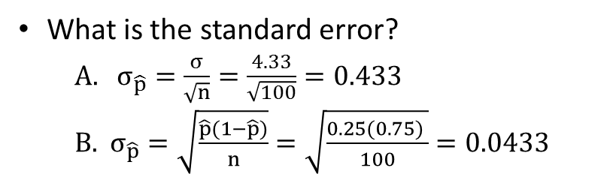
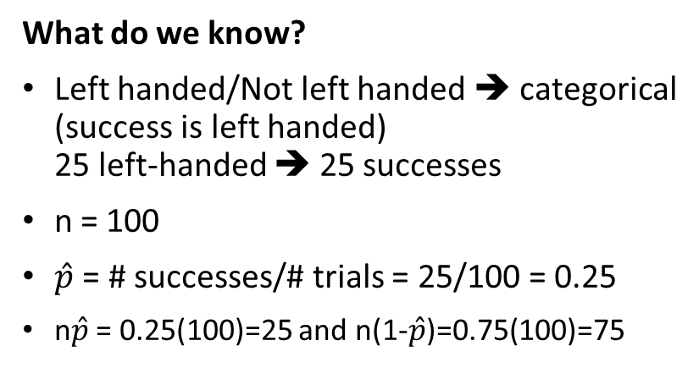
Example 1:
A random sample of 100 people shows that 25 are left-handed. Form a 95% confidence interval for the true proportion of left-handers
What do we know?
Left handed/Not left handed ➔ categorical
(success is left handed)
25 left-handed ➔ 25 successes
n = 100
$\hat{p}$ = # successes/# trials = 25/100 = 0.25
n$\hat{p}$ = 0.25(100)=25 and n(1-$\hat{p}$)=0.75(100)=75
95% CI = 0.25 ± 1.96(0.0433)
= 0.25 ± 0.0849
= (0.1651 , 0.3349)
Interpretation:
We are 95% confident that the true proportion of people in the population who are left-handed is between 0.1651 and 0.3349.
_OR_
We are 95% confident that the true percentage of left-handers in the population is between 16.51% and 33.49%.
What is the standard error?
  $σ_{\hat{p}}=\frac{σ}{\sqrt{n}}=\frac{4.33}{\sqrt{100}}=0.433$
  $σ_{\hat{p}}=\sqrt{\frac{\hat{p}(1−\hat{p})}{n}}=\sqrt{\frac{0.25(0.75) }{100}}=0.0433$
95% confidence ➔ z = 1.96
Although the interval from 0.1651 to 0.3349 may or may not contain the true proportion,
95% of intervals formed from samples of size 100 in this manner will cover the true value.

Slide 16
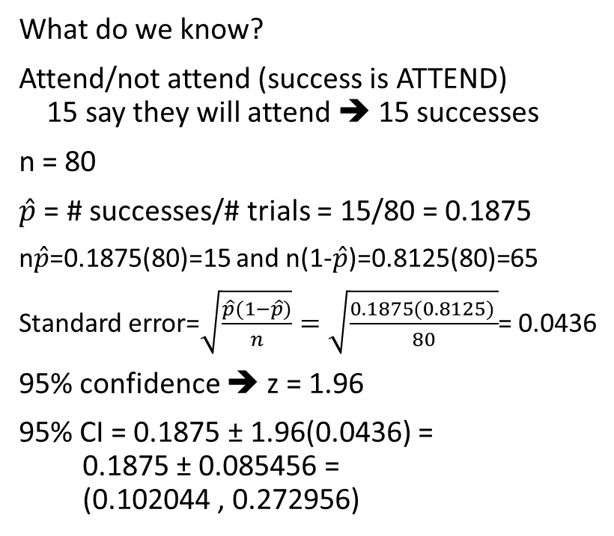
Example 2:
A planning committee needs to estimate the percentage of students at a large university who will attend an upcoming event so that they can determine an appropriate location for the event. 80 students are randomly selected, and 15 say that they will come to the event.
What is a 95% confidence interval for the proportion of all the university’s students who will attend the event? Interpret the interval. Is the confidence interval a valid method for this problem?
What do we know?
Attend/not attend (success is ATTEND)
15 say they will attend ➔ 15 successes
n = 80
$\hat{p}$ = # successes/# trials = 15/80 = 0.1875
n$\hat{p}$=0.1875(80)=15 and n(1-$\hat{p}$)=0.8125(80)=65
Standard error=$\sqrt{\frac{\hat{p}(1−\hat{p})}{n}}=\sqrt{\frac{0.1875(0.8125) }{80}}$= 0.0436
95% confidence ➔ z = 1.96
95% CI = 0.1875 ± 1.96(0.0436) =
0.1875 ± 0.085456 =
(0.102044 , 0.272956)
90% confidence ➔ z = 1.645
90% CI = 0.1875 ± 1.645(0.0436) =
0.1875 ± 0.071722 =
(0.115778, 0.259222)
99% confidence ➔ z = 2.58
99% CI = 0.1875 ± 2.58(0.0436) =
0.1875 ± 0.112488 =
(0.075012 , 0.299988)
.05 .10 .15 .20 .25 .30 .35

Slide 17
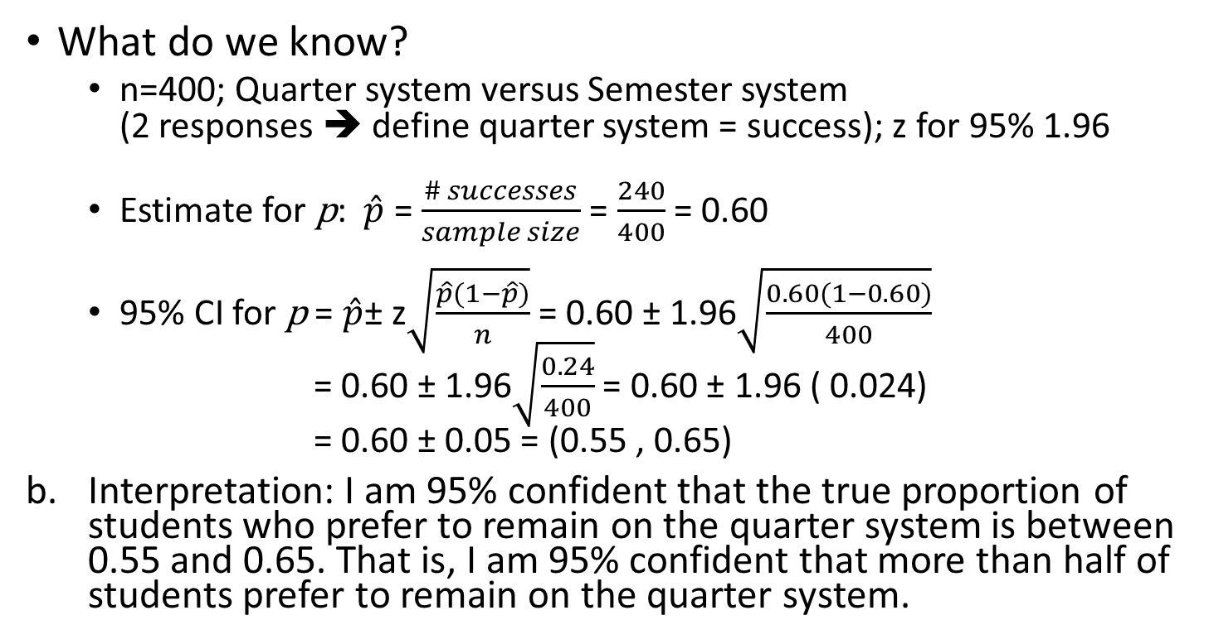
Source: Utts, Seeing Through Statistics, : p. 384, #11
Contemplating switch from quarter system to semester system
  Survey – random sample of n=400 students
  240 prefer quarter system
Construct 95% Confidence Interval for true proportion who prefer to remain on the quarter system
What do we know?
  n=400; Quarter system versus Semester system
  (2 responses ➔ define quarter system = success); z for 95% 1.96
  Estimate for p: $\hat{p}$ = $\frac{\# successes}{sample size}$ = $\frac{240}{400}$ = 0.60
  95% CI for p = $\hat{p}$± z$\sqrt{\frac{\hat{p}(1−\hat{p})}{n}}$ = 0.60 ± 1.96$\sqrt{\frac{0.60(1−0.60)}{400}}$
  = 0.60 ± 1.96$\sqrt{\frac{0.24}{400}}$ = 0.60 ± 1.96 ( 0.024)
  = 0.60 ± 0.05 = (0.55 , 0.65)
Interpretation: I am 95% confident that the true proportion of students who prefer to remain on the quarter system is between 0.55 and 0.65. That is, I am 95% confident that more than half of students prefer to remain on the quarter system.

Slide 18
Why can I say that more than half of the students prefer to stay on the quarter system versus semester?
Look at the number line
Where does ½ appear?
Where is the Confidence Interval?
Does it cover ½?
NO! Completely above 0.50.
Thus, we are able to say that we are 95% confident that more than half of the students prefer to stay on the quarter system.

Slide 19
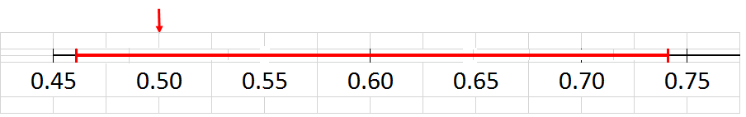
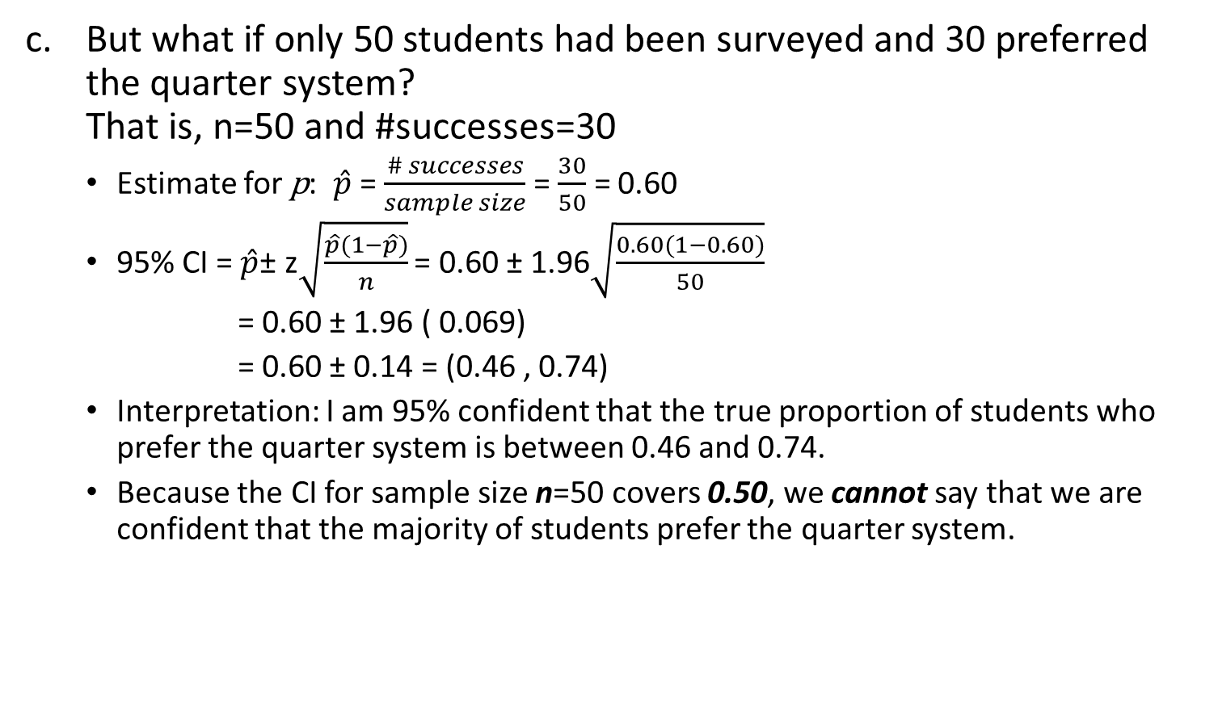
Source: Utts, Seeing Through Statistics, : p. 384, #11 (cont)
Contemplating switch from quarter system to semester system
But what if only 50 students had been surveyed and 30 preferred the quarter system?
That is, n=50 and #successes=30
  Estimate for p: $\hat{p}$ = $\frac{\# successes}{sample size}$ = $\frac{30}{50}$ = 0.60
  95% CI = $\hat{p}$± z$\sqrt{\frac{\hat{p}(1−\hat{p})}{n}}$ = 0.60 ± 1.96$\sqrt{\frac{0.60(1−0.60)}{50}}$
  = 0.60 ± 1.96 ( 0.069)
  = 0.60 ± 0.14 = (0.46 , 0.74)
  Interpretation: I am 95% confident that the true proportion of students who prefer the quarter system is between 0.46 and 0.74.
  Because the CI for sample size n=50 covers 0.50, we cannot say that we are confident that the majority of students prefer the quarter system.

Slide 20

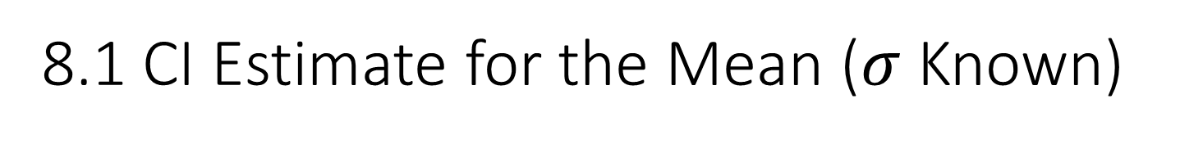
8.1 CI Estimate for the Mean ($σ$ Known)
Calculate Confidence Interval for the MEAN, µ, for quantitative variables
Remember: Confidence Interval = statistic ± MOE
Notice that our CI formula uses the population standard deviation, σ.
Categorical (proportions)
Quantitative (means)
Margin
of Error
Margin
of Error
Standard Deviation
for distribution of $\hat{p}$ values
Or
Standard Error
Standard Deviation of distribution of
X values or
Standard Error

Slide 21

Example:
A sample of 11 circuits from a large normal population has a mean resistance of 2.20 ohms. We know from past testing that the population standard deviation is 0.35 ohms. Determine a 95% confidence interval for the true mean resistance of the population.
Interpretation: We are 95% confident that the true mean resistance is between 1.9932 and 2.4068 ohms
What do we know?
  Mean resistance ➔ quantitative
  n = 11
  $\overline{X}=2.20 ohms$ and $σ=0.35 ohms$
  Standard error =$\frac{σ}{\sqrt{n}}=\frac{0.35}{\sqrt{11}}=0.1055$
  95% confidence ➔ z = 1.96
  95% CI = $\overline{X}$ ± 1.96($\frac{σ}{\sqrt{n}}$)
  = 2.20 ± 1.96(0.1055)
  =2.20 ±0.2068
  = (1.9932 , 2.4068)
Although the true mean may or may not be in this interval, 95% of intervals formed in this manner will contain the true mean

Slide 22

Can we ever know σ?
To know σ implies that you know all the values in the population
If you know all the values in the population, why calculate $\overline{X}$ instead of µ?
In real world situations, you would never know the standard deviation of the population…

Slide 23
Central Limit Theorem: Proportions AND Means
RULE: If many samples or repetitions of the SAME SIZE are taken, the frequency curve made from STATISTICS from the SAMPLES will be approximately normally distributed
Categorical (2 outcomes)
PROPORTIONS ($\hat{p}$’s):
Assumptions:
  Population w/fixed proportion
  Random sample from population
  np≥5 and n(1-p)≥5 (“large” samples)
MEAN of samples $\hat{p}$’s will be
population proportion (p)
STANDARD DEVIATION of the sample proportions ($\hat{p}′$s) will be:
Quantitative (Measurement)
MEANS ($\overline{X}$’s ):
Conditions/Assumptions
  If population bell-shaped (normal), random sample of any size
  If population not bell-shaped, a large random sample (≥ 30)
  MEAN of sample means$(\overline{X}$’s) will be population mean ($μ$)
  STANDARD DEVIATION of the sample means $(\overline{X}$’s) will be:
➔ $μ\hat{p}=p$
➔ $μ\overline{x}=μ$
$$\hat{p}$$

Slide 24
8.1 CI Estimate for the Mean ($σ$ Known)
Calculate Confidence Interval for the MEAN, µ, for quantitative variables
Remember: Confidence Interval = statistic ± MOE
Notice that our CI formula uses the population standard deviation, σ.
Categorical (proportions)
Quantitative (means)
Margin
of Error
Margin
of Error
Standard Deviation
for distribution of $\hat{p}$ values
Or
Standard Error
Standard Deviation of distribution of
X values or
Standard Error

Slide 25
Can we ever know σ?
To know σ implies that you know all the values in the population
If you know all the values in the population, why calculate $\overline{X}$ instead of µ?
In real world situations, you would never know the standard deviation of the population…

Slide 26
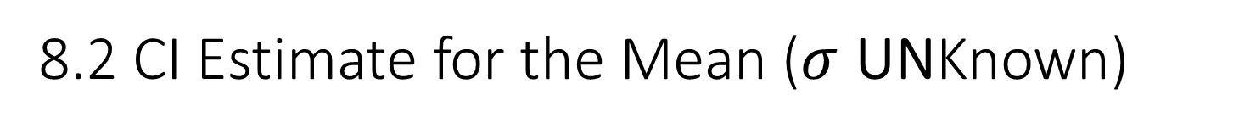
8.2 CI Estimate for the Mean ($σ$ UNKnown)
Student’s t Distribution
  William S. Gosset (under his pen name “Student”)
  Working for Guinness in Ireland
  Trying to help brew better beer less expensively
  Needed to make inferences about means without knowing σ
Substitute the sample standard deviation, S
Introduces extra uncertainty, since S is variable from sample to sample
Use the t distribution instead of the normal distribution

Slide 27
t - distribution
Similar to normal distribution
  Bell-shaped
  Symmetric
  Centered at mean/median/mode
  BUT… tails are “heavier” ➔ more probability in the tails
  Multiply by a little higher value (t-score) than z-score to get margin of error if n is small
Very close to z if n is large
DISADVANTAGES:
  To use the t-distribution, we must assume normality of the underlying population
  Degrees of freedom (associated with sample size) = n-1
  t-score times standard error estimate gives the margin of error for a confidence interval for the mean

Slide 28
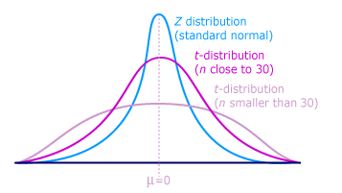
http://ci.columbia.edu/ci/premba_test/c0331/s7/s7_4.html

Slide 29

Confidence Level, (1-α)
Suppose confidence level = 95%
Also written (1 - α) = 0.95, (so α = 0.05)
Probability in the tails? (assuming two-tailed CI)
$\frac{α}{2}=$ $\frac{0.05}{2}=0.025$ (need for reading t-table)

Slide 30
Student’s t Table (Table E.3, p. 746)
Upper Tail Area
Let: n = 3
df = n - 1 = 2
α = 0.10
α/2 = 0.05
df
.10
.05
.025
1
3.078
6.314
12.706
2
1.886
2.920
4.303
3
1.638
2.353
3.182
α/2 = 0.05
The body of the table contains t values, not probabilities
0
2.920
t
Pearson slide (Chapter 8, #30)

Slide 31
Selected t distribution values
With comparison to the Z value
Confidence t t t Z
Level (10 d.f.) (20 d.f.) (30 d.f.) (∞ d.f.)
0.80 1.372 1.325 1.310 1.28
0.90 1.812 1.725 1.697 1.645
0.95 2.228 2.086 2.042 1.96
0.99 3.169 2.845 2.750 2.58
Note: t Z as n increases
Pearson slide (Chapter 8, #31)

Slide 32
Confidence Interval for a Population Mean
When the standard deviation of the population is unknown, the confidence interval for the population mean µ is
CI =
“t-score” is based on the t-distribution
  Determined from the level of confidence (α) and
  Degrees of freedom (df = n–1), where n is the sample size
To use this method, you need:
  Data obtained by randomization
  Approximately normal population distribution
    Especially important for small sample sizes (if non-normal, use large sample, i.e., n>30)
    Make a graphical display of the data and check for extreme outlier
    t-distribution is a robust method in terms of the normality assumption

Slide 33
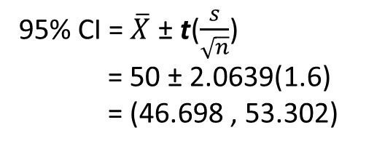
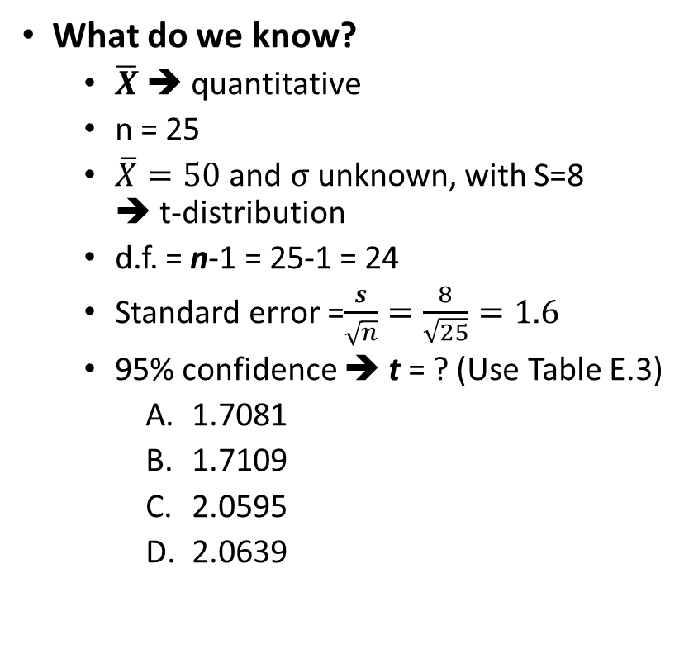
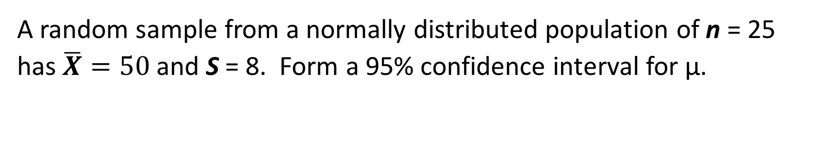
Example:
A random sample from a normally distributed population of n = 25 has $\overline{X}=50$and S = 8. Form a 95% confidence interval for μ.
95% CI = $\overline{X}$ ± t($\frac{s}{\sqrt{n}}$)
= 50 ± 2.0639(1.6)
= (46.698 , 53.302)
What do we know?
  $\overline{X}$ ➔ quantitative
  n = 25
  $\overline{X}=50$ and $σ$ unknown, with S=8
  ➔ t-distribution
  d.f. = n-1 = 25-1 = 24
  Standard error =$\frac{s}{\sqrt{n}}=\frac{8}{\sqrt{25}}=1.6$
  95% confidence ➔ t = ? (Use Table E.3)
    1.7081
    1.7109
    2.0595
    2.0639
Interpretation: Assuming that the underlying data are approximately normally distributed, we are 95% confident that the true mean is between 46.698 and 53.302
Although the true mean may or may not be in this interval, 95% of intervals formed in this manner will contain the true mean

Slide 34
8.4 Determining Sample Size
Sometimes given sample size reported with results for a sample already executed
BUT… determination of sample size is a part of the business world
We’ve already looked at Margin of Error (MOE) when we created confidence intervals
Develop sample size estimator (n_{e}) using our estimates for MOE
Margin
of Error
Margin
of Error
Standard Deviation of distribution of
values or
Standard Error
Standard Error
or
Standard Deviation
of the Sampling Distribution

Slide 35
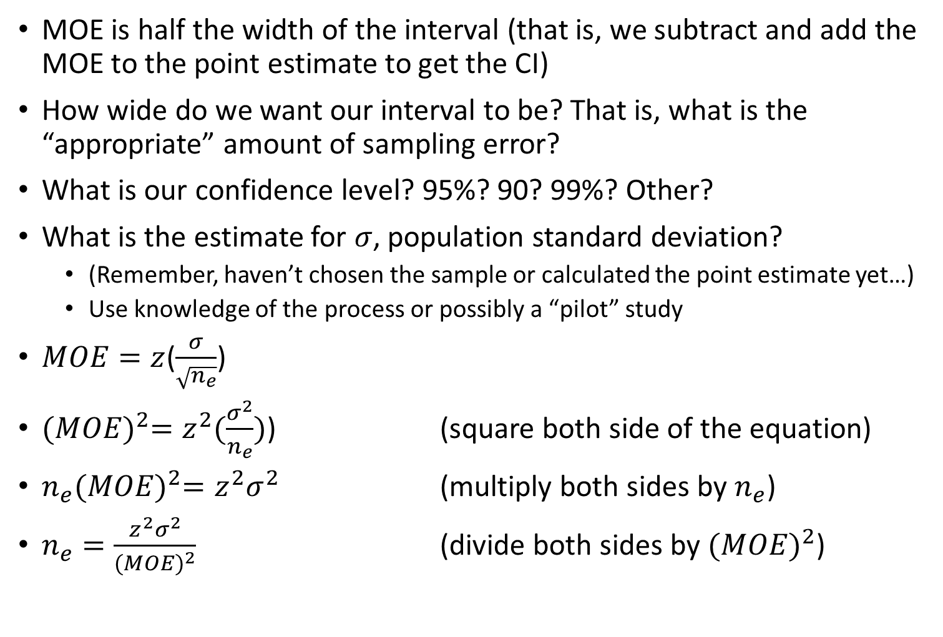
Sample size for means
MOE is half the width of the interval (that is, we subtract and add the MOE to the point estimate to get the CI)
How wide do we want our interval to be? That is, what is the “appropriate” amount of sampling error?
What is our confidence level? 95%? 90? 99%? Other?
What is the estimate for $σ$, population standard deviation?
  (Remember, haven’t chosen the sample or calculated the point estimate yet…)
  Use knowledge of the process or possibly a “pilot” study
$MOE=z$($\frac{σ}{\sqrt{n_{e}}}$)
${(MOE)}^{2}=z^{2}(\frac{σ^{2}}{n_{e}})$) (square both side of the equation)
$n_{e}{(MOE)}^{2}=z^{2}σ^{2}$ (multiply both sides by $n_{e}$)
$n_{e}=\frac{z^{2}σ^{2}}{{(MOE)}^{2}}$ (divide both sides by ${(MOE)}^{2}$)

Slide 36
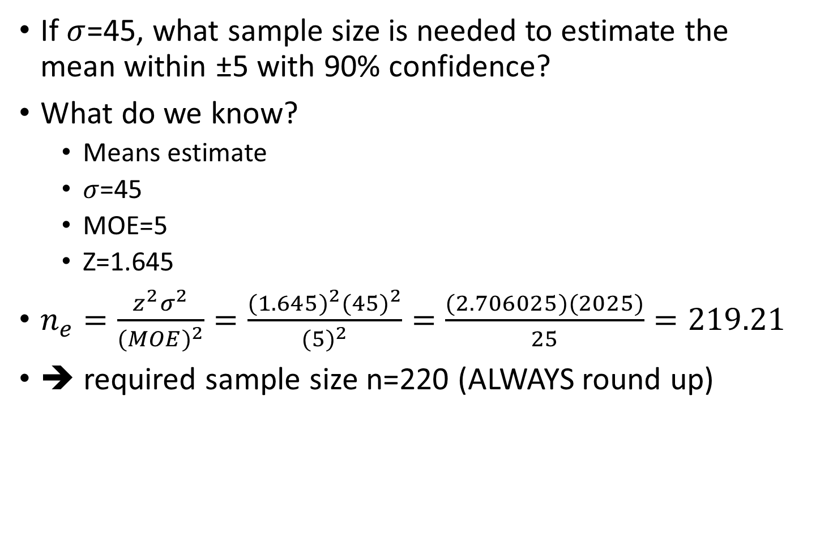
Example
If $σ$=45, what sample size is needed to estimate the mean within ±5 with 90% confidence?
What do we know?
  Means estimate
  $σ$=45
  MOE=5
  Z=1.645
$n_{e}=\frac{z^{2}σ^{2}}{{(MOE)}^{2}}=\frac{{(1.645)}^{2}{(45)}^{2}}{{(5)}^{2}}=\frac{(2.706025)(2025)}{25}=219.21$
➔ required sample size n=220 (ALWAYS round up)

Slide 37

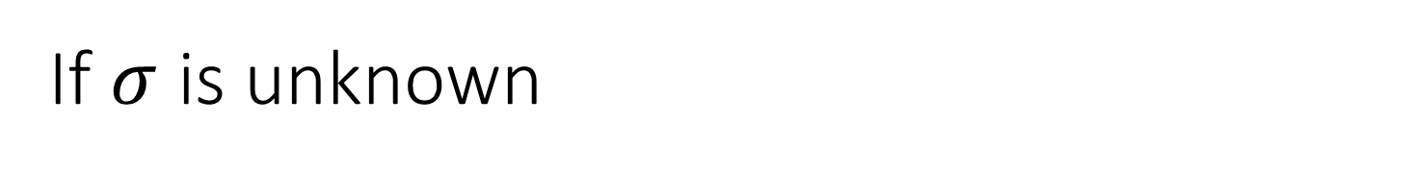
If $σ$ is unknown
Use the estimate for $σ$ expected to be at least as large as the actual value
Select a pilot sample to calculate a value, S, to use as an estimate

Slide 38
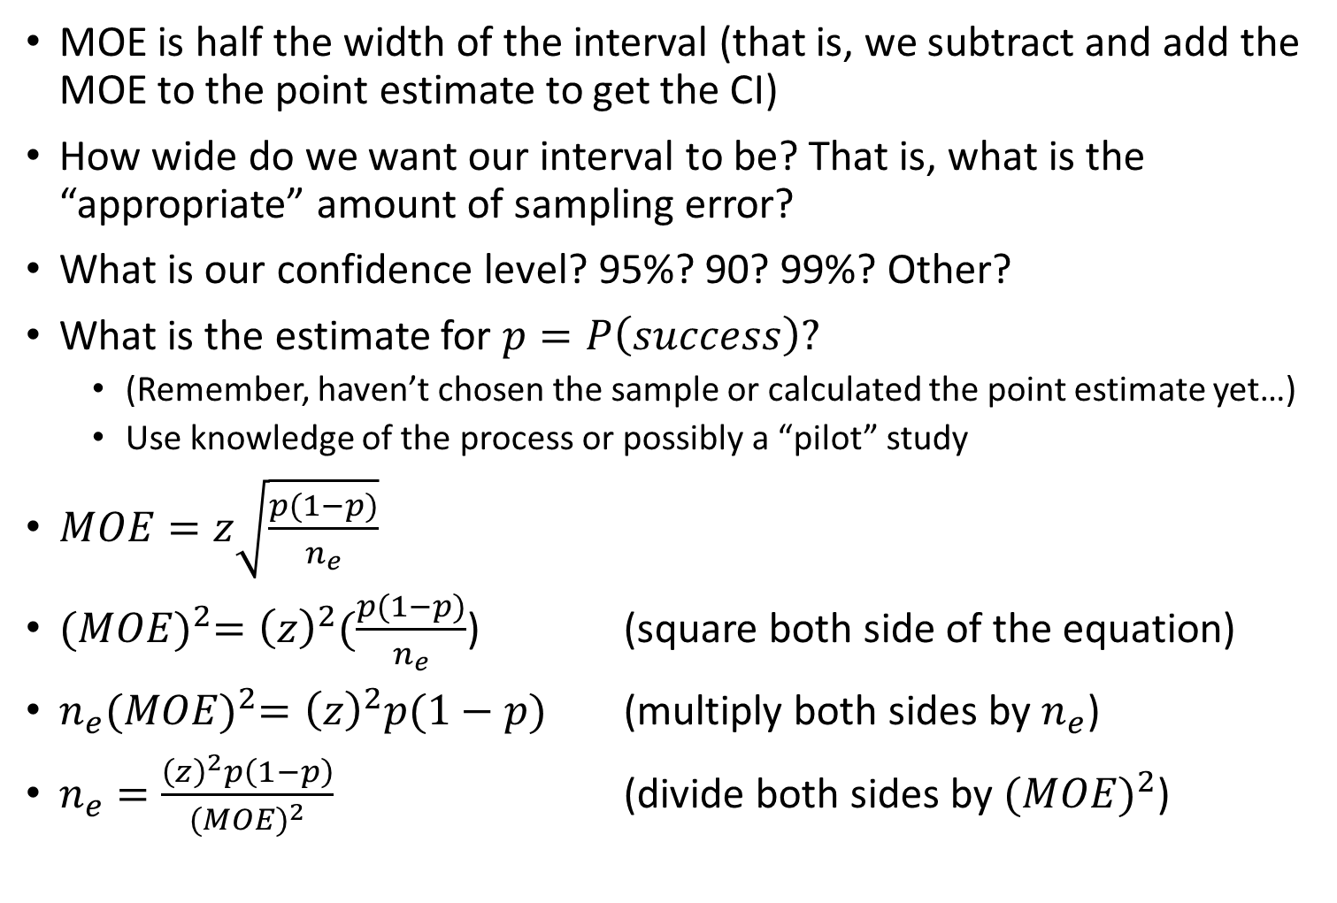
Sample size for proportions
MOE is half the width of the interval (that is, we subtract and add the MOE to the point estimate to get the CI)
How wide do we want our interval to be? That is, what is the “appropriate” amount of sampling error?
What is our confidence level? 95%? 90? 99%? Other?
What is the estimate for $p=P\left(success\right)?$
  (Remember, haven’t chosen the sample or calculated the point estimate yet…)
  Use knowledge of the process or possibly a “pilot” study
$MOE=z\sqrt{\frac{p(1−p)}{n_{e}}}$
${(MOE)}^{2}={\left(z\right)}^{2}(\frac{p(1−p)}{n_{e}}$) (square both side of the equation)
$n_{e}{(MOE)}^{2}={\left(z\right)}^{2}p(1−p)$ (multiply both sides by $n_{e}$)
$n_{e}=\frac{{\left(z\right)}^{2}p\left(1−p\right)}{{(MOE)}^{2}}$ (divide both sides by ${(MOE)}^{2}$)

Slide 39
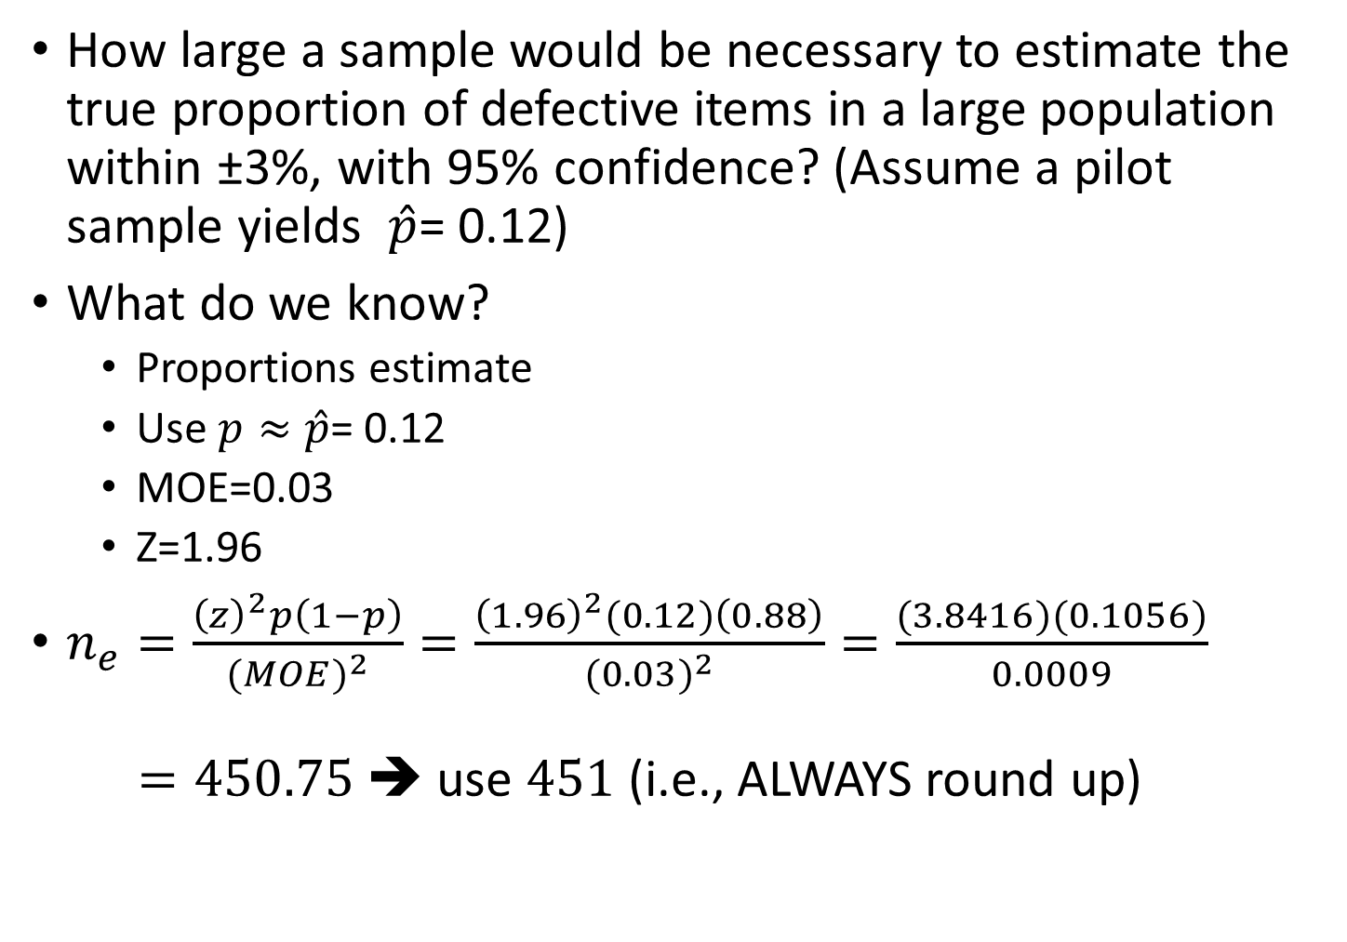
Example
How large a sample would be necessary to estimate the true proportion of defective items in a large population within ±3%, with 95% confidence? (Assume a pilot sample yields $\hat{p}$= 0.12)
What do we know?
  Proportions estimate
  Use $p≈\hat{p}$= 0.12
  MOE=0.03
  Z=1.96
$n_{e}=\frac{{\left(z\right)}^{2}p\left(1−p\right)}{{(MOE)}^{2}}=\frac{{\left(1.96\right)}^{2}(0.12)\left(0.88\right)}{{(0.03)}^{2}}=\frac{(3.8416)(0.1056)}{0.0009}$
$=450.75$ ➔ use 451 (i.e., ALWAYS round up)

Slide 40
8.5 CI Estimation and Ethical Issues
A confidence interval estimate (reflecting sampling error) should always be included when reporting a point estimate
The level of confidence should always be reported
The sample size should be reported
An interpretation of the confidence interval estimate should also be provided

Slide 41
Question:
You are trying to determine the required sample size for a study/analysis, but you do not have any idea what the population standard deviation may be. What is your next step?
  Give up. If you do not have basic information about the population, you cannot determine a sample size.
  Conduct a small study (pilot study) prior to carrying out your experiment to determine an estimated value s for your population standard deviation σ
  Conduct a small study (pilot study) prior to carrying out your experiment to determine an estimated value σ for your population standard deviation s
  Guess that σ =0, and carry out the sample size calculation

Slide 42
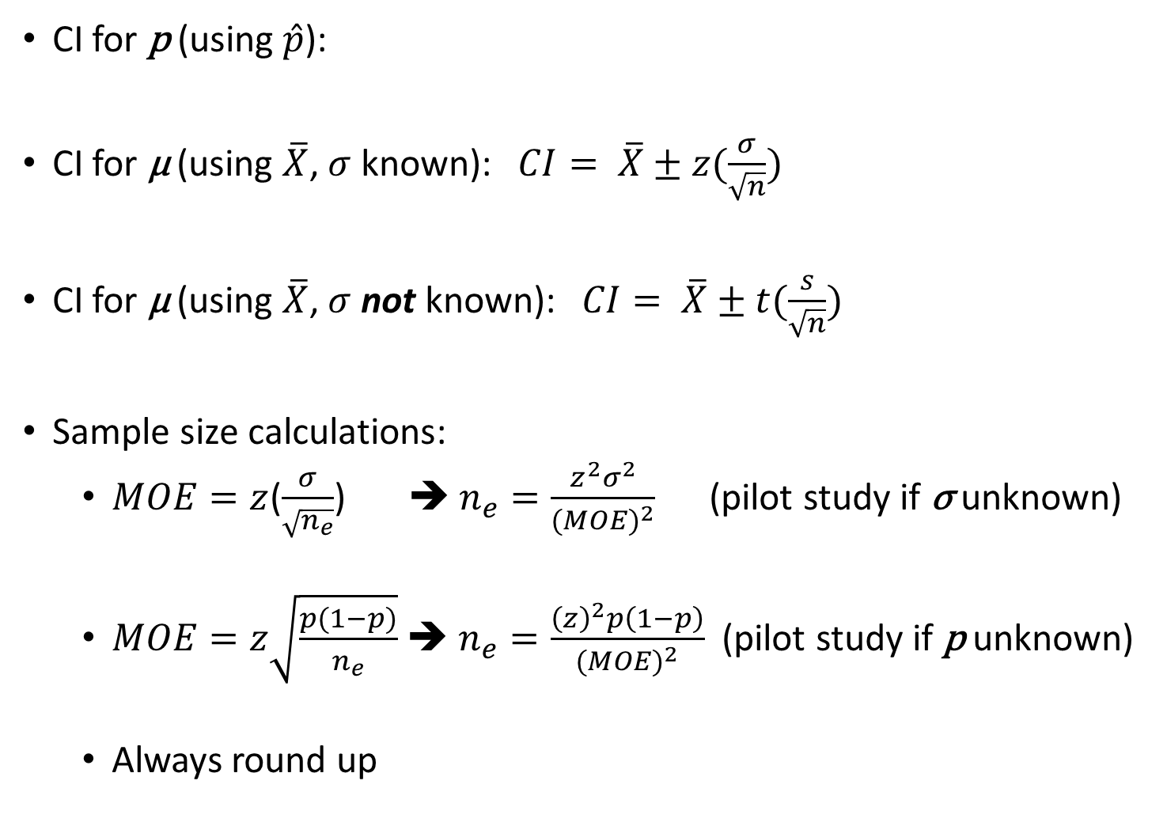
Review:
CI for p (using $\hat{p}$):
CI for µ (using $\overline{X}$, $σ$ known):$CI= \overline{X}±z(\frac{σ}{\sqrt{n}})$
CI for µ (using $\overline{X}$, $σ$ not known):$CI= \overline{X}±t(\frac{s}{\sqrt{n}})$
Sample size calculations:
  $MOE=z$($\frac{σ}{\sqrt{n_{e}}}$) ➔ $n_{e}=\frac{z^{2}σ^{2}}{{(MOE)}^{2}}$ (pilot study if σ unknown)
  $MOE=z\sqrt{\frac{p(1−p)}{n_{e}}}$ ➔ $n_{e}=\frac{{\left(z\right)}^{2}p\left(1−p\right)}{{(MOE)}^{2}}$ (pilot study if p unknown)
  Always round up

