Slide 1
STAT 206:
Chapter 9
Fundamentals of Hypothesis Testing:
One-Sample Tests

Slide 2
Ideas in Chapter 9
Basic principles of hypothesis testing
How to use hypothesis testing to test a mean or proportion
  Assumptions of each hypothesis-testing procedure
  How to evaluate them
  Consequences if they are seriously violated
Pitfalls & ethical issues involved in hypothesis testing
How to avoid the pitfalls involved in hypothesis testing

Slide 3

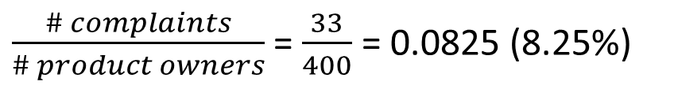
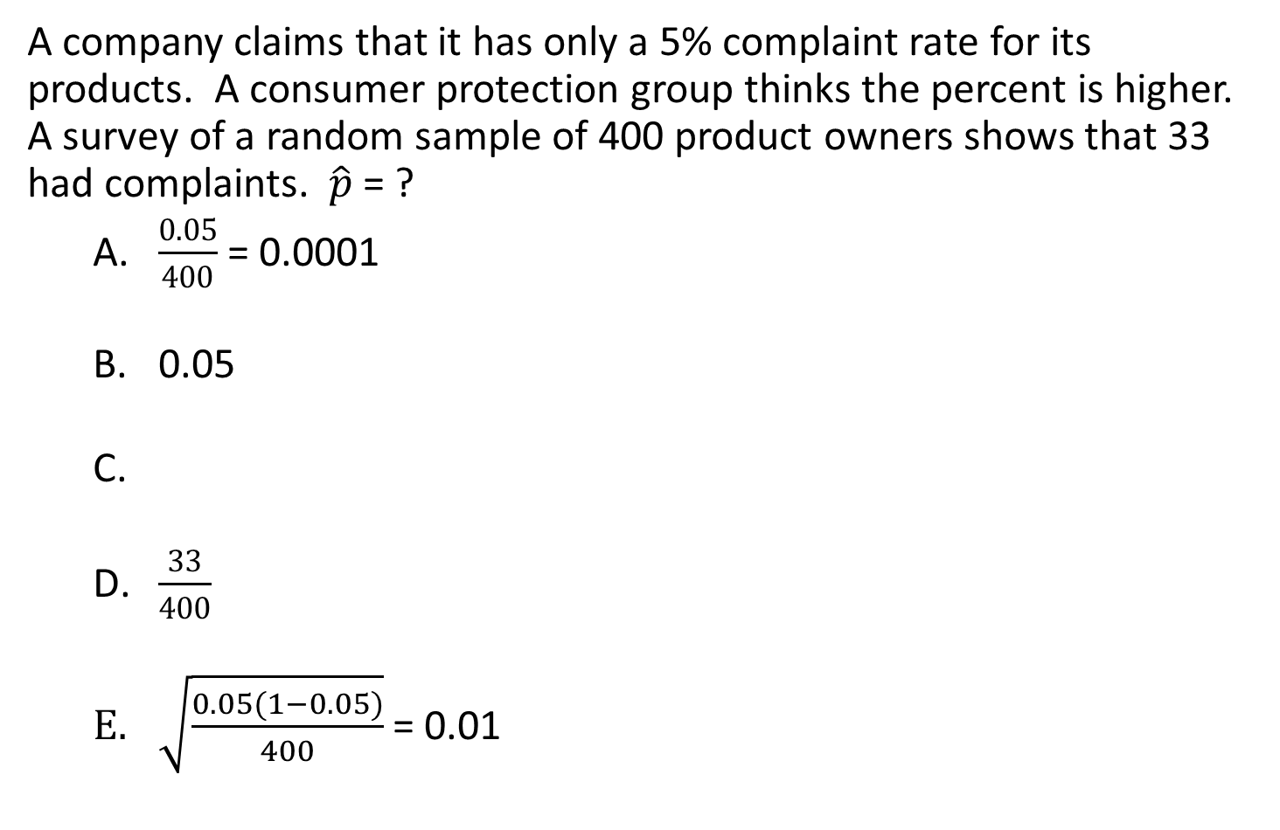
Consider:
A company claims that it has only a 5% complaint rate for its products. A consumer protection group thinks the percent is higher. A survey of a random sample of 400 product owners shows that 33 had complaints. $\hat{p}$ = ?
  $\frac{0.05}{400}$ = 0.0001
  0.05
  $\frac{33}{400}$
  $\sqrt{\frac{0.05(1−0.05)}{400}}$ = 0.01
$\frac{\# complaints}{\# product owners}$ = $\frac{33}{400}$ = 0.0825 (8.25%)

Slide 4
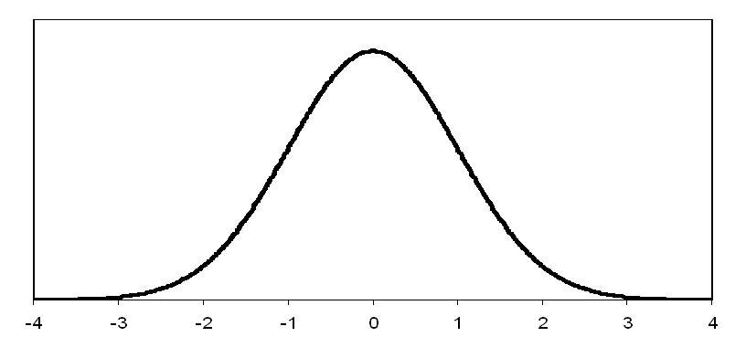
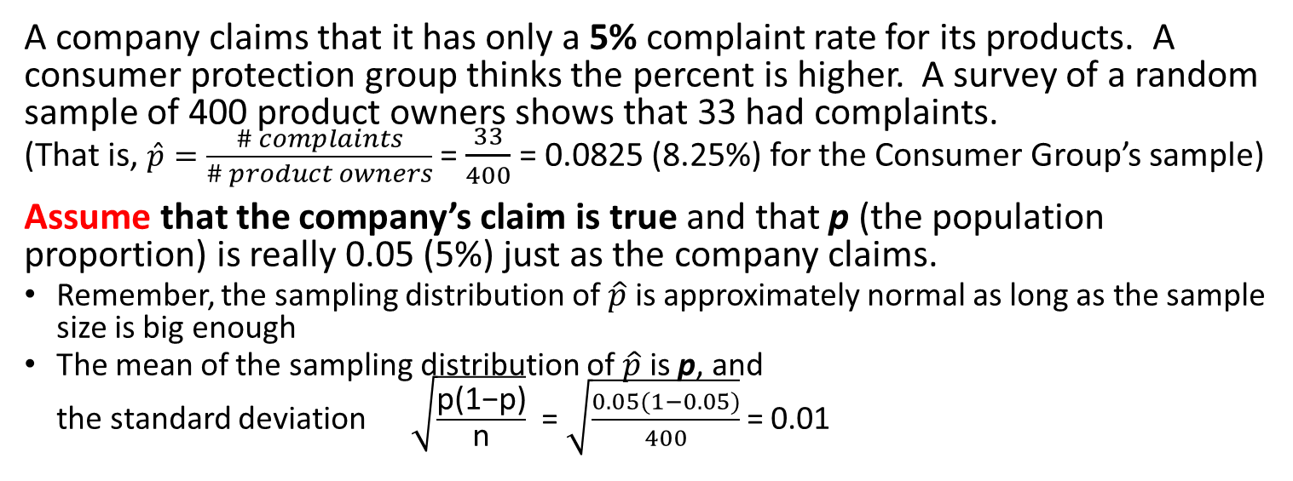
  A company claims that it has only a 5% complaint rate for its products. A consumer protection group thinks the percent is higher. A survey of a random sample of 400 product owners shows that 33 had complaints.
  (That is, $\hat{p}=\frac{\# complaints}{\# product owners}$ = $\frac{33}{400}$ = 0.0825 (8.25%) for the Consumer Group’s sample)
  Assume that the company’s claim is true and that p (the population proportion) is really 0.05 (5%) just as the company claims.
Remember, the sampling distribution of $\hat{p}$ is approximately normal as long as the sample size is big enough
The mean of the sampling distribution of $\hat{p}$ is p, and
the standard deviation $\sqrt{\frac{\text{p}\text{(1−}\text{p}\text{)}}{\text{n}}}$ = $\sqrt{\frac{0.05(1−0.05)}{400}}$ = 0.01
.02
.03
.04
.05
.06
.07
.08

Slide 5
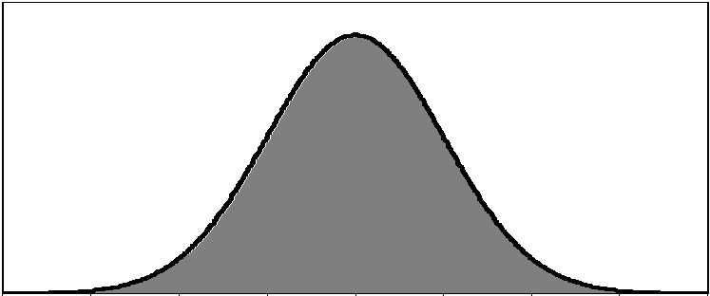


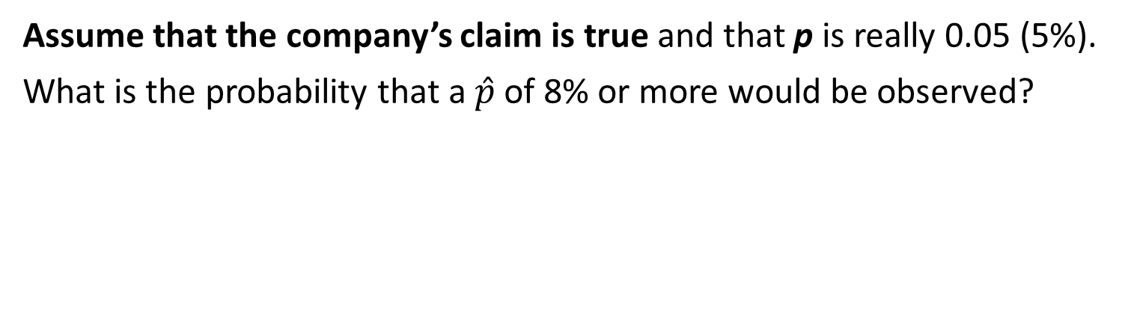
  Assume that the company’s claim is true and that p is really 0.05 (5%).
  What is the probability that a $\hat{p}$ of 8% or more would be observed?
$\hat{p}$ = 0.0825
0.997
.02
.03
.04
.05
.06
.07
.08
1.000 – 0.997 = 0.003
and 0.003 / 2 = 0.0015 (0.15%) in each tail
P($\hat{p}$ ≥0.08) = 0.0015 (0.15%)
That is, UNLIKELY!

Slide 6
Null Hypothesis, H₀ (H-naught)
Hypothesis test checks sample data against a claim or assumption about the population
H₀ states the claim of the assertion to be tested
  Null hypothesis is the status quo or historical value
H₀ is ALWAYS about a population parameter,
NOT a sample statistic
Always contains “=“, or “≤”, or “≥” sign
Until hypothesis test is completed and the decision is made, researcher must “ASSUME” that H₀ is TRUE
  Similar to the notion of innocent until proven guilty in our justice system…
ASSUMPTION of true H₀ may or may not be REJECTED
BUT the ASSUMPTION is NEVER ACCEPTED

Slide 7
Examples:
Consider a jury trial in which someone is accused of murder
  H₀: Defendant is innocent
Mean monthly cell phone bill in this city is μ = $42
(claim by telephone carriers)
  H₀: μ = $42
Proportion of adults in this city with cell phones is p = 0.68
  H₀: p = 0.68

Slide 8
Alternative Hypothesis, H₁ (or H_{A})
Opposite of the null hypothesis
Challenges the status quo
Never contains the “=“, or “≤”, or “≥” sign
  If H₀ contains “=“ ➔ H₁ must contain “≠”
  If H₀ contains “≤“ ➔ H₁ must contain “>”
  If H₀ contains “≥“ ➔ H₁ must contain “<”
May or may not be proven (that is, may or may not have sufficient evidence to accept the alternative)
Is generally the hypothesis that the researcher is trying to prove

Slide 9
Examples:
Consider a jury trial in which someone is accused of murder
  H₀: Defendant is innocent
  H₁: Defendant is guilty
Mean monthly cell phone bill in this city is μ = $42
(claim by telephone carriers)
  H₀: μ = $42
  H₁: μ ≠ $42
Proportion of adults in this city with cell phones is p = 0.68
  H₀: p = 0.68
  H₁: p ≠ 0.68

Slide 10
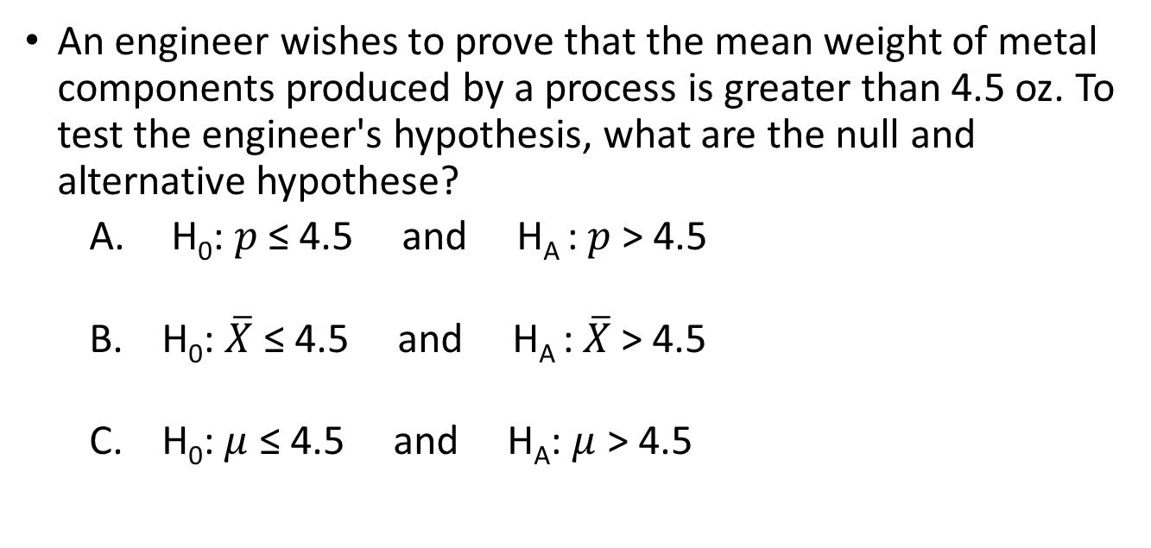
Questions:
The null hypothesis is:
  another name for the alternative hypothesis
  true with 95% probability
  usually “status quo,” “no effect” or “no difference”
  determined by looking at the data
  statistically significant
An engineer wishes to prove that the mean weight of metal components produced by a process is greater than 4.5 oz. To test the engineer's hypothesis, what are the null and alternative hypothese?
  H₀: $p$ ≤ 4.5 and H_{A} : $p$ > 4.5
  H₀: $\overline{X}$ ≤ 4.5 and H_{A} :$\overline{X}$> 4.5
  H₀:$μ$ ≤ 4.5 and H_{A}: $μ$ > 4.5

Slide 11
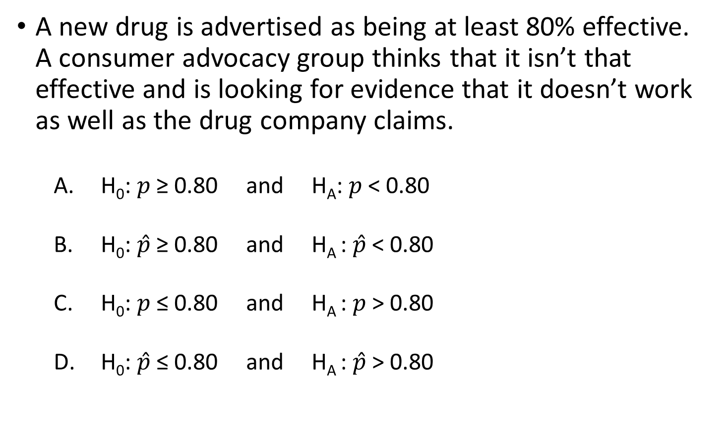
Question:
A new drug is advertised as being at least 80% effective. A consumer advocacy group thinks that it isn’t that effective and is looking for evidence that it doesn’t work as well as the drug company claims.
  H₀: $p$ ≥ 0.80 and H_{A}: $p$ < 0.80
  H₀: $\hat{p}$ ≥ 0.80 and H_{A} : $\hat{p}$ < 0.80
  H₀: $p$ ≤ 0.80 and H_{A} : $p$ > 0.80
  H₀: $\hat{p}$ ≤ 0.80 and H_{A} : $\hat{p}$ > 0.80

Slide 12
Review:
H₀ states the claim of the assertion to be tested – status quo or historical value
  H₀ is ALWAYS about parameter, NOT sample statistic
  Always contains “=“, or “≤”, or “≥” sign
  “ASSUME” H₀ is TRUE until reject/not reject - NEVER ACCEPT
H_{A} states hypothesis that the researcher is trying to prove – challenges status quo
  Opposite of the null hypothesis
  (H₀ “=“ ➔ H₁ “≠” ;
  H₀ “≤“ ➔ H₁ “>”;
  H₀ “≥“ ➔ H₁ “<”)
  May or may not be proven
  (that is, may or may not have
  sufficient evidence to reject
  the null in favor of
  the alternative)

Slide 13
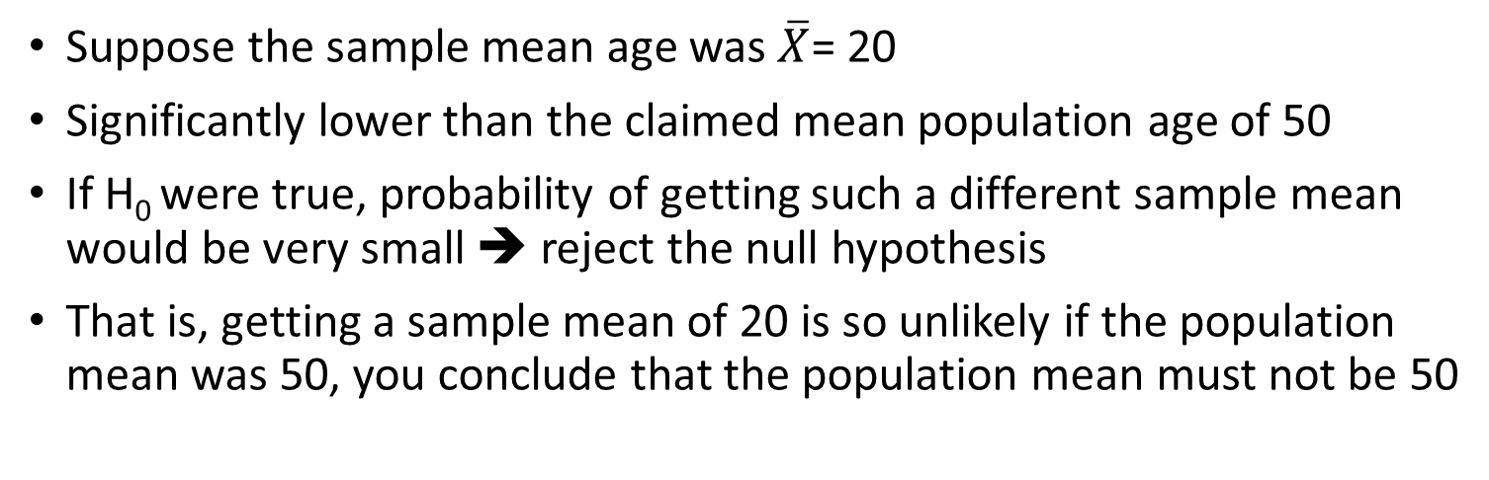
The Hypothesis Testing Process
Claim: The population mean age is 50
  H₀: μ = 50
  H₁: μ ≠ 50
Population
Sample the population and find the sample mean.
Sample
Suppose the sample mean age was $\overline{X}$= 20
Significantly lower than the claimed mean population age of 50
If H₀ were true, probability of getting such a different sample mean would be very small ➔ reject the null hypothesis
That is, getting a sample mean of 20 is so unlikely if the population mean was 50, you conclude that the population mean must not be 50

Slide 14
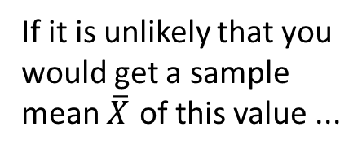
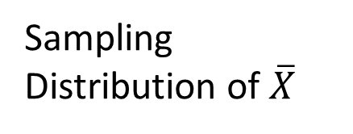
The Hypothesis Testing Process
Sampling Distribution of $\overline{X}$
X
20
μ = 50
If H₀ is true
... then you reject the null hypothesis that μ = 50
If it is unlikely that you would get a sample mean $\overline{X}$ of this value ...
... When in fact this was
the population mean…

Slide 15
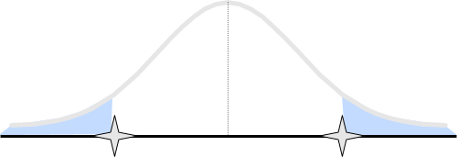
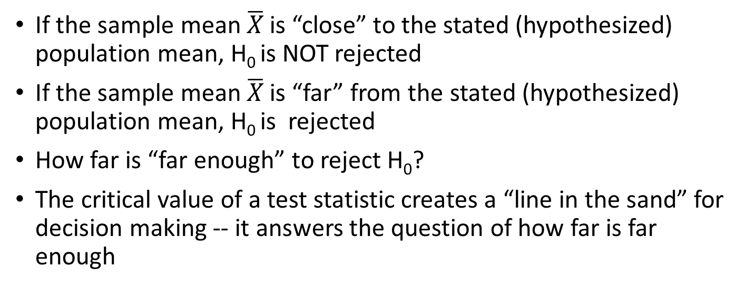
Test Statistic and Critical Values
If the sample mean $\overline{X}$ is “close” to the stated (hypothesized) population mean, H₀ is NOT rejected
If the sample mean $\overline{X}$ is “far” from the stated (hypothesized) population mean, H₀ is rejected
How far is “far enough” to reject H₀?
The critical value of a test statistic creates a “line in the sand” for decision making -- it answers the question of how far is far enough
Region of Rejection
Region of Rejection
Region of
Non-Rejection
Critical Values
“Too Far Away” From Mean of Sampling Distribution

Slide 16
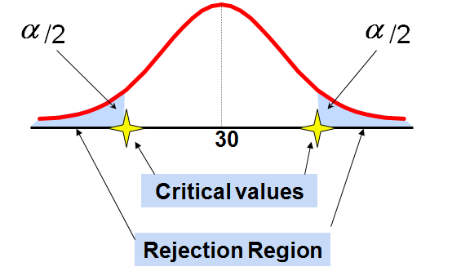
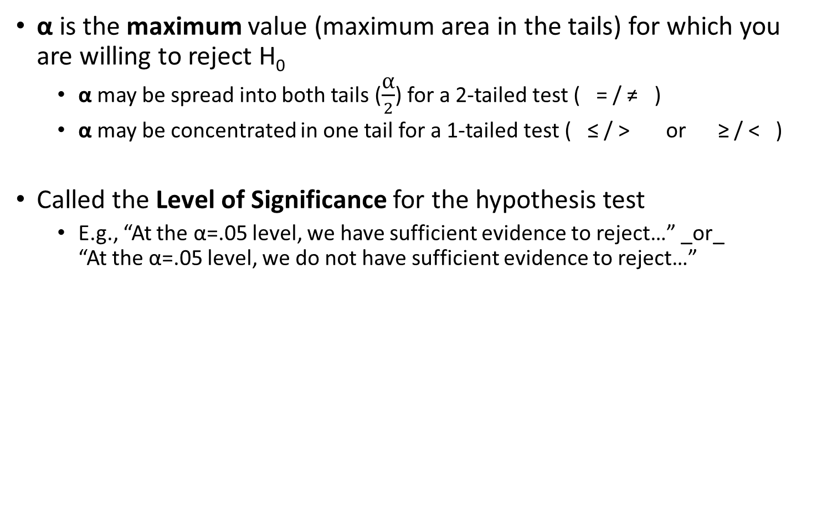
Level of Significance (α) and Rejection Region
α is the maximum value (maximum area in the tails) for which you are willing to reject H₀
  α may be spread into both tails ($\frac{\text{α}}{2}$) for a 2-tailed test ( = / ≠ )
  α may be concentrated in one tail for a 1-tailed test ( ≤ / > or ≥ / < )
Called the Level of Significance for the hypothesis test
  E.g., “At the α=.05 level, we have sufficient evidence to reject…” _or_
  “At the α=.05 level, we do not have sufficient evidence to reject…”

Slide 17
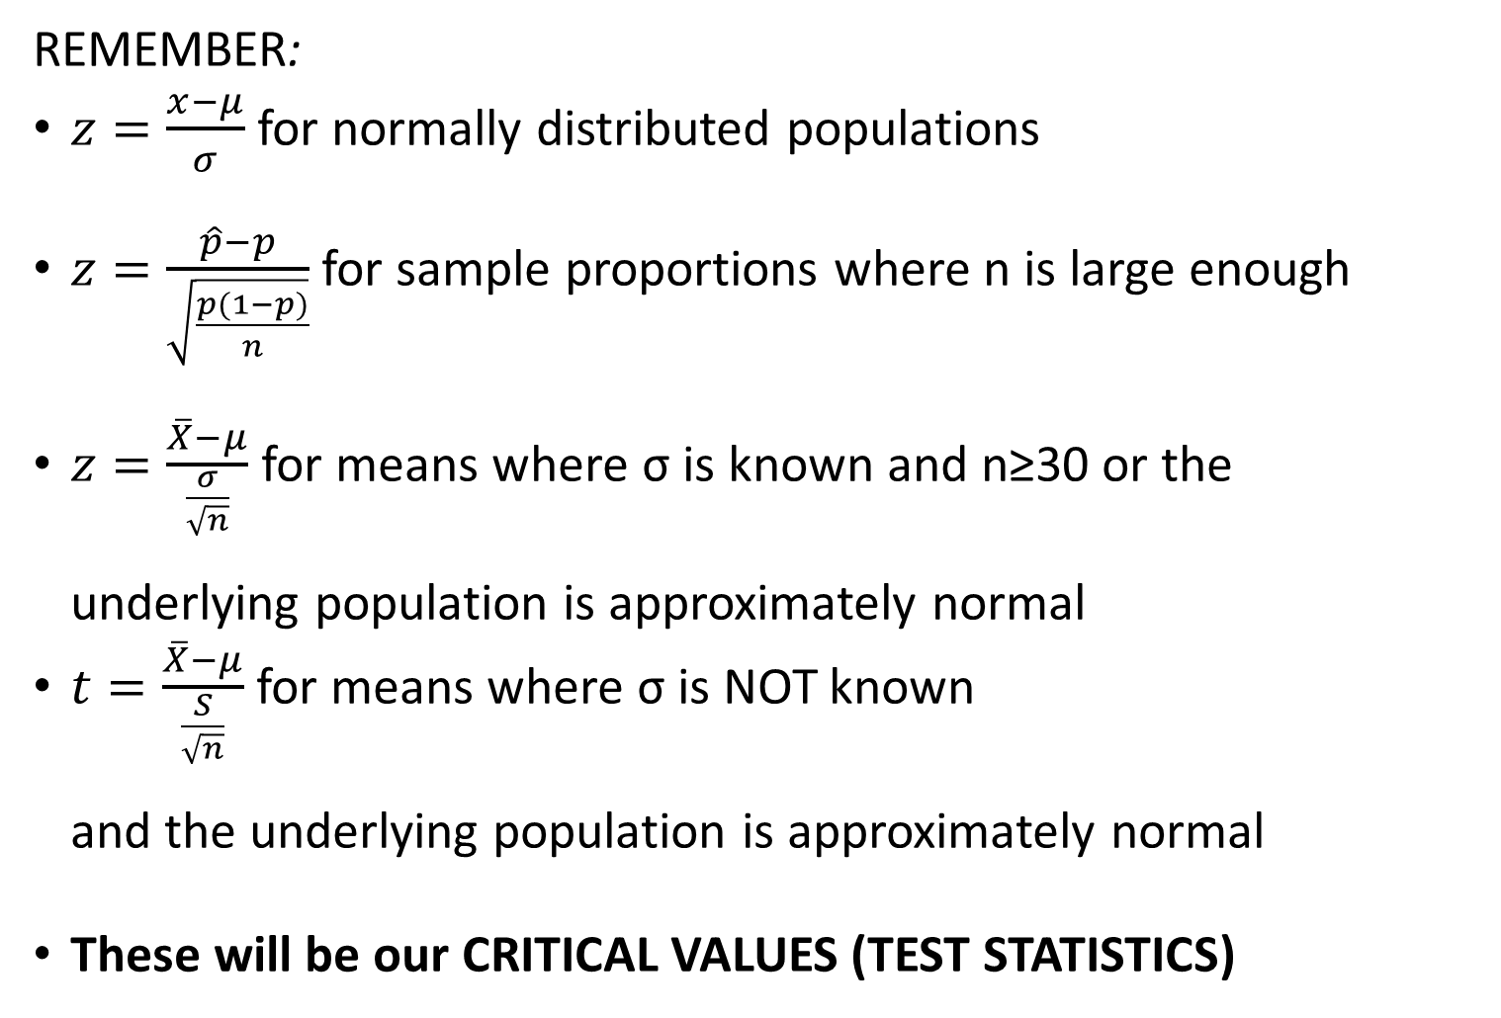
Critical Value Calculations
REMEMBER:
$z=\frac{x−μ}{σ}$ for normally distributed populations
$z=\frac{\hat{p}−p}{\sqrt{\frac{p(1−p)}{n}}}$ for sample proportions where n is large enough
$z=\frac{\overline{X}−μ}{\frac{σ}{\sqrt{n}}}$ for means where σ is known and n≥30 or the
underlying population is approximately normal
$t=\frac{\overline{X}−μ}{\frac{S}{\sqrt{n}}}$ for means where σ is NOT known
and the underlying population is approximately normal
These will be our CRITICAL VALUES (TEST STATISTICS)

Slide 18
6 Steps for
Critical Value Approach in Hypothesis Testing
State the null hypothesis, H₀ and the alternative hypothesis, H₁
Choose the level of significance, α, and the sample size, n
Determine the appropriate test statistic and sampling distribution, calculate test statistic
Determine the critical values that divide the rejection and non-rejection regions
Make the statistical decision and state the managerial conclusion. If the test statistic falls into the non-rejection region, do not reject the null hypothesis H₀. If the test statistic falls into the rejection region, reject the null hypothesis. Express the managerial conclusion in the context of the problem

Slide 19
Two-Tail Tests
H₀: μ = 30 H₁: μ ≠ 30
There are two cutoff values (critical values), defining the regions of rejection
α/2
α/2
X
30
Reject H₀
Do not reject H₀
Reject H₀
-Z_{α/2}
+Z_{α/2}
Z
0
Lower critical value
Upper critical value

Slide 20
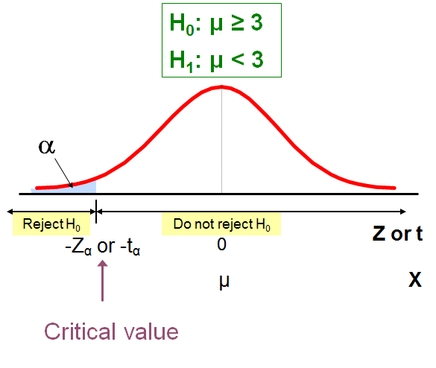
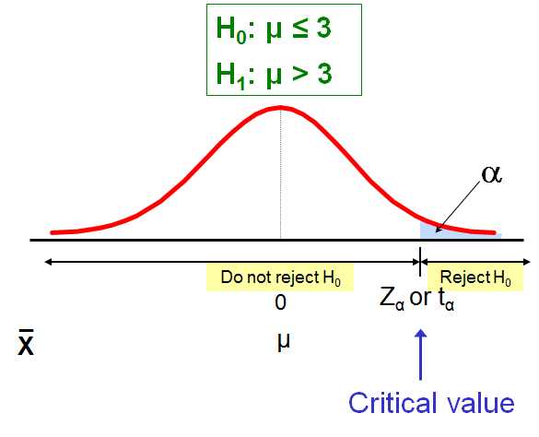
One-Tailed Tests
Lower Tail Test: There is only one critical value, since the rejection area is in only one tail
Upper Tail Test: There is only one critical value, since the rejection area is in only one tail

Slide 21
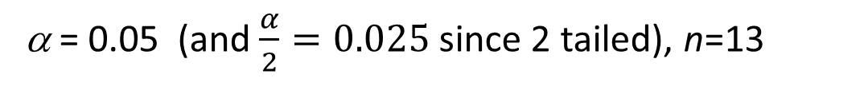
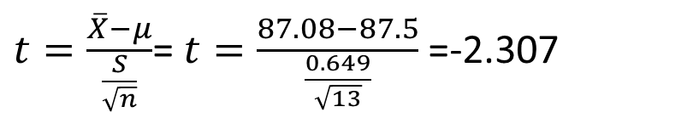
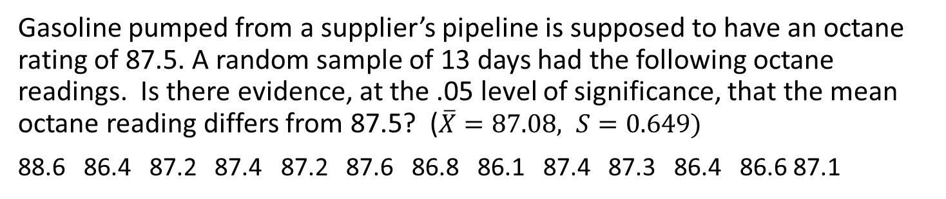
Example:
Gasoline pumped from a supplier’s pipeline is supposed to have an octane rating of 87.5. A random sample of 13 days had the following octane readings. Is there evidence, at the .05 level of significance, that the mean octane reading differs from 87.5? ($\overline{X}=87.08, S=0.649)$
88.6 86.4 87.2 87.4 87.2 87.6 86.8 86.1 87.4 87.3 86.4 86.6 87.1
  H₀: µ = 87.5
  Ha: µ ≠ 87.5
Step 1: Hypotheses
Step 2 : Choose the level of significance, α, and the sample size, n
α = 0.05 (and $\frac{α}{2}=0.025$ since 2 tailed), n=13
$t=\frac{\overline{X}−μ}{\frac{S}{\sqrt{n}}}$= $t=\frac{87.08−87.5}{\frac{0.649}{\sqrt{13}}}$ =-2.307
Step 3: Calculate Test Statistic
Step 4: Determine rejection region: t<-$t_{\frac{α}{2}}$ or t>$t_{\frac{α}{2}}$, $t_{\frac{α}{2}}$ = 2.179
Step 5: Decision and Interpretation
With -2.307<-2.179, there is sufficient evidence to reject the null hypothesis and to conclude that the long run mean octane reading differs from 87.5.

Slide 22
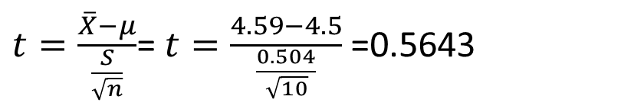
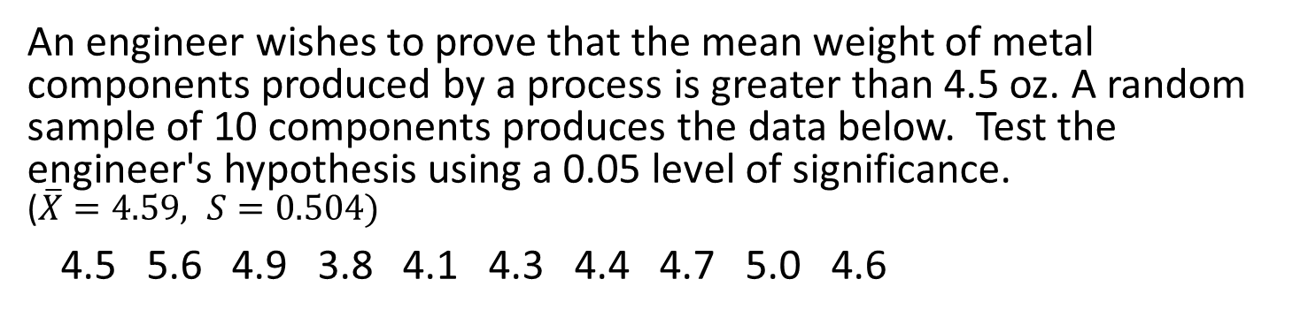
Example:
An engineer wishes to prove that the mean weight of metal components produced by a process is greater than 4.5 oz. A random sample of 10 components produces the data below. Test the engineer's hypothesis using a 0.05 level of significance.
($\overline{X}=4.59, S=0.504)$
4.5 5.6 4.9 3.8 4.1 4.3 4.4 4.7 5.0 4.6
Step 1: Hypotheses
  H₀: µ ≤ 4.5
  Ha: µ > 4.5
Step 2 : Choose the level of significance, α, and the sample size, n
α = 0.05 and n=10
$t=\frac{\overline{X}−μ}{\frac{S}{\sqrt{n}}}$= $t=\frac{4.59−4.5}{\frac{0.504}{\sqrt{10}}}$ =0.5643
Step 3: Calculate Test Statistic
Step 4: Determine rejection region: t>$t_{α}$, $t_{α}$ = 1.833
Step 5: Decision and Interpretation
With t=0.5643<1.833, there is NOT sufficient evidence to reject the null hypothesis. Thus, we are unable to conclude that the mean weight is greater than 4.5 oz.

Slide 23
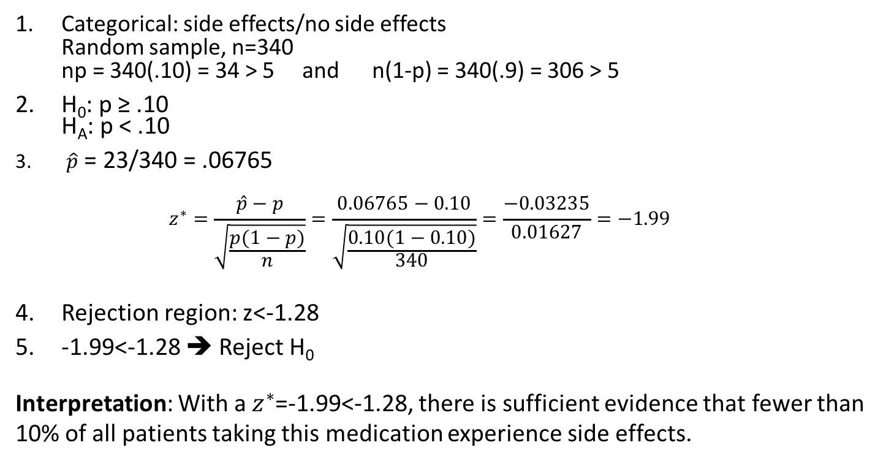
Example
A doctor is researching side effects with a new pain medication. A clinical trial including random sample of 340 people who took a new pain relief medication reveals that 23 suffered some side effects. At the α=.05 level of significance, is there evidence that less than 10% of all patients who take the medication will experience side effects?
✓
  Categorical: side effects/no side effects
  Random sample, n=340
  np = 340(.10) = 34 > 5 and n(1-p) = 340(.9) = 306 > 5
H₀: p ≥ .10
H_{A}: p < .10
$\hat{p}$ = 23/340 = .06765
$z^{∗}=\frac{\hat{p}−p}{\sqrt{\frac{p(1−p)}{n}}}=\frac{0.06765−0.10}{\sqrt{\frac{0.10(1−0.10)}{340}}}=\frac{−0.03235}{0.01627}=−1.99$
Rejection region: z<-1.28
-1.99<-1.28 ➔ Reject H₀
Interpretation: With a $z^{∗}$=-1.99<-1.28, there is sufficient evidence that fewer than 10% of all patients taking this medication experience side effects.
✓
✓

Slide 24
P-Value Approach to Testing
P-value: Probability of obtaining a test statistic equal to or more extreme than the observed sample value given H₀ is true
  The p-value is also called the observed level of significance
  Remember: α is the largest area in the tail(s) for which H₀ can be rejected
    If p-value < α , reject H₀
    If p-value ≥ α , do not reject H₀
    “If the p-value is low then H₀ must go”

Slide 25
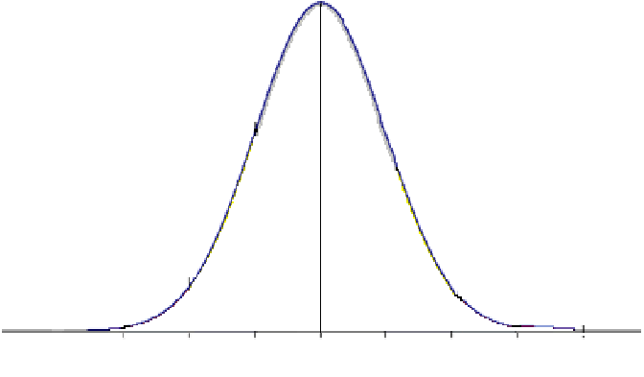
P-Value Approach to Testing
EXAMPLE H₀: p ≥ 0.70
H_{A}: p < 0.70
p =
0.70

Slide 26
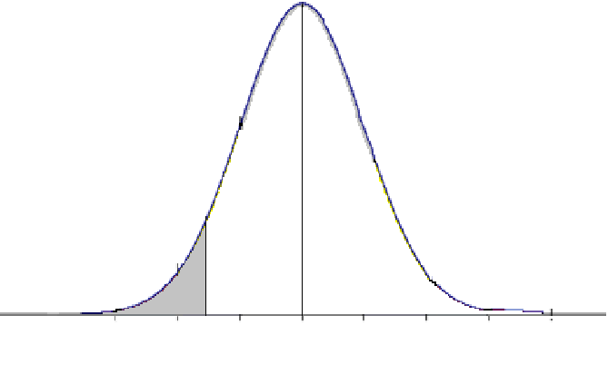
P-Value Approach to Testing
EXAMPLE H₀: p ≥ 0.70
H_{A}: p < 0.70
Let (α) = 0.05 ➔ we will reject H₀
if the probability in the tail is < 0.05
α = 0.05
= area under curve
p =
0.70

Slide 27
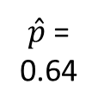

P-Value Approach to Testing
EXAMPLE H₀: p ≥ 0.70
H_{A}: p < 0.70
Let (α) = 0.05 ➔ we will reject H₀
if the probability in the tail is < 0.05
Our assumptions
and sample data
p = 0.70
n = 525
σ = 0.02
$$\hat{p}=0.64$$
α = 0.05
= area under curve
p =
0.70
$\hat{p}$ =
0.64

Slide 28
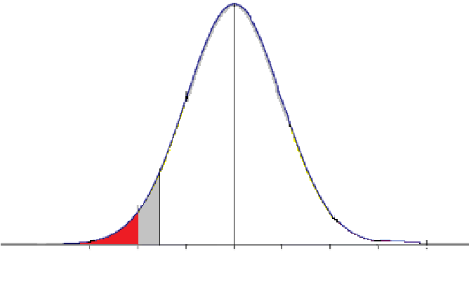
P-Value Approach to Testing
EXAMPLE H₀: p ≥ 0.70
H_{A}: p < 0.70
Let (α) = 0.05 ➔ we will reject H₀
if the probability in the tail is < 0.05
Our assumptions
and sample data
p = 0.70
n = 525
σ = 0.02
$$\hat{p}=0.64$$
α = 0.05
= area under curve
P-value
= area under curve
= 0.0228
p =
0.70
$\hat{p}$ =
0.64

Slide 29

P-Value Approach to Testing
EXAMPLE H₀: p ≥ 0.70
H_{A}: p < 0.70
Let (α) = 0.05 ➔ we will reject H₀
if the probability in the tail is < 0.05
Our assumptions
and sample data
p = 0.70
n = 525
$$\hat{p}=0.64$$
P-value = 0.0228 < 0.05 = α
➔ REJECT H₀: p = 0.70
In favor of H_{A}: p < 0.70
α = 0.05
= area under curve
P-value
= area under curve
= 0.0228
p =
0.70
$\hat{p}$ =
0.64

Slide 30
The 5 Step p-value approach to
Hypothesis Testing
State the null hypothesis, H₀ and the alternative hypothesis, H₁
Choose the level of significance, α, and the sample size, n
Determine the appropriate test statistic and sampling distribution
Collect data and compute the value of the test statistic and the p-value
Make the statistical decision and state the managerial conclusion. If the p-value is < α then reject H₀, otherwise do not reject H₀. State the managerial conclusion in the context of the problem

Slide 31
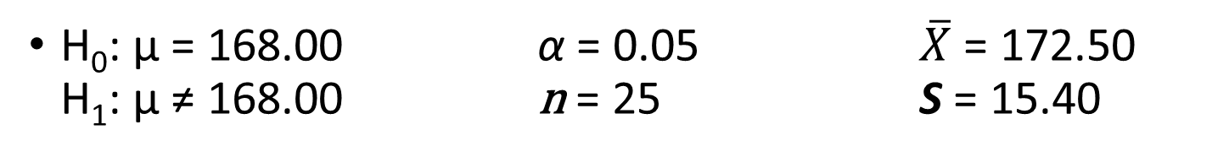
Excel Example two-tailed t-test of quantitative variable (µ) :
H₀: µ = 168.00 α = 0.05 $\overline{X}$ = 172.50
H₁: µ ≠ 168.00 n = 25 S = 15.40
 | A | B | C | D | E
1 | Null hypothesis: µ = | 168.00
2 | Alternative: µ ≠ | 168.00
3 | Level of Significance (α) | 0.05
4 | Sample size (n) | 25
5 | Sample mean (X-bar) | 172.50
6 | Sample standard deviation (S) | 15.40
7
8 | Standard Error of Mean | 3.08 | =B6/SQRT(B4)
9 | Degrees of Freedom | 24 | =B4 - 1
10 | t test-statistic | 1.46 | =(B5-B1)/B8
11
12 | Lower Critical Value | -2.06389856 | =-T.INV.2T(B3,B9) | =-T.INV.2T(<α>,<deg_freedom>))
13 | Upper Critical Value | 2.063898562 | =T.INV.2T(B3,B9) | =T.INV.2T(<α>,<deg_freedom>))
14 | P-value | 0.156974373 | =T.DIST.2T(B10,B9) | =T.DIST.2T(<test statistic>,<deg_freedom)
15
P-value = 0.15697 > 0.05 = α
➔ FAIL to reject

Slide 32
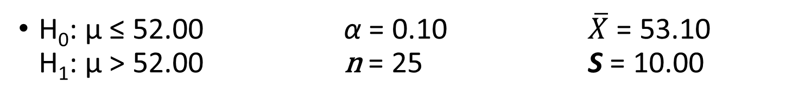
Excel example for one-tailed t-test of quantitative variable (µ) :
H₀: µ ≤ 52.00 α = 0.10 $\overline{X}$ = 53.10
H₁: µ > 52.00 n = 25 S = 10.00
 | A | B | C | D | E
1 | Null hypothesis: µ ≤ | 52.00
2 | Alternative: µ > | 52.00
3 | Level of Significance (α) | 0.10
4 | Sample size (n) | 25
5 | Sample mean (X-bar) | 53.10
6 | Sample standard deviation (S) | 10.00
7
8 | Standard Error of Mean | 2.00 | =B6/SQRT(B4)
9 | Degrees of Freedom | 24 | =B4 - 1
10 | t test-statistic | 0.55 | =(B5-B1)/B8
11
12 | Upper Critical Value | 1.31784 | =ABS(T.INV(B3,B9)) | =ABS(T.INV(<α>,<deg_freedom>))
13 | P-value | 0.29375 | =T.DIST.RT(B10,B9) | =T.DIST.RT(<test statistic>,<deg_freedom)
14
15
P-value = 0.29375 > 0.10 = α
➔ FAIL to reject

Slide 33
Questions:
The P-value of a hypothesis test (test of significance) is calculated assuming:
  Nothing – we make no assumptions about which hypothesis is true in order to avoid bias
  A level of significance of 0.05
  The alternative hypothesis is true
  The null hypothesis is true
A recent study looked at the effect of cardiorespiratory fitness in middle age on the onset of dementia. The researchers found that the chance of developing dementia after age 65 is significantly less for those who are very fit at age 50. This means that:
  observing low rates of dementia after age 65 for the very fit group (at age 50) would often occur just by chance
  observing low rates of dementia after age 65 for the very fit group (at age 50) would rarely occur just by chance
  observing low rates of dementia after age 65 for the very fit group (at age 50) would never occur just by chance

Slide 34
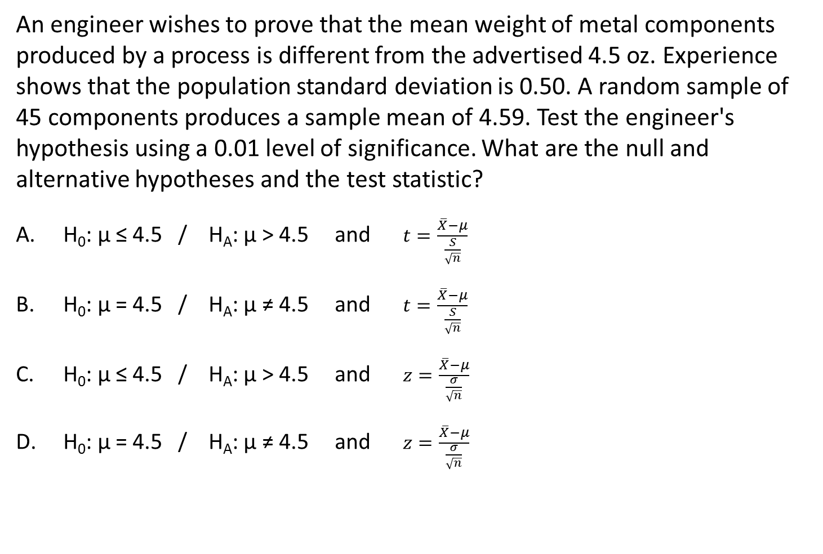
Question:
An engineer wishes to prove that the mean weight of metal components produced by a process is different from the advertised 4.5 oz. Experience shows that the population standard deviation is 0.50. A random sample of 45 components produces a sample mean of 4.59. Test the engineer's hypothesis using a 0.01 level of significance. What are the null and alternative hypotheses and the test statistic?
H₀: µ ≤ 4.5 / H_{A}: µ > 4.5 and $t=\frac{\overline{X}−μ}{\frac{S}{\sqrt{n}}}$
H₀: µ = 4.5 / H_{A}: µ ≠ 4.5 and $t=\frac{\overline{X}−μ}{\frac{S}{\sqrt{n}}}$
H₀: µ ≤ 4.5 / H_{A}: µ > 4.5 and $z=\frac{\overline{X}−μ}{\frac{σ}{\sqrt{n}}}$
H₀: µ = 4.5 / H_{A}: µ ≠ 4.5 and $z=\frac{\overline{X}−μ}{\frac{σ}{\sqrt{n}}}$

Slide 35
6 Steps for Critical Value Approach
Null (H₀) and alternative (H₁) hypotheses
Level of significance, α, and the sample size, n
Determine the appropriate test statistic
Critical values to define rejection/non-rejection regions
Collect data and compute the value of the test statistic
Make the statistical decision and state the managerial conclusion.
5 Steps for P-value Approach
Null (H₀) and alternative (H₁) hypotheses
Level of significance, α, and the sample size, n
Determine the appropriate test statistic
Collect data and compute the value of the test statistic and
the p-value
Make the statistical decision and state the managerial conclusion.

Slide 36
Example:
Gasoline pumped from a supplier’s pipeline is supposed to have an octane rating of 87.5. A random sample of 13 days had the following octane readings. Is there evidence, at the .05 level of significance, that the mean octane reading differs from 87.5? ($\overline{X}=87.08, S=0.649)$
88.6 86.4 87.2 87.4 87.2 87.6 86.8 86.1 87.4 87.3 86.4 86.6 87.1
  H₀: µ = 87.5
  Ha: µ ≠ 87.5
Step 1: Hypotheses
Step 2 : Choose the level of significance, α, and the sample size, n
α = 0.05 (and $\frac{α}{2}=0.025$ since 2 tailed), n=13
$t=\frac{\overline{X}−μ}{\frac{S}{\sqrt{n}}}$= $t=\frac{87.08−87.5}{\frac{0.649}{\sqrt{13}}}$ =-2.307
Step 3: Calculate Test Statistic
P-value=0.0397
i.e., 0.01985 in
each tail
Step 4: Determine P-value (Use Excel for 2-tailed test)
Step 5: Decision and Interpretation
With p-value = 0.0397<0.05= α, there is sufficient evidence to reject the null hypothesis and to conclude that the long run mean octane reading differs from 87.5.

Slide 37
Example:
An engineer wishes to prove that the mean weight of metal components produced by a process is greater than 4.5 oz. A random sample of 10 components produces the data below. Test the engineer's hypothesis using a 0.05 level of significance.
($\overline{X}=4.59, S=0.504)$
4.5 5.6 4.9 3.8 4.1 4.3 4.4 4.7 5.0 4.6
Step 1: Hypotheses
  H₀: µ ≤ 4.5
  Ha: µ > 4.5
Step 2 : Choose the level of significance, α, and the sample size, n
α = 0.05 and n=10
$t=\frac{\overline{X}−μ}{\frac{S}{\sqrt{n}}}$= $t=\frac{4.59−4.5}{\frac{0.504}{\sqrt{10}}}$ =0.5643
Step 3: Calculate Test Statistic
Step 4: Determine P-value (Use Excel)
P-value=0.2932
Step 5: Decision and Interpretation
With p-value = 0.2932>0.05= α, there is NOT sufficient evidence to reject the null hypothesis. Thus, we are unable to conclude that the mean weight is greater than 4.5 oz.

Slide 38
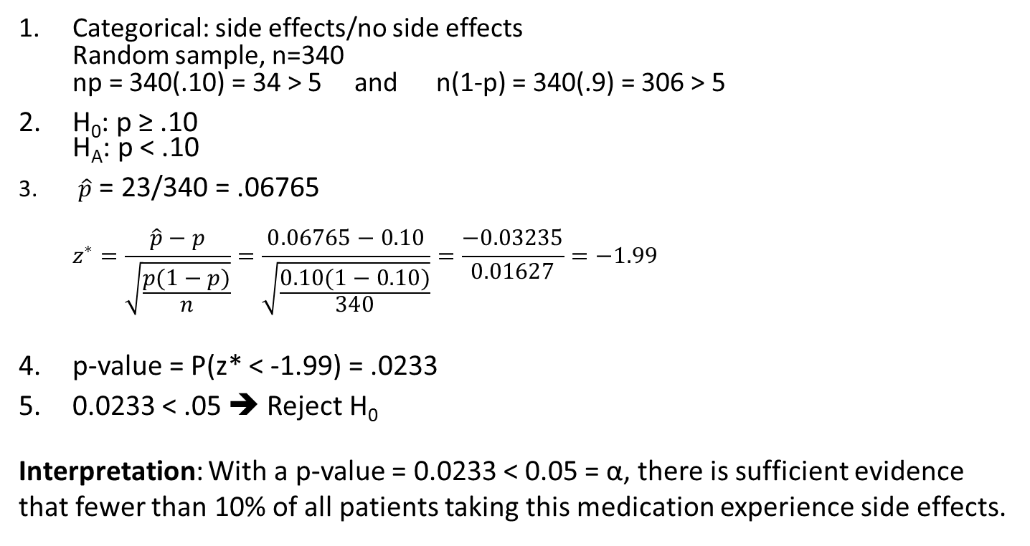
Example
A doctor is researching side effects with a new pain medication. A clinical trial including random sample of 340 people who took a new pain relief medication reveals that 23 suffered some side effects. At the α=.05 level of significance, is there evidence that less than 10% of all patients who take the medication will experience side effects?
✓
  Categorical: side effects/no side effects
  Random sample, n=340
  np = 340(.10) = 34 > 5 and n(1-p) = 340(.9) = 306 > 5
H₀: p ≥ .10
H_{A}: p < .10
$\hat{p}$ = 23/340 = .06765
$z^{∗}=\frac{\hat{p}−p}{\sqrt{\frac{p(1−p)}{n}}}=\frac{0.06765−0.10}{\sqrt{\frac{0.10(1−0.10)}{340}}}=\frac{−0.03235}{0.01627}=−1.99$
p-value = P(z* < -1.99) = .0233
0.0233 < .05 ➔ Reject H₀
Interpretation: With a p-value = 0.0233 < 0.05 = α, there is sufficient evidence that fewer than 10% of all patients taking this medication experience side effects.
✓
✓

Slide 39
What can go wrong?
When dealing with samples and levels of confidence, there is always the possibility of making an error in our hypothesis (significance) test
What kinds of errors?
  There is always the possibility that the null hypothesis H₀ is true. If we reject a true H₀ in favor of an incorrect alternative H_{A}, we make one type of error
  If H₀ is, indeed, false, and we fail to reject a false null in favor of a true H_{A}, we would make a different type of error
Consider a jury trial in which someone is accused of murder
  H₀: Defendant is innocent
  H_{A}: Defendant is NOT innocent
  If the defendant is innocent but is wrongly convicted, a true H₀ was rejected in favor of a false H_{A}
  If the defendant found NOT guilty but truly committed the murder, a false H₀ was NOT rejected. That is, we failed to reject a false H₀ in favor of a true H_{A}

Slide 40
Errors in Hypothesis Testing
Type I Error
  Reject a true null hypothesis
  Considered a serious type of error
  The probability of a Type I Error is α (Significance Level)
  Called level of significance of the test
  Set by researcher in advance
  Confidence coefficient (1-α) = P(NOT rejecting true H₀)
  Confidence level of a hypothesis test is (1-α)*100%
Type II Error
  Failure to reject a false null hypothesis
  Probability of a Type II Error is β
POWER of a statistical test (1-β) is the probability of rejecting H₀ when it is false)
  POWER = P(REJECTING a H₀)

Slide 41
Type I and Type II Errors
Type I and Type II errors CANNOT happen at the same time
A Type I error can only occur if H₀ is true
(H₀ is rejected but in reality H₀ is true)
A Type II error can only occur if H₀ is false
(H₀ is not rejected but in reality H₀ is false)
 | Do NOT Reject H₀ | Reject H₀
H₀ True
H₀ False
No Error
Probability 1- α
Type I Error
P(Type I)= α
P(Type I Error) = α
P(Type II Error) = β
Power = 1 - β
Type II Error
P(Type II)= β
No Error
Power=1- β
We can control the probability of a Type I error by our choice of the significance level
The more serious the consequences of a Type I error, the smaller α should be
As P(Type I Error) = α goes Down, P(Type II Error) goes Up

Slide 42
Factors Affecting Type II Error
All else equal,
  β when the difference between hypothesized parameter and its true value
  β when α
  β when σ
  β when n

Slide 43
Example 1
A planning committee needs to estimate the percentage of students at a large university who will attend an upcoming event so that they can determine an appropriate location for the event. Data is collected to see if there is evidence, at the .05 level of significance, that less than 30% of students will attend this year?
H₀: p≥0.30
H_{A}: p<0.30
Describe a Type I Error for this problem:
  Committee determines that less than 30% of students will attend the event, but in fact, 30% WILL attend the event.
Potential consequence:
  The committee reserves a space that is too small.
Describe a Type II Error for this problem:
  Committee determines there is no evidence that less than 30% of students will attend but, in fact, less than 30% attend the event.
Potential consequence:
  The committee reserves a space that is too large.

Slide 44
Example 2
An environmentalist takes samples at a nearby river to study the average concentration level of a contaminant. He wants to find out, using a .10 level of significance, if the average concentration level exceeds the acceptable level for safely consuming fish from the river.
H₀: µ is at or lower than acceptable level
H_{A}: µ exceeds acceptable level
Describe a Type I Error for this problem:
  Researcher determines that the average concentration exceeds acceptable levels (too high) when, in fact, they are safe.
Potential consequence:
  People are not allowed to fish in the river when it is really safe to fish.
Describe a Type II Error for this problem:
  Researcher determines that the average concentration level is acceptable when, in fact, the concentration level exceeds the acceptable level
  ➔ it is really NOT safe to fish.
Potential consequence:
  People consume contaminated fish.

Slide 45
Question:
Many consumer groups feel that the U.S. Food and Drug Administration (FDA) drug approval process is too easy and, as a result, too many drugs are approved that are later found to be unsafe. On the other hand, a number of industry lobbyists have pushed for a more lenient approval process so that pharmaceutical companies can get new drugs approved more easily and quickly. Consider the hypotheses – H₀: new, unapproved drug is unsafe
H_{A}: new, unapproved drug is safe
(Berenson, 9.11, p. 321)
What is a Type I error in this situation?
  Reject H₀ that the drug is unsafe when, in fact, H₀ is true.
  That is, the drug IS UNSAFE.
  Fail to reject H₀ that the drug is unsafe when, in fact, H₀ is false.
  That is, the drug is SAFE
What are the consequences of the Type I error?
  Public is exposed to an UNSAFE drug and may be harmed
What are the consequences of the Type II error?
  Drug with possible benefits will NOT be available to the Public
Type II error

Slide 46
Review:
Hypothesis Testing errors: Type I / Type 2
Control P(Type I) by choice of the significance level, α
  Criticality of consequences controls choice
As P(Type I Error) = α goes Down, P(Type II Error) = β goes Up
All else equal,
  β when difference between hypothesized parameter and its true value
  β when α
  β when σ
  β when n
Differences between statistical significance and practical significance

Slide 47
Statistical vs. Practical: Warnings
Can’t simply rely on news reports to determine results of studies
If word significant used – determine if used in usual sense or in statistical sense
If very large sample size, statistical significance may not indicate practical importance
If “no difference” or “no relationship” reported, try to determine sample size
  Unless sample size is very large, relationship/difference may exist but not enough data to detect
Look for confidence intervals in addition to hypothesis test results

Slide 48
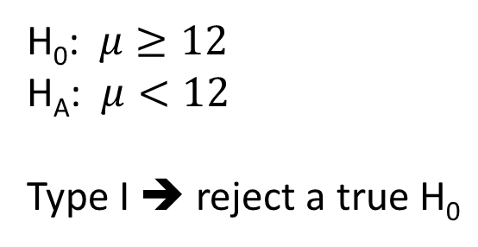
Question:
Bottles of water have a label stating that the volume is 12 oz. A consumer group suspects the bottles are under-filled and plans to conduct a test using α=0.10. A Type I error in this situation would mean:
  The consumer group concludes the bottles have less than 12 oz. when the true mean amount actually is 12 oz. or more
  The consumer group does not conclude the bottles have less than 12 oz. when the true mean amount
  actually is less than 12 oz.
H₀: $μ≥12$
H_{A}: $μ<12$
Type I ➔ reject a true H₀

Slide 49
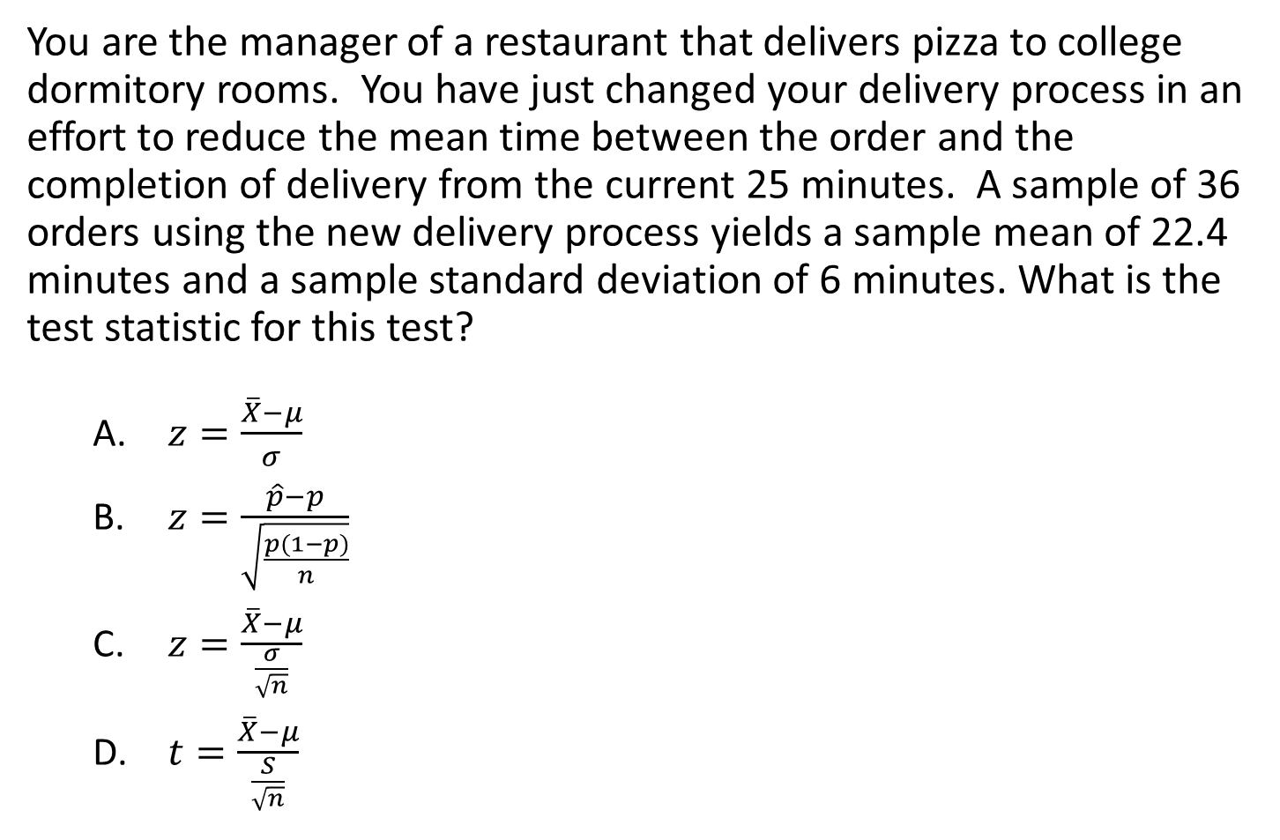
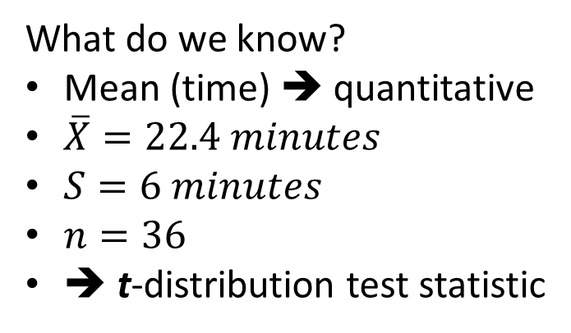
Question:
You are the manager of a restaurant that delivers pizza to college dormitory rooms. You have just changed your delivery process in an effort to reduce the mean time between the order and the completion of delivery from the current 25 minutes. A sample of 36 orders using the new delivery process yields a sample mean of 22.4 minutes and a sample standard deviation of 6 minutes. What is the test statistic for this test?
  $z=\frac{\overline{X}−μ}{σ}$
  $z=\frac{\hat{p}−p}{\sqrt{\frac{p(1−p)}{n}}}$
  $z=\frac{\overline{X}−μ}{\frac{σ}{\sqrt{n}}}$
  $t=\frac{\overline{X}−μ}{\frac{S}{\sqrt{n}}}$
What do we know?
Mean (time) ➔ quantitative
$\overline{X}=22.4 minutes$
$S=6 minutes$
$n=36$
➔ t-distribution test statistic

Slide 50
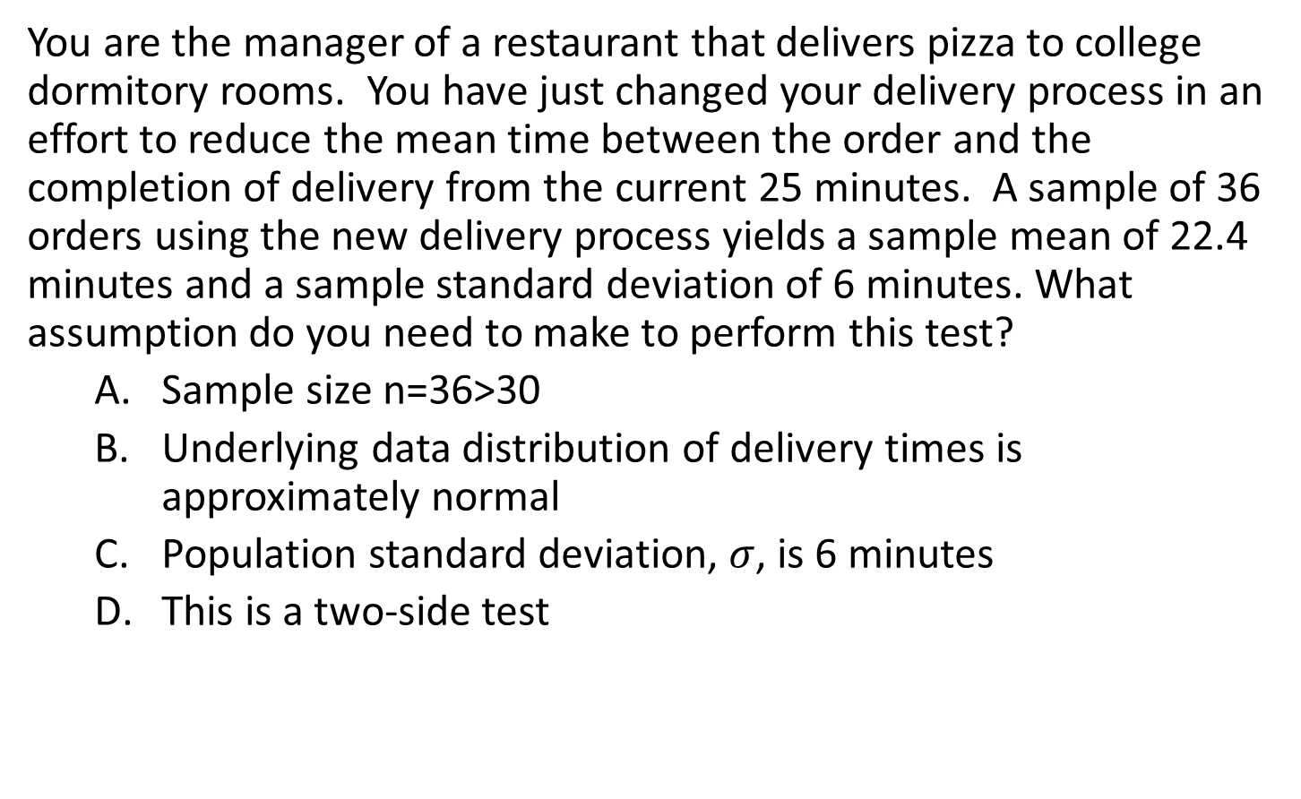
Question:
You are the manager of a restaurant that delivers pizza to college dormitory rooms. You have just changed your delivery process in an effort to reduce the mean time between the order and the completion of delivery from the current 25 minutes. A sample of 36 orders using the new delivery process yields a sample mean of 22.4 minutes and a sample standard deviation of 6 minutes. What assumption do you need to make to perform this test?
  Sample size n=36>30
  Underlying data distribution of delivery times is approximately normal
  Population standard deviation, $σ$, is 6 minutes
  This is a two-side test

Slide 51
Review:
H₀ states the claim of the assertion to be tested – status quo or historical value
  H₀ is ALWAYS about parameter, NOT sample statistic
  Always contains “=“, or “≤”, or “≥” sign
  “ASSUME” H₀ is TRUE until reject/not reject - NEVER ACCEPT
H_{A} states hypothesis that the researcher is trying to prove – challenges status quo
  Opposite of the null hypothesis
  (H₀ “=“ ➔ H₁ “≠” ;
  H₀ “≤“ ➔ H₁ “>”;
  H₀ “≥“ ➔ H₁ “<”)
  May or may not be proven
  (that is, may or may not have
  sufficient evidence to reject
  the null in favor of
  the alternative)
α –maximum area in tails for
which you are willing to reject H₀

Slide 52
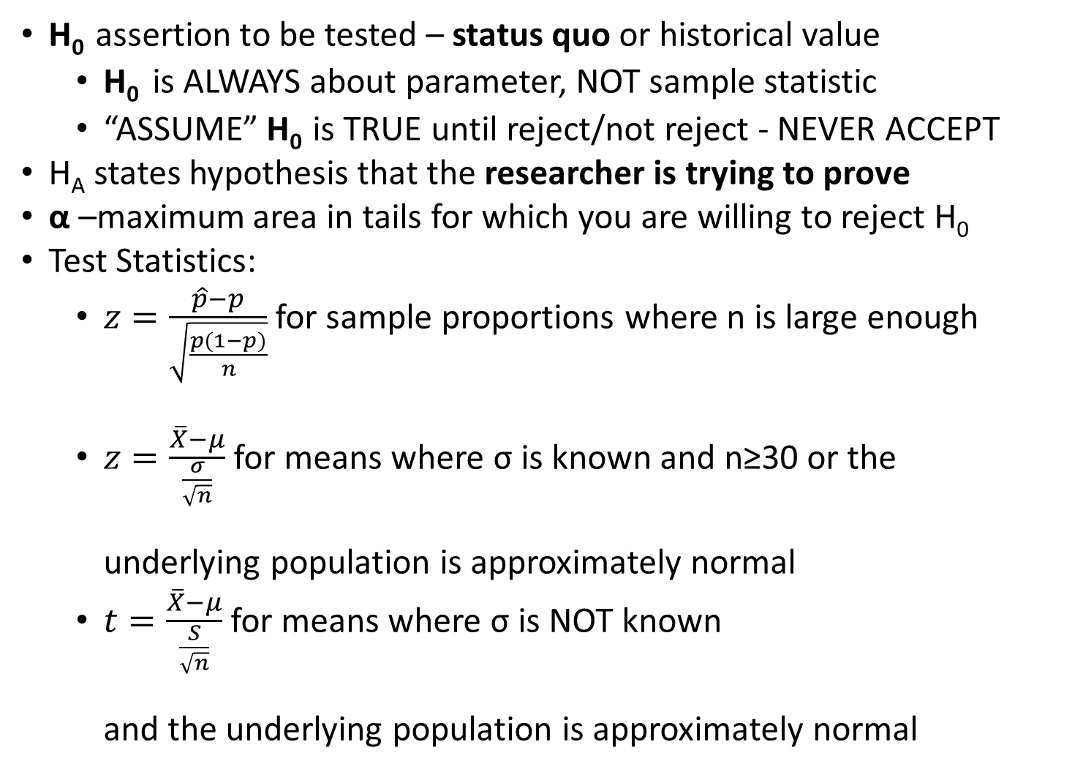
Review:
H₀ assertion to be tested – status quo or historical value
  H₀ is ALWAYS about parameter, NOT sample statistic
  “ASSUME” H₀ is TRUE until reject/not reject - NEVER ACCEPT
H_{A} states hypothesis that the researcher is trying to prove
α –maximum area in tails for which you are willing to reject H₀
Test Statistics:
  $z=\frac{\hat{p}−p}{\sqrt{\frac{p(1−p)}{n}}}$ for sample proportions where n is large enough
  $z=\frac{\overline{X}−μ}{\frac{σ}{\sqrt{n}}}$ for means where σ is known and n≥30 or the
  underlying population is approximately normal
  $t=\frac{\overline{X}−μ}{\frac{S}{\sqrt{n}}}$ for means where σ is NOT known
  and the underlying population is approximately normal

